Slide 1
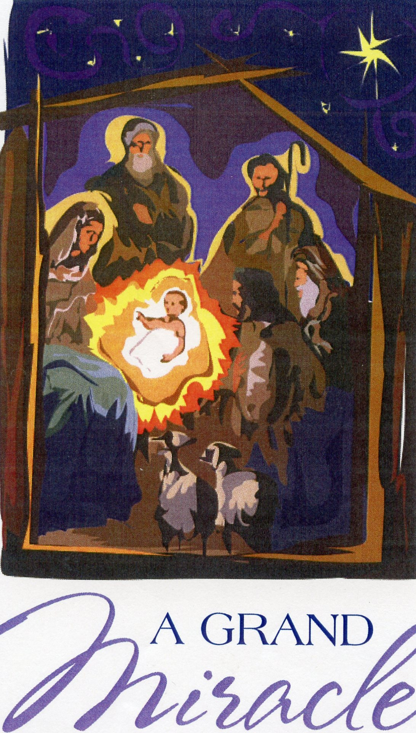
Notes:
Left: 2016. Right: 2009. Also a Lenten devotional booklet from 2015.

Slide 2
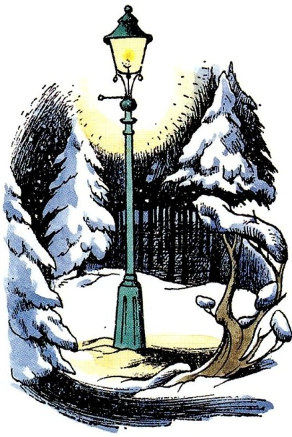
The Lion, the witch and the wardrobe
To Lucy Barfield
The story of the one who is not a tame lion.
Notes:
I lent a copy of this book to our youngest child when he was about twelve years old. The rest is history.

Slide 3
Humor (and some authorial intrusions)
“… and other creatures whom I won’t describe because if I did the grownups would probably not let you read this book…” (Chapter XIV. The Triumph of the Witch)
“… giants of any sort are now so rare in England and so few giants are good tempered that ten to one you have never seen a giant when his face is beaming. It’s a sight well worth looking at.” (Chapter XVI. What Happened about the Statues)
“Bless me, what do they teach them at these schools?” (Chapter XVII. The Hunting of the White Stag)

Slide 4
Humor (and one authorial intrusion)
Mr. Beaver:
“It’s all right,” he was shouting. “Come out, Mrs. Beaver. Come out, Sons and Daughters of Adam and Eve. It’s all right! It isn’t her!” This was bad grammar of course, but that is how beavers talk when they are excited; I mean, in Narnia—in our world they usually don’t talk at all.

Slide 6
Moral Development
For example, “Lucy was a very truthful girl” vs. the Witch’s house in which “There are whole rooms full of Turkish Delight” and “I want a nice boy whom I could bring up as a Prince and who would be King of Narnia when I am gone.”
And “ ‘I’m all right,’ said Edmund, but this was not true. He was feeling very sick.”
Or, “But Edmund had got past thinking about himself after all he’d been through and after the talk he’d had that morning. He just went on looking at Aslan. It didn’t seem to matter what the Witch said.” (XIII. Deep Magic from the Dawn of Time)

Slide 7
Background
Lewis started writing the first chronicle in 1939 and then stopped.
Started again in Summer, 1948.
Finished in Spring, 1949.
Published in 1950.
“It All Began with a Picture…”
George Sayer: Lewis would say, “But it’s there for the story.”
Lewis: “No, I didn’t start with four real children in mind: I just made them up.”

Slide 8
Ten Facts That Add Meaning
Pevensie: Pevensey Bay, Normans landed in 1066.
The names Kirke and Macready: Digory Kirke. Kirk is a Scottish form of the word church. Kirkpatrick? As boys, Jack and Warren had a housekeeper named Mrs. McCreedy.
Bigwardrobeinspareroom: The name of a train station in E. Nesbit’s “The Aunt and Amabel.”
Modesty: Mr. Beaver about his house and Lewis about the book.
Animal Characters: Peter thinks of eagles, stags, and hawks; Lucy of badgers; Edmund of snakes; and Susan of foxes.

Slide 9
Ten Facts That Add Meaning
Fur coats: Lucy enjoys, foreshadowing her enjoyment of Aslan’s fur.
The Right Side: Moral choice by Tumnus, Peter, and Fenris Ulf/Maugrim.
New Names: “Peter the Magnificent,” “Susan the Gentle,” “Edmund the Just,” “Lucy the Valiant.”
Father Christmas and the Trinity.
Dedication: Lucy Barfield later got multiple sclerosis. “And when he shakes his mane, we shall have spring again.”

Slide 10
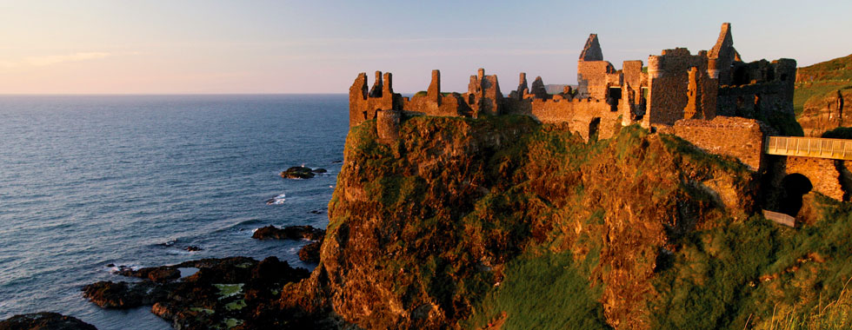
David C. Downing: Dunluce Castle
County Antrim near Portrush. Inhabited in the 13th century and built in about 1500. The last chapter of TLWW with the seagulls, waves, salt water, and the smell of the sea also owes much to Castlerock and Portrush.
Notes:
County Antrim near Portrush. The castle was built around 1500, but the area was inhabited in the 13th century. The last chapter with the seagulls, waves, salt water, and the smell of the sea also owes much to Castlerock and Portrush. There is a free cell phone app for Dunluce Castle, complete with pictures, diagrams, audio, video, and cyber-tours.

Slide 11
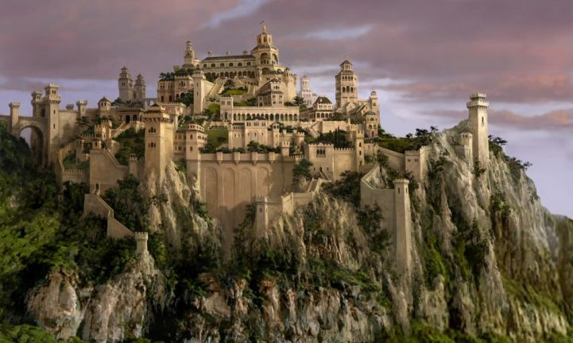
From the movie

Slide 12
Pauline Baynes

Slide 13
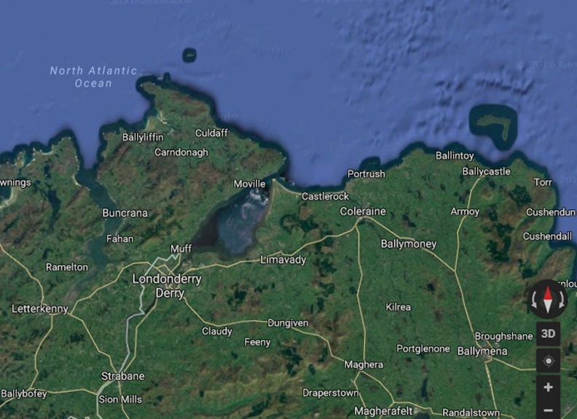

Slide 14
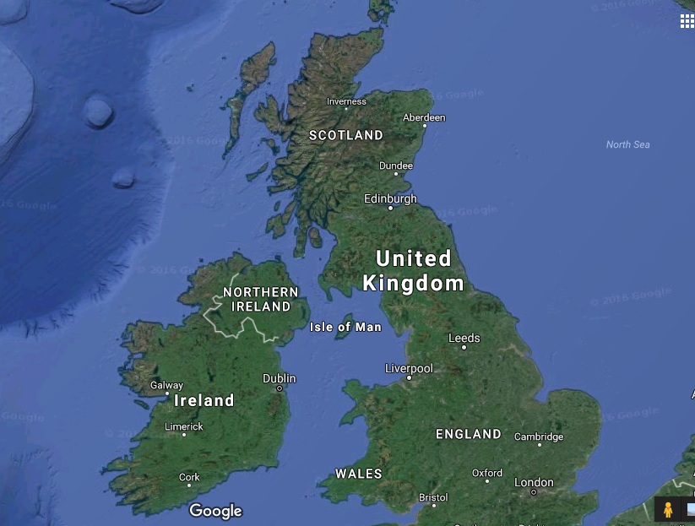

Slide 15
Notes on the Order of the Books
After Mr. Beaver had said the name Aslan, we read, “None of the children knew who Aslan was any more than you do; but the moment the Beaver had spoken these words everyone felt quite different” (Chapter VII. A Day with the Beavers).
We experience an “Aha!” when we read The Magician’s Nephew after The Lion, the Witch and the Wardrobe. We say, “So that’s where the lamppost came from! And the talking animals, and the wardrobe, and the professor, etc.”

Slide 16
Narnian Time
The year is 1000 in Narnian time and 1940 in English time.
Jadis returned to Narnia in 898, and the long winter began in 900. Therefore, as the story starts, winter has lasted for one hundred years.
At the end of the story they hunt the White Stag in 1015. And they see the lamppost.

Slide 17
A Comparison of Narnian and Earth Time
Notes:
Paul Ford, Companion to Narnia

Slide 18
First Words
The very first words uttered by a Narnian are “Goodness gracious me!”
Goodness and grace will play fundamental roles throughout the story.

Slide 19
Important Words
“Always winter and never Christmas.”
The “four thrones” at Cair Paravel
Only once, but … “Not like a tame lion.”

Slide 20
Father Christmas
Tolkien’s criticism: he detested the mixture of various mythologies in TLWW
Lewis: they exist side by side in a child’s mind
“Always winter and never Christmas.”
The arrival of Father Christmas
“These are your presents,” states Father Christmas, “and they are tools not toys.” (to be continued)

Slide 21
The Story Line
Because of the bombing in London during the war, four children arrive at the Professor’s house.
They enter Narnia through a wardrobe.
Narnia is under a spell cast by the White Witch.
They have been prophesied:
When Adam’s flesh and Adam’s bone
Sits at Cair Paravel in throne,
The evil time will be over and done.
Edmund falls under a different spell (Turkish delight).
Mr. Beaver leads them to his lodge.
Edmund sneaks away to go to the witch’s castle.
The beavers, Peter, Susan, and Lucy head to the Stone Table.

Slide 22
The Story Line
Aslan, the Christ-figure of Narnia, brings a thaw.
Father Christmas appears.
In exchange for Edmund … the Stone Table
Resurrection
A final, climactic battle
The enthronement of Peter, Susan, Edmund, & Lucy

Slide 23
Notes:
The arrow is pointing to Aslan’s How. The witch’s castle, the castle of Miraz, Lantern Waste, and the beavers’ dam are above and to the left of Aslan’s How.

Slide 24
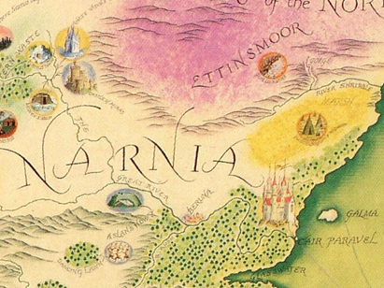
Aslan’s How/The Stone Table
Cair Paravel

Slide 25
Biblical Theme I: Deep and Deeper Magic
The Witch to Aslan: “Fool! Now I will kill you instead of the human traitor and so the Deep Magic will be appeased!”
(Chapter XIV. The Triumph of the Witch)
Gen. 2:17
Ezek. 18:4
Rev. 13:8
1 Peter 1:20

Slide 26
Biblical Theme I: Deep and Deeper Magic
“When a willing victim who had committed no treachery was killed in a traitor’s stead, the Table would crack and Death itself would start working backwards.”
(Chapter XV. Deeper Magic from Before the Dawn of Time)

Slide 27
Literary Artistry
“… and whether it was more like playing with a thunderstorm or playing with a kitten Lucy could never make up her mind.”
After all, Aslan is not a tame lion!

Slide 28
Biblical Theme II: Sons of Adam and Daughters of Eve
Phrasing borrowed from William Morris
G. K. Chesterton: “The simplest truth about man is that he is a very strange being; almost in the sense of being a stranger on the earth.”
Alexander Pope: humanity as “the glory, jest, and riddle of the world.”
Socrates: “I want to know … about myself. Am I a monster more complicated and swollen with passion than the serpent Typho, or a creature of a gentler and simpler sort?”

Slide 29
Biblical Theme II: Sons of Adam and Daughters of Eve
“When Adam’s flesh and Adam’s bone
Sits at Cair Paravel in throne,
The evil time will be over and done.”
(Chapter VIII. What Happened After Dinner)
Psalm 8:3-4 and 5-6
Matt. 19:28
Lewis: “It is a serious thing to live in a society of possible gods and goddesses…”
Professor Kirke: “Once a King in Narnia, always a King in Narnia.”

Slide 30
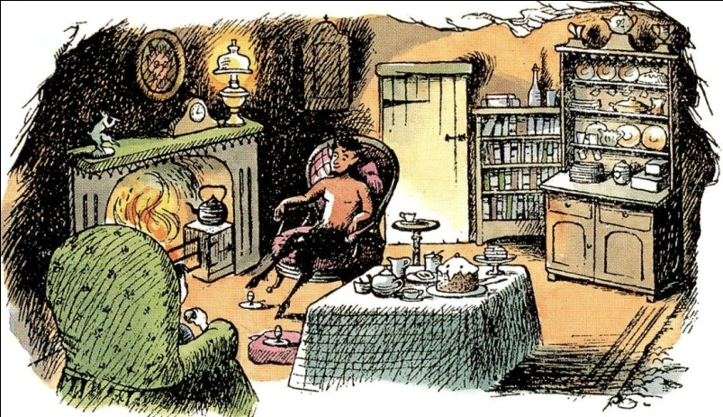
Lucy & the Trilemma in The Lion, the Witch…
The context of this story early in The Lion, the Witch and the Wardrobe.
The three options for describing Lucy.
“Logic!” said the Professor half to himself. “Why don’t they teach logic at these schools? There are only three possibilities.”

Slide 31
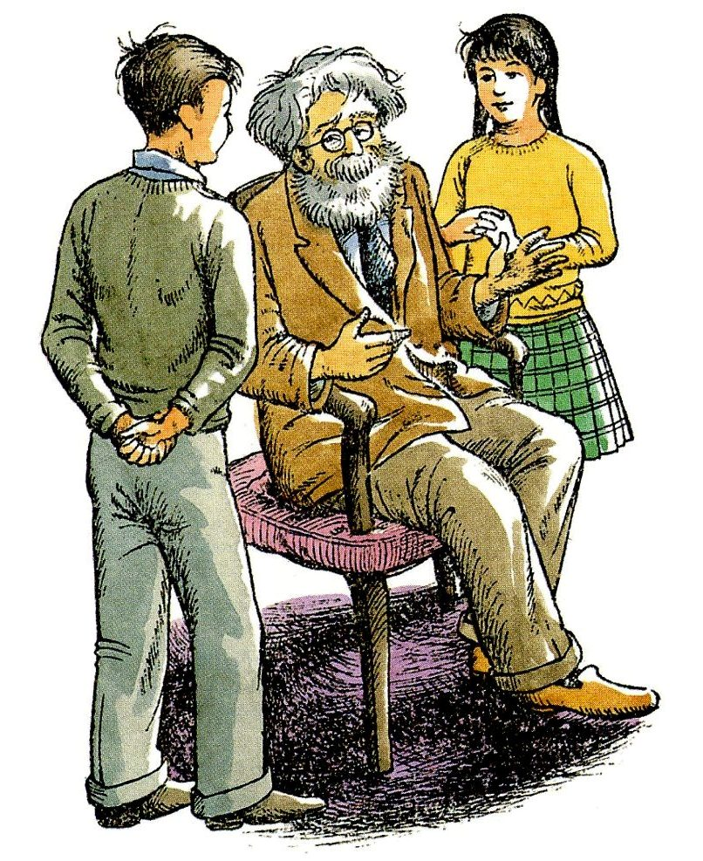
Professor Kirke
“Either your sister is telling lies, or she is mad, or she is telling the truth. You know she doesn’t tell lies and it is obvious that she is not mad. For the moment then and unless any further evidence turns up, we must assume that she is telling the truth.”

Slide 32
“The Shocking Alternative”: Lord, Liar, or lunatic
I am trying here to prevent anyone saying the really foolish thing that people often say about Him: “I’m ready to accept Jesus as a great moral teacher, but I don’t accept His claim to be God.” That is the one thing we must not say. A man who was merely a man and said the sort of things Jesus said would not be a great moral teacher. He would either be a lunatic—on a level with the man who says he is a poached egg—or else he would be the Devil of Hell.
Notes:
Mere Christianity, “The Shocking Alternative”

Slide 33
Lord, Liar, or lunatic
You must make your choice. Either this man was, and is, the Son of God: or else a madman or something worse. You can shut Him up for a fool, you can spit at Him and kill Him as a demon; or you can fall at His feet and call Him Lord and God. But let us not come with any patronizing nonsense about His being a great human teacher [a good man]. He has not left that open to us. He did not intend to.

Slide 34
Michael Ward, Planet Narnia
After Aslan’s death and before his resurrection:
“The sky in the East was whitish by now and the stars were getting fainter—all except one very big one low down on the Eastern horizon.”
The planet?
Characteristics: kingship, prosperity, cheerfulness
Element: wood (patient, hard-working, reliable)
Metal: tin
Jupiter

Slide 35
Lewis, The Discarded Image
“Jupiter, the King . . . The character he produces in men would now be very imperfectly expressed by the word ‘jovial,’ and is not very easy to grasp . . . We may say that it is Kingly; but we must think of a King at peace, enthroned, taking his leisure, serene. The Jovial character is cheerful, festive, yet temperate, tranquil, magnanimous. When this planet dominates we may expect halcyon days and prosperity.”

Slide 36
From “The Planets”:
Joy and jubilee. It is JOVE’s orbit,
Filled and festal, faster turning
With arc ampler. From the Isles of Tin
Tyrian traders, in trouble steering
Came with his cargoes; the Cornish treasure
That his ray ripens. Of wrath ended
And woes mended, of winter passed
And guilt forgiven, and good fortune
Jove is master; and of jocund revel,
Notes:
“Wrong will be right, when Aslan comes in sight, / At the sound of his roar, sorrows will be no more.”

Slide 37
From “The Planets”:
Laughter of ladies. The lion-hearted,
The myriad-minded, men like the gods,
Helps and heroes, helms of nations
Just and gentle, are Jove’s children,
Work his wonders. On his wide forehead
Calm and kingly, no care darkens
Nor wrath wrinkles: but righteous power
And leisure and largess their loose splendors
Have wrapped around him—a rich mantle
Of ease and empire. Up far beyond

Slide 38
Factual Quiz Just for Fun
Lucy entered Narnia through the Wardrobe (a) once, (b) twice, (c) three times, (d) four times.
The first to risk his life for another was (a) the old professor, (b) the Faun, (c) Aslan, (d) Rumblebuffin.
“At the sound of his roar, ________ will be no more.” (a) winter, (b) summer, (c) sorrows, (d) deep magic.
The name of the White Witch was (a) Jadis, (b) Lilith, (c) Wanda, (d) Samantha.
Peter obeyed Aslan and risked his life killing the wolf in order to save (a) Edmund, (b) Susan, (c) Lucy, (d) the Faun.
Aslan died for the sins of (a) Adam, (b) all humankind, (c) Jadis, (d) Edmund.
The four kings and queens were finally led back to this world by a creature the Faun had told Lucy about on her first visit: (a) a talking robin, (b) a White Stag, (c) Mr. Beaver, (d) a Red Dwarf.
Answer: c
Answer: b
Answer: c
Answer: a
Answer: b
Answer: d
Answer: b

Slide 39
Factual Quiz Just for Fun
Which one of the following phrases does not appear in The Lion, the Witch and the Wardrobe? a) “Always winter and never Christmas.” b) “Not like a tame lion,” c) “We’re on an island!” d) “Adam’s flesh and Adam’s bone.”
“When Adam’s flesh and Adam’s bone, sits at Cair Paravel _________...” a) well done, b) in stone, c) well known, d) in throne.
What was the last name of Peter, Susan, Edmund, and Lucy? a) Smith, b) Pevensie, c) Baldridge, d) Windsor.
Answer: c
Answer: d
Answer: b

Slide 40
Benediction
May Aslan restore all names to their proper owners.
May the warmth of his breath come over us.
May his breath bring the stone parts of us to life.
May we live on both sides of the wardrobe door.
P.S.
As Queen Susan said at the end of the story, “Let us go on and take the adventure that shall fall to us.”

Slide 41
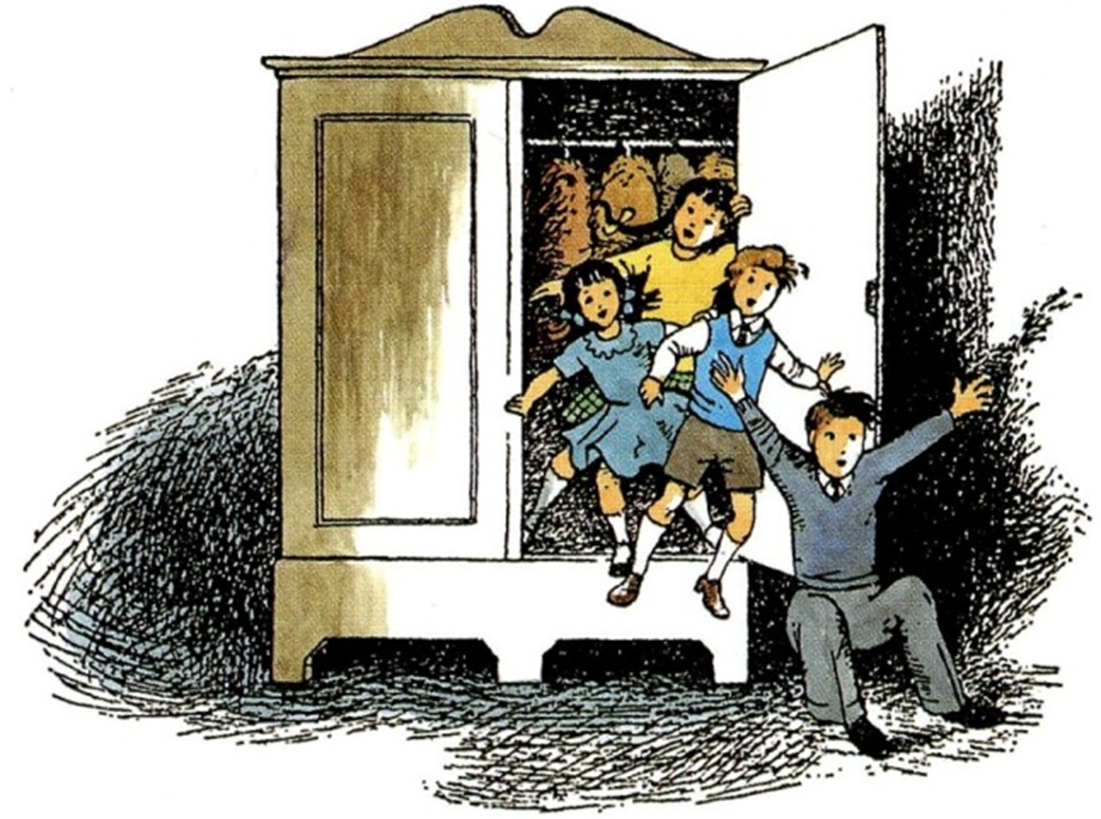
Next Week: Prince Caspian

