Slide 1
The Weight of glory
“For our light affliction, which is but for a moment, worketh for us a far more exceeding and eternal weight of glory” (2 Cor. 4:17, KJV).

Slide 2
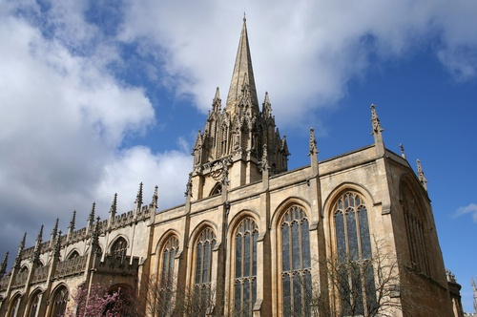
A Sermon
St. Mary the Virgin
Lewis preached here twice
Sunday evening
Later published in Theology (November 1941)
April 26, 1941 letter to Mrs. Mary Neylan (former student and convert to Christianity): “On being ‘patted on the head’…”

Slide 3
“The Weight of glory” in context
The London Blitz: In August 1940, the Battle of Britain began, and on Sept. 7 German bombers struck London. The Blitz struck London for fifty-seven consecutive days and did not end until May 10 and 11, 1941, the worst part of the Blitz, just a few days after Lewis had his microphone test in preparation for his first series of BBC broadcasts (later Mere Christianity).
Preached “The Weight of Glory” on June 8, 1941
So what?

Slide 4
An outline
Our desires are too weak, not too strong
Natural examples of reward
Christians are like the schoolboy
The desire
Inconsolable secret in each of us
Made from the enchantment of worldliness
No natural happiness will satisfy it
The desire uncertain of the object
Promises of Scripture
Why God produces anything more than the first

Slide 5
An outline (continued)
Glory
Fame
Luminosity
The practical use of this lesson
We need to follow Him
Your neighbor is the holiest object

Slide 6
Summary by Paragraph
Paragraph 1: The highest virtue should be a positive—the rewards of the Gospels—rather than a negative, such as unselfishness.
“Indeed, if we consider the unblushing promises of reward and the staggering nature of the rewards promised in the Gospels, it would seem that Our Lord finds our desires, not too strong, but too weak. We are half-hearted creatures, fooling about with drink and sex and ambition when infinite joy is offered us, like an ignorant child who wants to go on making mud pies in a slum because he cannot imagine what is meant by the offer of a holiday at the sea. We are far too easily pleased.” (1)

Slide 7
Summary by Paragraph
2: “We must not be troubled by unbelievers when they say that this promise of reward makes the Christian life a mercenary affair.” Three examples: the reward of love is marriage, for a general it is victory, for a schoolboy studying Greek it is Sophocles (Greek poetry). Other activities have their natural or proper reward, or their consummation, but not always obviously.
3: Initial rewards lead to ultimate rewards. The charge of mercenary against the Christian is absurd.
4: Goods we desire in this world bear a symbolic relation to the ultimate good that truly satisfies, but should not replace the true object of our natural desire. “… if we are made for heaven, the desire for our proper place will be already in us, but not yet attached to the true object, and will even appear as the rival of that object.”

Slide 8
Summary by Paragraph
5: Beauty and memory are good images of the heaven we really desire; modern philosophies point us instead to earth (like George Bernard Shaw or Henri Bergson). “…it is a desire for something that has never actually appeared in our experience.” Here, an instance of pre-evangelism, “they are only the scent of a flower we have not found, the echo of a tune we have not heard, news from a country we have never yet visited.”
6: “Do what they will, then, we remain conscious of a desire which no natural happiness will satisfy.” Hunger doesn’t prove one will get bread, but it does suggest that bread exists. So also a desire for heaven.
7: Scripture gives us an authoritative, but symbolic, image of heaven, but also a puzzling one. And the puzzle points to what we need to know.

Slide 9
Summary by Paragraph
8: Scripture gives five promises of what heaven will be like, sometimes interpreted in too earthly a fashion.
9: The fifth promise, on glory, suggests that glory is either fame or luminosity (brightness), neither of them seemingly right.
10: Some prominent Christians have viewed heavenly glory as fame, i.e. the approval of God or fame with God. Four examples of those that love praise: a child, a beast, a pupil, a creature (all of them are echoes of the ultimate approval from God). Caution—praise can easily become conceit, but not when I realize it is God’s doing rather than mine. It’s what God made me to be.

Slide 10
Summary by Paragraph
11: Glory (good report with God) satisfies my original desire, my spiritual longings, when I stop considering my own needs. “The door … will open at last.”
12: The New Testament describes being received or rejected by God, and we walk on that edge.
13: One day God will also give us the other sense of glory as brightness or luminosity. Nature also reflects heaven. But not yet.
14: In heaven we will have glorified bodies which we can hardly imagine now.
15: Remember the glory of which my neighbor is capable in eternity—so love him (my responsibility to witness to my neighbor is a weight or burden of glory). Treat your neighbor as if he were Christ Himself.

Slide 11
The Art of analogy
Lover Marriage
General Victory
Schoolboy Sophocles & Aeschylus
Greek Enjoying Greek poetry
Christian Heaven
So … Nature Heaven

Slide 12
Two quotations
But all the leaves of the New Testament are rustling with the rumor that it will not always be so. Some day, God willing, we shall get in. (13)
Meanwhile the cross comes before the crown and tomorrow is a Monday morning. A cleft has opened in the pitiless walls of the world, and we are invited to follow our great Captain inside. (14)

Slide 13
One more quotation
There are no ordinary people. You have never talked to a mere mortal. Nations, cultures, arts, civilization—these are mortal, and their life is to ours as the life of a gnat. But it is immortals whom we joke with, work with, marry, snub, and exploit—immortal horrors or everlasting splendors…. Next to the Blessed Sacrament itself, your neighbor is the holiest object presented to your senses. If he is your Christian neighbor he is holy in almost the same way, for in him also Christ vere latitat—the glorifier and the glorified, Glory Himself, is truly hidden. (15f.)

Slide 14
Discussion questions
How do most people experience beauty? (4f.) Do they wonder what’s truly going on there?
How can Plato’s doctrine of shadow and reality fit in with this sermon? (5)
What does Lewis say about being mercenary and its relation to a “natural connection”? (2)
How could this sermon be pre-evangelism?

Slide 15
Discussion questions
What can a spell (i.e. a spell that someone casts) do? (5)
What do some people call this desire (at least five alternative names)? (4)
What does the phrase “weight of glory” mean? That is, what does weight mean and what does glory mean? (next slide) (10, 15)
What two things can glory mean according to Lewis? (next slide) (8)
What does Lewis mean when he says, “Perfect humility dispenses with modesty”? (10)

Slide 16
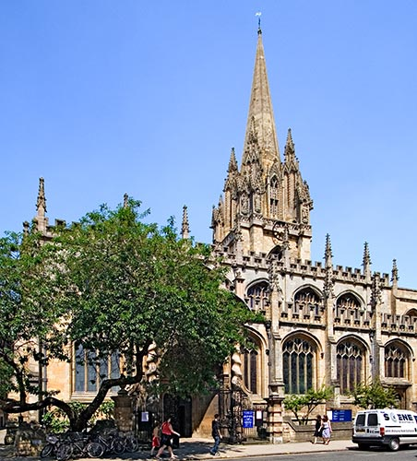
The Weight of Glory
Weight =
Glory =
Burden or responsibility
Fame or luminosity

Slide 17
Discussion questions
Do you agree with Lewis when he says, “I read in a periodical the other day that the fundamental thing is how we think of God. By God Himself, it is not! How God thinks of us is not only more important, but infinitely more important. Indeed, how we think of Him is of no importance except in so far as it is related to how He thinks of us”? (10)
What does Lewis mean when he says, “Meanwhile the cross comes before the crown and tomorrow is Monday morning”? (14)
What does Lewis say about my responsibility to witness? (15)
Explain the significance of the following quote: “But it is immortals whom we joke with, work with, marry, snub, and exploit⎯immortal horrors or everlasting splendors.” (15)

