Slide 1
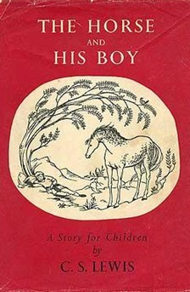
The Horse and His Boy
To David and Douglas Gresham

Slide 2
Background
In 1945-1948, Lewis had a Middle Eastern student named M. A. Manzalaoui, whose thesis on eighteenth century English translations from Arabic Lewis supervised. Manzalaoui has no doubt that Lewis reread the Arabian Nights to equip himself for the task. Lewis obviously drew on that experience to write The Horse and His Boy.
The Horse and His Boy is the 8th title. Previously . . .
Shasta and the North, The Horse and the Boy, The Desert Road to Narnia, Cor of Archenland, The Horse Stole the Boy, Over the Border, and The Horse Bree.
“Narnia and the North” ten times in the book.

Slide 3
More Background
The dedication came later, since the book was written in 1950, and he didn’t know the Gresham boys at that time.
Published in 1954 as the fifth book in the series, although it was written fourth.
The year is 1940 in English time and 1014 in Narnian time. The four Pevensies have been ruling Narnia for fourteen years. In 1015 they will hunt the White Stag and their reign will end. Susan mentions the recent planting of an apple orchard (Chapter V). So what?
Notes:
That apple orchard reappears in Prince Caspian.

Slide 4
The Plot
Shasta is the “son” of Arsheesh, a Calormene fisherman.
A Tarkaan wants to buy Shasta, but Shasta escapes to the North at night on the Tarkaan’s talking horse Bree.
They meet Aravis and her horse Hwin, also escaping. She is fleeing a forced marriage in Calormen.
They come to the city of Tashbaan, where Shasta is mistaken for Corin, son of the king of Archenland.
Edmund is in Tashbaan with Susan, who is considering a proposal of marriage from Prince Rabadash, son of the Tisroc.
Tashbaan

Slide 6
Notes:
The star represents Tashbaan. The river to the north of Tashbaan is the Winding Arrow River.

Slide 7
The Plot
Susan, Edmund, and their entourage fear they may not be able to leave Tashbaan.
They pretend to prepare a party for the Calormenes on board their ship and escape at night on the Splendor Hyaline.
While everyone is preparing for the party and Shasta is alone and asleep, Corin returns.
Shasta escapes through the window and heads for the Tombs, where he had agreed to meet Aravis if separated.
After she is separated from Shasta, Aravis meets Tarkheena Lasaraleen and with her help gets to the Tombs a day later.
While in Tashbaan and heading toward the Tombs, Aravis hears about the plan of Rabadash to attack Archenland and then Narnia.

Slide 9
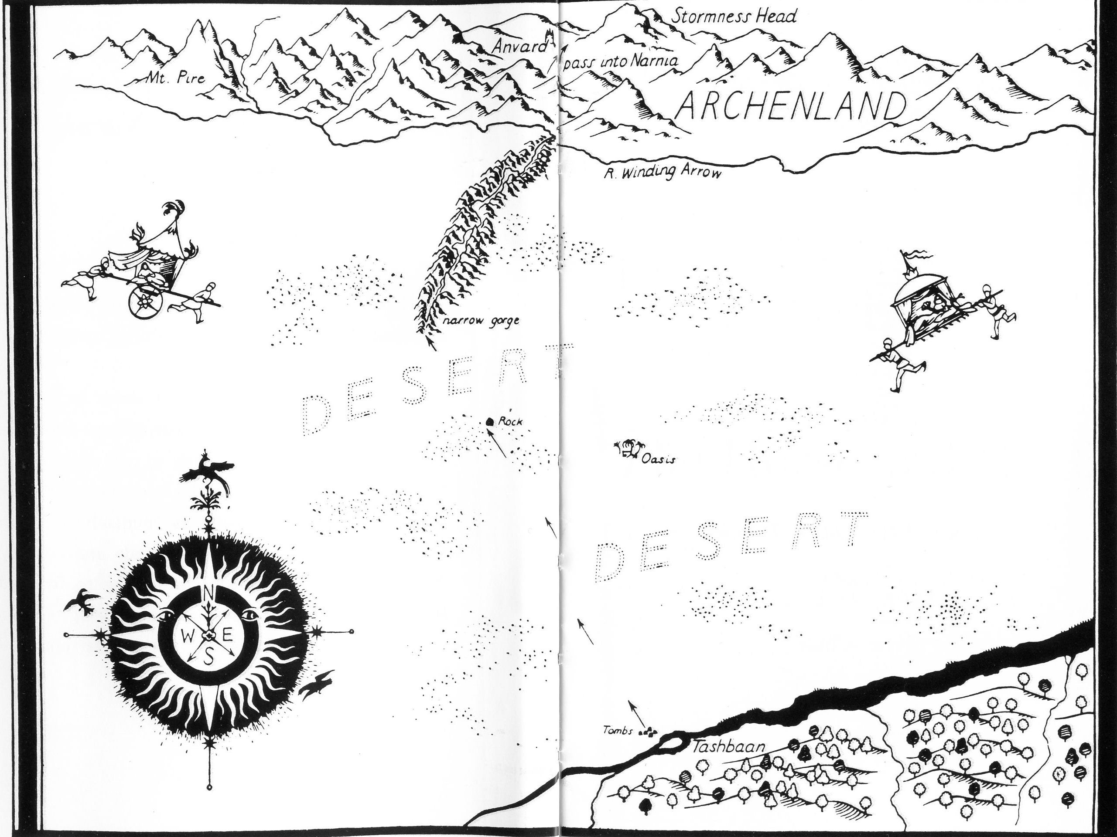

Slide 10
The Plot
They head north across the desert in an attempt to get to Archenland first, but they delay too much.
They see Rabadash’s army approaching: “And certainly both Horses were doing, if not all they could, all they thought they could; which is not quite the same thing.”
Then Aslan chases them, and they move faster.
Aslan slashes Aravis’ back as Shasta jumps off Bree and runs at Aslan without any weapons.

Slide 11
Moral Development
“Shasta slipped his feet out of the stirrups, slid both his legs over on the left side, hesitated for one hideous hundredth of a second, and jumped. It hurt horribly and nearly winded him; but before he knew how it hurt him he was staggering back to help Aravis. He had never done anything like this in his life before and hardly knew why he was doing it now.

Slide 12
Moral Development
“One of the most terrible noises in the world, a horse’s scream, broke from Hwin’s lips. Aravis was stooping low over Hwin’s neck and seemed to be trying to draw her sword.

Slide 13
Moral Development
“And now all three—Aravis, Hwin, and the lion—were almost on top of Shasta. Before they reached him the lion rose on its hind legs, larger than you would have believed a lion could be, and jabbed at Aravis with its right paw. Shasta could see all the terrible claws extended. Aravis screamed and reeled in the saddle. The lion was tearing her shoulders. Shasta, half mad with horror, managed to lurch towards the brute.

Slide 14
Moral Development
“He had no weapon, not even a stick or a stone. He shouted out, idiotically, at the lion as one would at a dog. ‘Go home! Go home!’ For a fraction of a second he was staring right into its wide-opened, raging mouth. Then, to his utter astonishment, the lion, still on its hind legs, checked itself suddenly, turned head over heels, picked itself up, and rushed away.”

Slide 15
The Plot
They reach an enclosure where the Hermit of the Southern March lives.
The Hermit sends Shasta to warn King Lune.
Aravis thinks she has been lucky, but the Hermit says, “I have now lived a hundred and nine winters in this world and have never yet met any such thing as Luck.”
The male horse Bree and the female traveler Aravis are humbled by the events surrounding their escape.

Slide 16
The Plot
Shasta meets King Lune and a hunting party, and he warns them of Rabadash and his 200 soldiers.
After Shasta gets lost in some fog and takes the right fork of a road, Rabadash and his men take the left fork and make their way to the castle of King Lune.
As Shasta moves on, he pities himself.
He hears the breath of Something walking alongside him in the fog.

Slide 17
The Plot
“Who are you?” asked Shasta.
“Myself,” said the Voice, very deep and low so that the earth shook: and again “Myself,” loud and clear and gay: and then the third time “Myself,” whispered so softly you could hardly hear it, and yet it seemed to come from all round you as if the leaves rustled with it.
The voice comes from Aslan, who encourages Shasta, and then Shasta keeps walking and comes into Narnia.
He tells of the attack on King Lune’s castle, and a group of Narnian soldiers go and defeat Rabadash.
They discover that Shasta is Corin’s twin brother.

Slide 18
The Plot
Aslan comes to the Hermit’s home and speaks to the Hermit, Aravis, and the talking horses Bree and Hwin.
As Aslan approaches Bree from behind, Bree is speaking to the others, “‘No doubt,’ continued Bree, ‘when they speak of him as a Lion they only mean he’s as strong as a lion or (to our enemies, of course) as fierce as a lion. Or something of that kind.
“Even a little girl like you, Aravis, must see that it would be quite absurd to suppose he is a real lion. Indeed it would be disrespectful. If he was a lion he’d have to be a Beast just like the rest of us. Why!’ (and here Bree began to laugh) ‘If he was a lion he’d have four paws, and a tail, and Whiskers!’”
Aslan addresses the pride of Bree and Aravis.

Slide 19
The Plot
Shasta comes and tells his story, saying that King Lune wants her to live in his court.
King Lune attempts to deal with Rabadash, who is impenitent.
Aslan arrives and turns Rabadash into a donkey.
Rabadash will turn back into a man, but he must stay within ten miles of Tashbaan for the rest of his life.
Shasta (Cor) becomes next in line to be king.
“Aravis also had many quarrels (and, I’m afraid even fights) with Cor, but they always made it up again: so that years later, when they were grown up they were so used to quarreling and making it up again that they got married so as to go on doing it more conveniently.”

Slide 20
More Humor
One of the sayings of the poets of Calormen:
“Natural affection is stronger than soup and offspring more precious than carbuncles.”

Slide 21
More Moral development
King Lune to Rabadash, “By attacking our castle of Anvard in time of peace without defiance sent, you have proved yourself no knight, but a traitor, and one rather to be whipped by the hangman than to be suffered to cross swords with any person of honor.”
Aravis’ apology to Shasta.
When Cor (Shasta) protested that Corin should be king, King Lune states, “The King’s under the law, for it’s the law makes him a king.”

Slide 22
Moral development
“Won’t it be stealing to use the money?” asked Shasta.
“Oh,” said the Horse, looking up with its mouth full of grass, “I never thought of that. A free horse and a talking horse mustn’t steal, of course.”
Many other examples.

Slide 23
Lindskoog’s Favorite Quotation
Aslan to both Shasta and Aravis: “Child,” he said, “I am telling you your story, not hers. No one is told any story but their own.”
So what?
Jesus to Peter in John 21:22, “What is that to you? Follow me!”

Slide 24
Biblical Theme I: “Narnia and the North!”
We met this previously in Reepicheep
Phil. 3:13-14
Lewis: “huge regions of northern sky”
Heb. 11:13
Eccl. 3:11

Slide 25
Biblical Theme II: Most Unfortunate
Abandoned as an infant
Almost sold as a servant
Something Joseph could have said, and Shasta did, “I am the unluckiest person in the whole world.”
“Why do bad things happen to good people?”
“Why do bad things happen to me?”
Rom. 8:28-29
Eph. 1:11-12

Slide 26
Factual Quiz Just for Fun
1. Shasta was going to be sold by his father Arsheesh to (a) Tarkish Tashbaan, (b) Aramis Tisroc, (c) Tarkaan Anradin.
2. Shasta ran away with Bree, who was (a) a warhorse named Breehy-hinny-brinny-hoohy-ha, (b) a Narnian donkey, (c) a French cheese.
3. Shasta and Bree were forced into journeying with Hwin and Aravis by (a) lack of food, (b) fear of lions, (c) fear of flying.
4. Calormen was (a) south of Archenland and Narnia, (b) between Archenland and Narnia, (c) westward (inland) from Narnia.

Slide 27
Factual Quiz Just for Fun
5. Prince Rabadash, son of the Tisroc, was determined to (a) capture Shasta, (b) marry Lasaraleen, (c) capture and marry Queen Susan.
6. The Narnians escaped (a) from Tashbaan in their ship Splendour Hyaline, (b) from Archenland by fighting King Lune, (c) from Tarsus in their ship The Dawn Treader.

Slide 28
Factual Quiz Just for Fun
7. The Hermit of the Southern March (a) had lived 70 years and never seen Aslan, (b) had lived 901 years and could foretell the future, (c) had lived 109 years and had never met Luck.
8. Shasta “accidentally” crossed the mountain Stormness Head thus summoning (a) Narnians to save Anvard, (b) an aardvark to marry Ahoshta, (c) the Raven Sallowpad to Mount Pire.

Slide 29
Factual Quiz Just for Fun
9. Shasta had been kidnapped as a baby by (a) Arsheesh, (b) Lord Bar, (c) Corin Thunder-Fist.
10. Rabadash was permanently pacified by (a) becoming a horse, (b) becoming a donkey, (c) growing an extremely long nose.

Slide 30
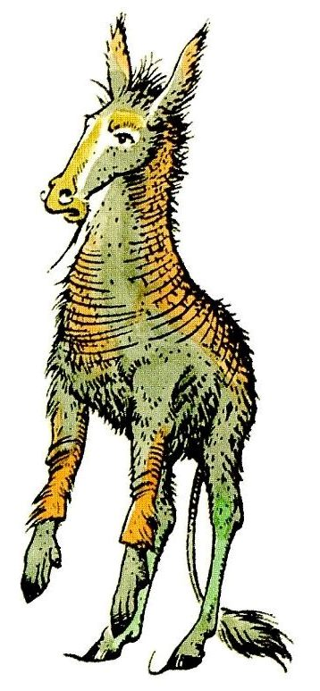

Slide 31
Wiki-thoughts
Shasta’s story draws parallels with the story of Moses: both are sent away from their families at birth, both turn away from the country they are raised in, and both end up being the savior of their true countries.
In one respect, the roles are reversed: Moses was raised in nobility and wealth and eventually became a shepherd. Shasta was raised in a poor fisherman’s home, and eventually became a King. But actually both are comedies.

Slide 32
Wiki-thoughts
The association of Cor with horses, and his twin brother Corin with boxing, recalls the traditional associations of the Spartan twins Castor and Pollux of Greek mythology.
The relationship between Aravis and Lasaraleen is similar to the dynamic between the sisters Antigone and Ismene in Greek tragedy.

Slide 33
A Biblical Insight
How is The Horse and His Boy a commentary on this Bible passage:
“For everyone who exalts himself will be humbled, and he who humbles himself will be exalted” (Luke 18:14).
BTW: Remember from the first week Lewis’s fascination with language (couch, davenport, settee, sofa [group], and divan[alone]).

Slide 34
Discussion Questions
How do you feel about Lewis’s obvious admiration for females who are active, athletic, and brave? Chapter 7: “Aravis had always been more interested in bows and arrows and horses and dogs and swimming.”
Shasta asks 65 questions in the story. Why do you think Lewis portrays him in this way?

Slide 35
The Moral Development of Children
Aravis (when asked about her servant): “Doubtless she was beaten for sleeping late,” said Aravis coolly. “But she was a tool and spy of my stepmother’s. I am very glad they should beat her.”
Shasta: “I say, that was hardly fair.”
Shasta to Corin: “You’ll just have to tell them the truth, once I’m safely away.”
Corin: “What else did you think I’d be telling them?”

Slide 36
Names
Aravis: like Avaris, the capital city of the Hyksos
Archenland: “archen” is Greek, suggesting “ruler” or “beginning” or “old.”
Aslan: Turkish for “lion.” Dr. Ana Aslan of Romania, an authority on the endocrine glands. Harry J. Aslan of Kingsburg, California, international president of the Lion’s Club in 1976-77.
Calormen: “Calor” means heat in Latin, and “men” may suggest menace.

Slide 37
Names
Cor: two meanings, first, the English horn, and, second, heart.
Narnia: once a hilltop colony twenty miles north of Rome, named in 303 B.C. after the nearby Narnia River.
Rabadash: suggests rabid and balderdash, or bad and dash.

Slide 38
Names
Tash: in the Uzbek language of Central Asia tash means stone.
Tashbaan: resembles ancient Tashkent, the largest city in Central Asia and one of the oldest.
Tisroc: the roc is a fabulous bird of enormous size and strength in Arabian mythology (see next slide). The Tisroc is supposedly descended from the great god Tash.

Slide 39
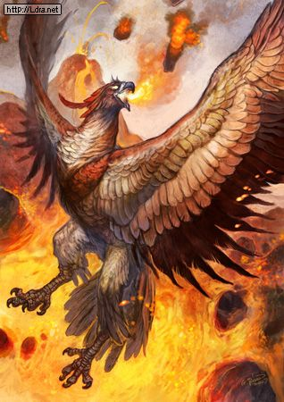

Slide 40
Planet Narnia, by Michael Ward
“The Planets” (lines 17-18): “Meeting selves, same but sundered.” (The planet is Mercury.)
The reunion of Corin and Shasta (i.e. “meeting selves, / Same but sundered”), Dar and Darrin and also Cole and Colin in Archenland (in astrology Gemini is ruled by Mercury)

Slide 41
Planet Narnia, by Michael Ward
Castor and Pollux were renowned in Homer, the first a great breaker of horses and the second a renowned boxer, so Shasta is based on Castor and Corin on Pollux (according to Greek mythology Mercury invented boxing).
The twinning of many: two armies, two girls, two hands, two horses, two humans, two paths for Shasta to take, a divided river around Tashbaan, etc., and lots of twofold images

Slide 42
“The Planets”: “same but sundered”
Because of Aslan, Bree veers off the path and then the four are forced together; they separate in Tashbaan and are reunited on the other side of the city; the river divides into two streams at Tashbaan and reunites on the other side of the city; Shasta and Aravis became “so used to quarrelling and making it up again that they got married so as to go on doing it more conveniently.”

Slide 43
“The Planets”: “same but sundered”
“I was the lion.” And as Shasta gaped with open mouth and said nothing, the Voice continued. “I was the lion who forced you to join with Aravis. I was the cat who comforted you among the houses of the dead. I was the lion who drove the jackals from you while you slept. I was the lion who gave the Horses the new strength of fear for the last mile so that you should reach King Lune in time. And I was the lion you do not remember who pushed the boat in which you lay, a child near death, so that it came to shore where a man sat, wakeful at midnight, to receive you.”

Slide 44
Discussion Questions
Aslan to the unbelieving horse Bree in The Horse and His Boy, “Do not dare not to dare. Touch me. Smell me. Here are my paws, here is my tail, these are my whiskers. I am a true Beast” (pp. 169-70). So what?
John 20:27, “Put your finger here; see my hands. Reach out your hand and put it into my side. Stop doubting and believe.”

Slide 45
Humor
As Shasta got into Narnia, Lewis writes, “He turned and unsaddled his horse and took off its bridle⎯‘Though you are a perfectly horrid horse,’ he said. It took no notice of this remark and immediately began eating grass. That horse had a very low opinion of Shasta.”
One other bit of humor when Shasta discovers that he is Cor, son of King Lune: “… Education and all sorts of horrible things are going to happen to me.”

Slide 46
Benediction
We are aliens in this land and we don’t know it.
Chase us and guide us to our true country.
We don’t know the way or the real reasons.
We are still rude and ragged, but you love us.
Bring us safe to our Father-King at last.
Next: The Magician’s Nephew

