Slide 1
The Last Battle
Carnegie Medal Winner, 1956,
established in 1936 in honor of Andrew Carnegie, Scottish philanthropist
Notes:
Gary Friesen, Multnomah School of the Bible: This is the best one.

Slide 2
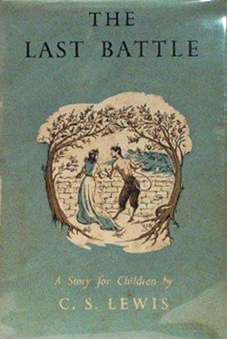
Cover Photos, Modern and Original

Slide 3
“The Last Battle”
Not only the title of the last Narnian chronicle
The title of the last chapter in the story of King Arthur, i.e., King Arthur and His Knights of the Round Table
The second book of Cornelius Ryan’s World War Two trilogy
The title of Ralph Wetterhahn’s book on the Vietnam War
And probably many other books, poems, chapters, excerpts, etc.
Chapter XII. Through the Stable Door: “And then the last battle of the last King of Narnia began.”

Slide 4
Reviews: The Last Battle
Chad Walsh, The New York Times Review (Sept. 30, 1956): “This is one of the best … The Christian symbolism is clear enough, but the book can stand on its own feet as a deeply moving and hauntingly lovely story apart from the doctrinal content.”
H. P. M., Horn Book (October 1956): “It is the culmination of an excellent series, and boys and girls who have loved the other books will find it very satisfying.”

Slide 5
Reviews: The Last Battle
Paul Karkainen: “Lewis’s description of the Narnian Last Days is brilliant in its conception, dazzling in its execution, achingly beautiful, unspeakably sad, and gloriously hopeful.”
Farsight, the Eagle

Slide 6
Reviews: The Chronicles of Narnia
Edmund Fuller, Chicago Sunday Tribune (Nov. 11, 1956): “The series known as ‘The Chronicles of Narnia’ … I believe to be the finest group of stories for children, Christian in theme, written in our times.”
Charles A. Brady, America (Oct. 27, 1956): “The greatest addition to the imperishable deposit of children’s literature since the Jungle Books [Kipling]. Narnia takes its place forever now beside the jasper-lucent landscapes …

Slide 7
Reviews: The Chronicles of Narnia
“… of Carroll, Anderson, MacDonald and Kipling … The child will not respond to these values at once, though they will awaken in his memory when the time comes for full realization. He will respond immediately, however, to the narrative sweep; to the evocation of the heroic mood; to the constant eliciting of the numinous. Very possibly this latter service is the … “

Slide 8
Reviews: The Chronicles of Narnia
“… most startling one Lewis renders contemporary childhood…. He touches the nerve of religious awe on almost every page. He evangelizes through the imagination.”
King Tirian, Jewel, and Roonwit the Centaur

Slide 9
Some Preliminaries
Shift is a lot like Napoleon, the pig and leading farm animal in George Orwell’s novel Animal Farm (1945).
Aslan is not “… a tame lion.”
The phrase appears eight times in the book!

Slide 10
The Plot
The ape Shift and the donkey Puzzle live near Caldron Pool not far from the Western Wild.
One day a lion’s skin floats down to them.
Shift decides that Puzzle should wear it and pretend to be Aslan.

Slide 11
The Plot
King Tirian is enjoying a summer cottage in the company of Jewel the Unicorn.
They have heard reports of Aslan.
Roonwit the Centaur brings bad news from his reading of stars.
Dryads are dying, and talking horses are being enslaved.

Slide 12
The Plot
In a rage, Tirian and Jewel kill two Calormenes and then give themselves up.
They are brought before “Aslan.”
Shift says that Aslan and Tash are the same.
While bound, Tirian calls to the children from another world, and Jill Pole and Eustace Scrubb come and free him.

Slide 13
The Plot
Tirian leads them to a guard tower, where they arm themselves.
They head for Stable Hill to rescue Jewel, which they do, while Jill rescues Puzzle from the Stable.
Tirian frees a group of Dwarfs heading to the salt mines of the Tisroc.

Slide 14
The Plot
Poggin the Dwarf joins them, but the rest do not.
They see Tash heading toward Narnia.
They learn that Ginger the cat and Rishda the Calormene are using Shift.
Farsight the Eagle brings the news that Cair Paravel has fallen and Roonwit the Centaur is dead.

Slide 15
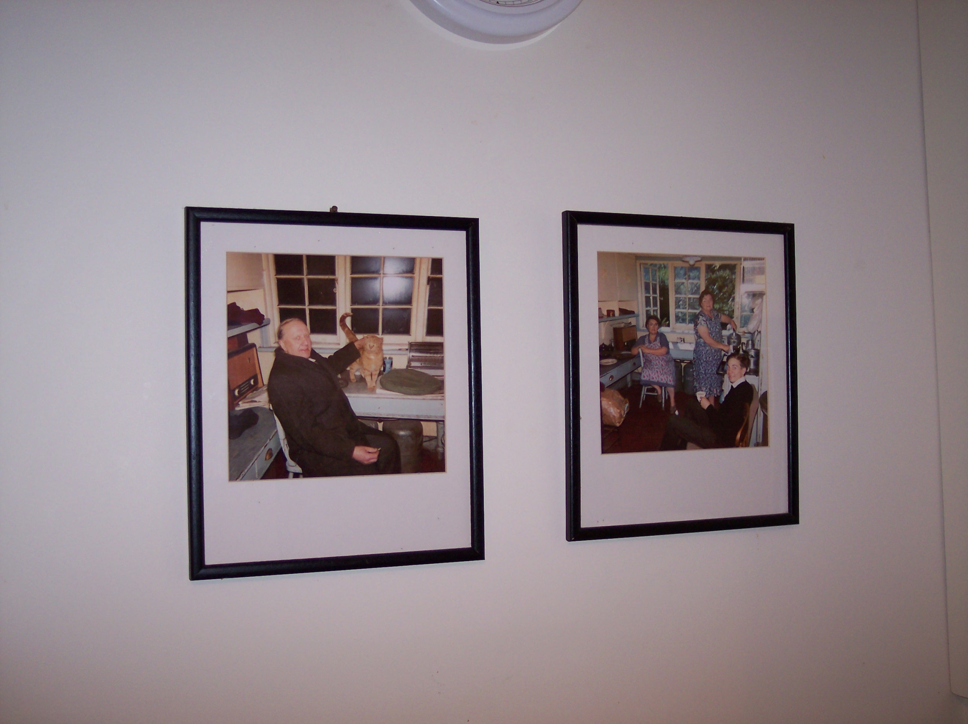
Ginger the cat
Notes:
Photos on the wall of the Kilns, Oxford.

Slide 16
The Plot
That night, while a bonfire burns at the stable, Shift announces that a donkey is running around as Aslan and should be stopped.
Shift states that Aslan will no longer come out, but any creature may go in to him.
Ginger does.

Slide 17
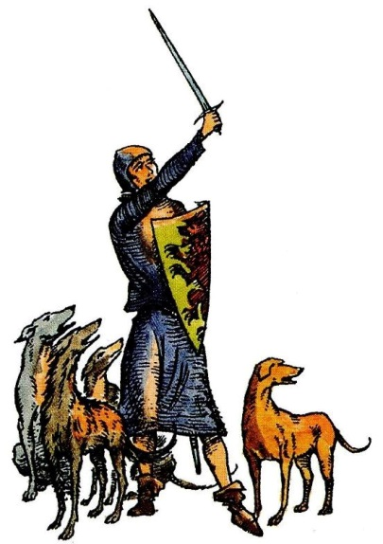
The Plot
Ginger comes out scared, having lost the ability to speak.
Emeth, a young Calormene officer, enters.
A Calormene soldier is thrown out, dead.
Tirian and the other six, who had been hiding, step out to fight.

Slide 18
Emeth
The name of a Calormene soldier
The Hebrew word for “truth”: אֱמֶת
True 22 times, truth 11 times, truly 5 times.
How does this play out in the book?
Is “Aslan” truly at the stable?
Is Tash really Aslan?
What is truly in the stable?
Does Emeth truly serve Aslan or Tash?

Slide 19
The Plot
Tirian tosses Shift into the stable, and a battle ensues.
The dogs come over to Tirian’s side, while the Dwarfs remain neutral.
The Calormenes begin to throw others into the Stable, first Eustace, then dwarfs.

Slide 20
Chapter 12: Through the Stable Door
Tirian pulls Rishda Tarkaan into the stable, where Tash grabs Rishda.
Tirian meets all of the past kings and queens of Narnia, looking young.
Though inside the Stable, they are really standing on an open countryside.

Slide 21
The Plot
Peter and Digory describe being in a train crash, which sent them to Narnia.
Peter describes the door by which Tirian came through with Rishda.
The Stable’s “inside is bigger than its outside.”

Slide 22
The Plot
The Dwarfs think they are in a dark hole.
Aslan arrives.
The Dwarfs say, “The Dwarfs are for the Dwarfs.”
Aslan says of them, “Their prison is only in their own minds, yet they are in that prison; and so afraid of being taken in that they cannot be taken out.”

Slide 23
The Plot
Father Time brings an end to Narnia as he sounds a horn.
All the creatures come towards Aslan, some go to his right into Narnia and others to his left and disappear.
In the Stable, Emeth appears.

Slide 24
The Plot
Aslan tells Emeth, “All the service thou hast done to Tash, I account as service done to me.”
They all discover that they are in a new, more colorful, more beautiful Narnia.
The old Narnia “was only a shadow or a copy of the real Narnia.”
The watchword is “Further up and further in!” (12 times)
Emeth

Slide 25
One Great Conclusion
And for us this is the end of all the stories, and we can most truly say that they all lived happily ever after. But for them it was only the beginning of the real story. All their life in this world and all their adventures in Narnia had only been the cover and the title page: now at last they were beginning Chapter One of the Great Story, which no one on earth has read: which goes on forever: in which every chapter is better than the one before.

Slide 26
Biblical Theme I: Seeing It
For the Dwarfs, even freshly picked flowers smell like filthy stable litter.
“The Dwarfs are for the Dwarfs.”
“You can’t take us in.”
Rom. 1:19-21
John 1:4, 9-10
John 3:18-19

Slide 27
Biblical Theme II: Further Up and Further In
They run fast without growing tired.
They swim up a waterfall.
Reepicheep, “Welcome, in the Lion’s name.”
The Unicorn, “I have come home at last!”
John 14:2
Matt. 25:21
Rev. 21:1, 3-4

Slide 28
Medievalism
Tirian: “But to leap on them unawares—without defying them—while they were unarmed—faugh! We are two murderers, Jewel. I am dishonored forever.”
The castles, modes of transportation, clothing, weaponry, cosmology, customs, astronomy (Roonwit the Centaur), education, manner of speech, and chivalry of the Middle Ages.

Slide 29
One Medieval Linguistic Fact
“Ware,” which appears three times in this form in The Last Battle
From “beware”
“Beware” comes from two words, “be wary,” which comes from the 14th century Middle English “been war”
This, in turn, is derived from the Old English (Anglo-Saxon) warian "to guard against, beware; protect, defend” (related to the word “ward”)
“War” = “careful, wary”

Slide 30
Quotations
“Tash is only another name for Aslan. All that old idea of us being right and the Calormenes wrong is silly. We know better now. The Calormenes use different words but we all mean the same thing. Tash and Aslan are only two different names for you know Who.”

Slide 31
Quotations
“As soon as Tirian saw that she [i.e., Jill] was the best pathfinder of the three of them he put her in front.”
The Dwarfs: “…so afraid of being taken in that they can not be taken out.”
Lucy: “In our world too, a Stable once had something inside it that was bigger than our whole world.”
“It was at the coldest hour of the night, just before dawn, that they got back to the Tower. “
Notes:
The last quotation, from Chapter VII, “Mainly About Dwarfs,” may come from Lewis’s personal experience in the Local Defense Volunteers during World War Two./

Slide 32
About Susan
At the end, seven kings and queens appear in Narnia: Peter, Edmund, Lucy, Digory, Polly, Jill, and Eustace.
What about Susan?
“Oh Susan!” said Jill, “she’s interested in nothing nowadays except nylons and lipstick and invitations. She always was a jolly sight too keen on being grownup.”
However, as Aslan once said, “Once a king or queen in Narnia, always a king or queen.”

Slide 33
Emeth and Humor
“And this is the marvel of marvels, that he called me, Beloved, me who am but as a dog⎯”
“Eh? What’s that?” said one of the Dogs.
“Sir,” said Emeth. “It is but a fashion of speech which we have in Calormen.”
“Well, I can’t say it’s one I like very much,” said the Dog.
“He doesn’t mean any harm,” said an older Dog. “After all, we call our puppies, Boys, when they don’t behave properly.”
“So we do,” said the first Dog. “Or, girls.”
“S-s-sh!” said the Old Dog. “That’s not a nice word to use. Remember where you are.”

Slide 34
Planet Narnia
The Planet: Saturn
Its Greek name: Chronos (“time”)
Father Time appears in the story.
“saturnine” means gloomy, moody, dark
Metal: Lead (the mines of the Tisroc?)
Saturnine features here include ill-chance in Shift’s discovery of the lionskin, treachery by the dwarfs, the appearance of Father Time who, according to The Discarded Image is “derived from earlier pictures of Saturn”; and, ultimately, the death of Narnia, “a perilous draught / That the lip loves not”.

Slide 35
Benediction
Help us to be wiser than Puzzle and more prudent than Tirian;
But help us to be as humble as Puzzle and as noble as Tirian.
Preserve us from false doctrine and the antichrist.
Give us the courage to stand for the right against all odds.
Thank you that although all worlds end, no good thing is destroyed.
We are eager for the beginning of the real story.

Slide 36
Factual Quiz Just for Fun
Use your Smartphone to go to Kahoot.it.
Choose a name, either a made-up name or your real name.
Enter the PIN that you see on the screen.
Read the four choices for answers on the screen, but select your choice on your phone.
The top five scores and names will appear on the screen at the end of the quiz.

