Slide 1
The Legacy of C. S. Lewis
Part I
Joel D. Heck, Concordia Lutheran Seminary
Notes:
William Howard Taft at the 100th centennial of an Ohio city, probably Cincinnati. “I shall name it Chauncey Depew.”

Slide 2
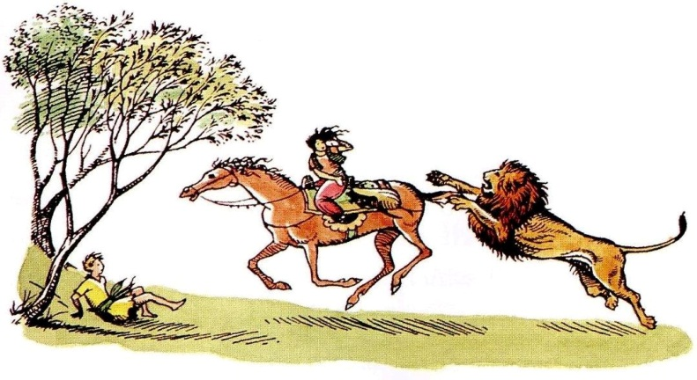
Apologetics as Defense
“The Weight of Glory”
The Abolition of Man
Mere Christianity (his major apologetic work)
The Problem of Pain
Miracles
Poet and critic
Leonard Bacon called
The Screwtape Letters
“the most exciting piece
of Christian apologetics that
has turned up in a long time.”
Some other essays…

Slide 3
Especially
“Christian Apologetics,” delivered on April 1, 1945 to the Carmarthen Conference for Youth Leaders and Junior Clergy in Carmarthen, Wales.
“Modern Theology and Biblical Criticism,” delivered at Westcott House, Cambridge, on May 11, 1959.
“A Christmas Sermon for Pagans,” published in The Strand in December 1946 (for Part II).

Slide 4
“Christian Apologetics” at Carmarthen, Wales
Ireland
Irish Sea

Slide 5
“Christian Apologetics”
From the collection God in the Dock.
In the first half of the essay he is speaking more about Christian witness and evangelism than apologetics.
For example, he invites us to check our assumptions about what people think words such as “charity,” “Christian,” “atonement,” and “morality” mean.
He states, “What we want is not more little books about Christianity, but more little books by Christians on other subjects—with their Christianity latent.”

Slide 6
“Christian Apologetics”
He also writes, “A sense of sin is almost totally lacking.” That is an idea worth remembering and including in our apologetics. (see also the essay “God in the Dock”)
“… in my experience, if one begins from the sin that has been one’s own chief problem during the last week, one is very often surprised at the way this shaft goes home. But whatever method we use, our continual effort must be to get their mind away from public affairs and ‘crime’ and bring them down to brass tacks—to the whole network of spite, greed, envy, unfairness and conceit in the lives of ‘ordinary decent people’ like themselves (and ourselves).”

Slide 7
“Christian Apologetics”
The second half of the essay: “I turn now to the question of the actual attack.” That is, his apologetics. And here follow his points.
“Do not attempt to water Christianity down…. You must frankly argue for supernaturalism from the very outset.”

Slide 8
“Christian Apologetics”
“The two popular ‘difficulties’ you will probably have to deal with are these. (1) ‘Now that we know how huge the universe is and how insignificant the Earth, it is ridiculous to believe that the universal God should be specially interested in our concerns.’”
“(2) ‘People believed in miracles in the Old Days because they didn’t then know that they were contrary to the Laws of Nature.’ But they did…. The very idea of ‘miracle’ presupposes knowledge of the Laws of Nature; you can’t have the idea of an exception until you have the idea of a rule.”

Slide 9
“Christian Apologetics”
“I have found that people are usually disposed to hear the divinity of Our Lord discussed before going into the existence of God.”
“… some form of the aut Deus aut malus homo can be used. The majority of them start with the idea of the ‘great human teacher’ who was deified by His superstitious followers…. [a position Lewis himself once held]

Slide 10
“Christian Apologetics”
… It must be pointed out how very improbable this is among Jews and how different to anything that happened with Plato, Confucius, Buddha, Mohammed.’ The Lord’s own words and claims (of which many are quite ignorant) must be forced home.”
That is, “The Shocking Alternative” from Mere Christianity, with the Lord, liar, lunatic trilemma.

Slide 11
“Christian Apologetics”
“Something will usually have to be said about the historicity of the Gospels.” (Whisper game)
“My own line was to say that I was a professional literary critic and I thought I did know the difference between legend and historical writing: that the Gospels were certainly not legends …: and that if they are not history then they are realistic prose fiction of a kind which actually never existed before the eighteenth century.”
That is, “Modern Theology and Biblical Criticism.”

Slide 12
“Christian Apologetics”
“One of the great difficulties is to keep before the audience’s mind the question of Truth. They always think you are recommending Christianity not because it is true but because it is good. And in the discussion they will at every moment try to escape from the issue ‘True—or False’ into stuff about a good society, or morals, or the incomes of Bishops, or …

Slide 13
“Christian Apologetics”
… the Spanish Inquisition, or France, or Poland—or anything whatever. You have to keep forcing them back, and again back, to the real point.”
“… Christianity is a statement which, if false, is of no importance, and, if true, of infinite importance. The one thing it cannot be is moderately important.”

Slide 14
“Christian Apologetics”
“… we are not pronouncing all other religions to be totally false, but … we must attack wherever we meet the nonsensical idea that mutually exclusive propositions about God can both be true.”
“No doctrine of that Faith seems to me so spectral, so unreal as one that I have just successfully defended in a public debate.”

Slide 15
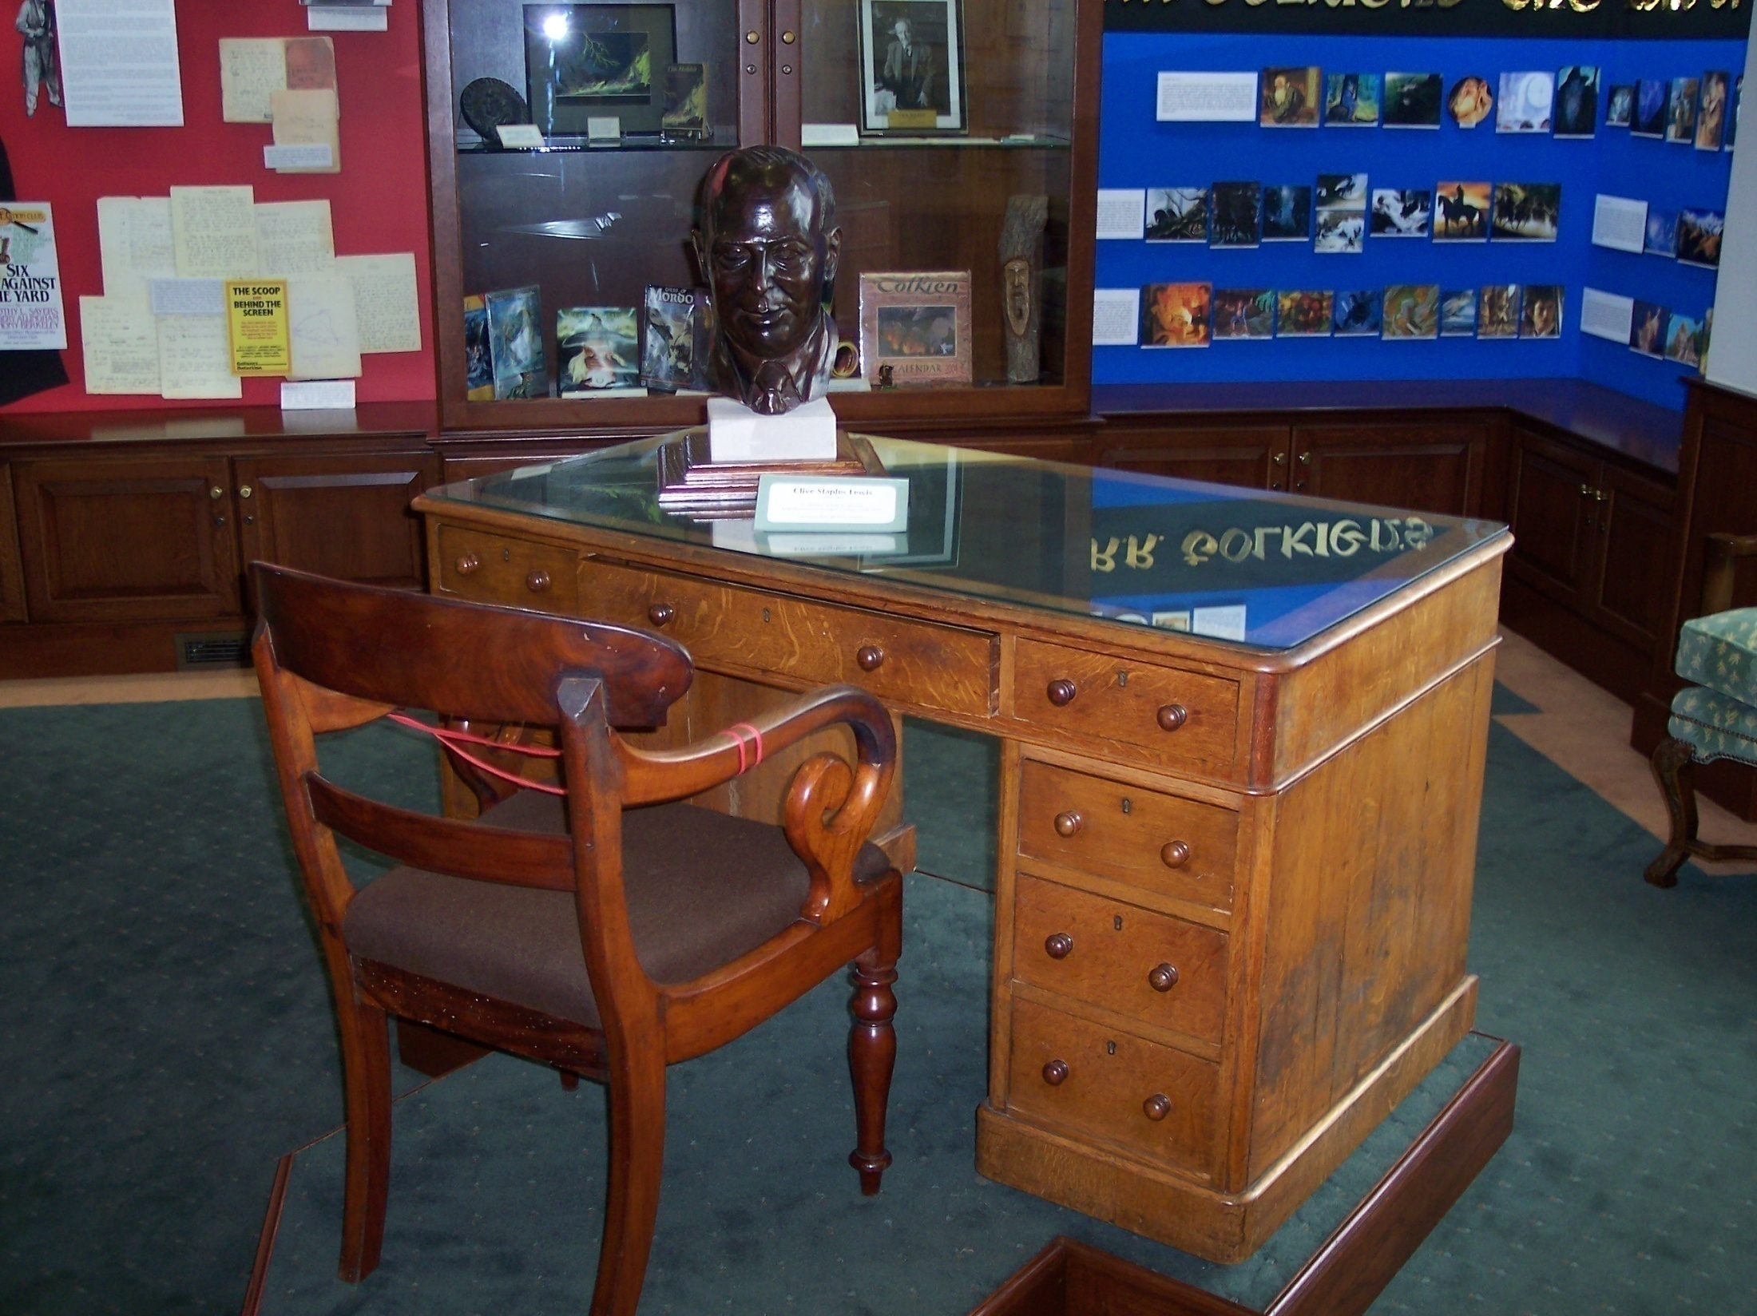

Slide 16
The Wade Center
Notes:
The Marion E. Wade Center, Wheaton College, Wheaton, Illinois

Slide 17
Addison’s Walk
Notes:
The Midnight Conversation with Dyson and Tolkien.

Slide 18
Mere Christianity as Apologetics
“Ever since I became a Christian, I have thought that the best, perhaps the only, service I could do for my unbelieving neighbors was to explain and defend the belief that has been common to nearly all Christians at all times.”
Notes:
Mere Christianity, Preface, 6.

Slide 19
Characteristics of Mere Christianity
Apologetics (i.e., defense)
A reflection of Lewis’s personality (rational, ordered, and imaginative)
Autobiographical, i.e., a reflection of Lewis’s life
A well-known voice in England during World War Two (first delivered over the BBC)
Battlefield language
Radio

Slide 20
Not Covered
Baptism and the Lord’s Supper (the Sacraments)
The Virgin Mary (see Lewis’s Preface)
The Pope
Military service vs. pacifism
The Bible as understood by certain traditions

Slide 21
Not Covered
Eschatology
Divorce
Creation
Those who never heard of Christ—lost or capable of salvation
Birth control
The existence of the devil

Slide 22
Not Covered
Baptism in the Holy Spirit and spiritual gifts
The Seven Ecumenical Councils
Spiritual authority of the local congregation or higher ecclesiastical jurisdictions
Worship and music

Slide 23
That is, …
We can easily get bogged down in irrelevant details rather than focusing on the real issues, such as the deity of Christ or the specific matter that bothers the agnostic. Or truth, as Lewis recommends.
Ultimately, the key issue is the problem of sin in the individual’s life, which they usually want to avoid.

Slide 24
Words from the Battlefield
More than one per page (251)
Battle, invasion/invade, force (20x), Allies, march, Gestapo, army, blow to bits, soldier (16x), war (80x), ration (21x), battle/battlefield, enemy (22x), fight (16x), struggle, German/Germany, Nazi, infantry, sabotage, rebel/rebellion (9x), surrender (8x), arms (7x), conquest, conquer, Jews, smuggle, regiment (4x), and military
Written during World War Two by a veteran of World War One (spiritual warfare)

Slide 25
Paul’s Strategy
Just as Lewis wrote Mere Christianity in the context of World War II, Paul spoke to the Athenians about an unknown God and wrote differently to a largely Gentile church (Philippians) without using Old Testament Scriptures and to a largely Jewish church in Rome using frequent Old Testament quotations, so we need to use the language of our audience.

Slide 26
Jesus’ Strategy
What two things was Jesus always doing?
Asking questions.
Telling stories.

Slide 27
Analogies (Book I, Chapter 5)
Putting the clock back (p. 28)
Taking a wrong turn (28)
Doing arithmetic (29)
Somebody as a great artist (29)
Building a house (29)
The multiplication table (30)
Being sick and needing a doctor (31f.)
War (32)
International politics (32)

Slide 28
Notes:
New Building

Slide 29
When asked by James Welch
I think what I mainly want to talk about is the Law of Nature, or objective right and wrong. It seems to me that the N.T., by preaching repentance and forgiveness, always assumes an audience who already believe in the law of Nature and know that they have disobeyed it. In modern England we cannot at present assume this, and therefore most apologetic begins a stage too far on. The first step is to create, or recover, the sense of guilt. (Lewis letter to Welch, Feb. 10, 1941)

Slide 30
Book I
Five talks
August 6 through September 6, 1941
“Right and Wrong: A Clue to the Meaning of the Universe” (pre-evangelism)
Focus: Chapter 1

Slide 31
His Opening
Everyone has heard people quarrelling. Sometimes it sounds funny and sometimes it sounds merely unpleasant; but however it sounds, I believe we can learn something very important from listening to the kinds of things they say.

Slide 32
Book I, Chapter 1
They say things like this: “How’d you like it if anyone did the same to you?”—“That’s my seat, I was there first”—“Leave him alone, he isn’t doing you any harm”—“Why should you shove in first?”—“Give me a bit of your orange, I gave you a bit of mine”—“Come on, you promised.” People say things like that every day, educated people as well as uneducated, and children as well as grown-ups.

Slide 33
His Opening
Now what interests me about all these remarks is that the man who makes them is not merely saying that the other man’s behavior does not happen to please him. He is appealing to some kind of standard of behavior which he expects the other man to know about. And the other man very seldom replies: “To hell with your standard.”

Slide 34
Book I, Chapter 1
Nearly always he tries to make out that what he has been doing does not really go against the standard, or that if it does there is some special excuse. He pretends there is some special reason in this particular case why the person who took the seat first should not keep it, or that things were quite different when he was given the bit of orange, …

Slide 35
His Opening
… or that something has turned up which lets him off keeping his promise. It looks, in fact, very much as if both parties had in mind some kind of Law or Rule of fair play or decent behavior or morality or whatever you like to call it, about which they really agreed.

Slide 36
His Opening
And they have. If they had not, they might, of course, fight like animals, but they could not quarrel in the human sense of the word. Quarrelling means trying to show that the other man is in the wrong. And there would be no sense in trying to do that unless you and he had some sort of agreement as to what Right and Wrong are; just as there would be no sense in saying that a footballer had committed a foul unless there was some agreement about the rules of football.

Slide 37
The Moral Law
Everyone recognizes moral imperatives, and we all realize we’re not following them too well. Lewis calls this the Tao, a broad moral consensus found all over the world, past and present.

Slide 38
The Moral Law
In The Silver Chair, Jill and Eustace are given four signs to guide them on their quest, very much like God giving the law in the Pentateuch. Even though they muff three of the four Signs, they are still able to accomplish their mission, as we are saved by grace, not by keeping the law in every jot and tittle.

Slide 39
The Moral Law elsewhere in Lewis
Lewis, “The greatest barrier I have met is the almost total absence from the minds of my audience of any sense of sin.” (“God in the Dock,” 243)
Hence, The Screwtape Letters, which teach us the subtlety and deceptiveness of temptation to sin.
In the opening chapter of The Pilgrim’s Regress, when John is learning about religion, we read, “Knowledge of broken law precedes all other religious experiences….” Lewis (The Pilgrim’s Regress, 28).

Slide 40
Law and Gospel
While Lewis had little contact with Lutherans and did not use the terms “Law and Gospel,” he understood the basic theology of sin and grace, good news and bad news, judgment and hope, law and gospel.
And the need for the Law to expose the problem.

Slide 41
Book II
Five talks
January 11 through February 15, 1942
“What Christians Believe”
Focus: Chapter 3

Slide 42
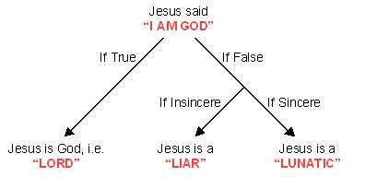
Book II: “The Shocking Alternative”

Slide 43
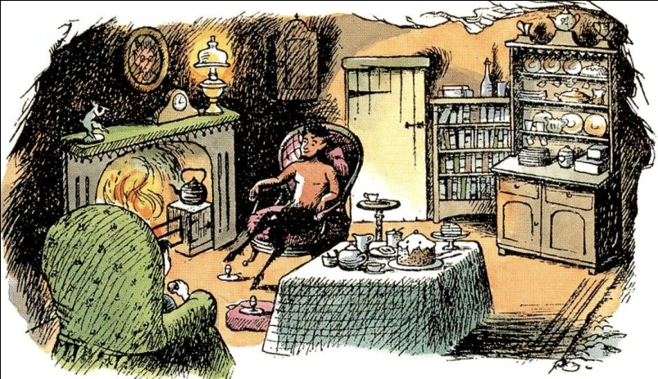
Lucy in The Lion, the Witch…
The context
The three options for Lucy.
“Logic!” said the Professor half to himself. “Why don’t they teach logic at these schools? There are only three possibilities.” …
Notes:
Note the image from the colorized fiftieth anniversary edition of TLWW.

Slide 44
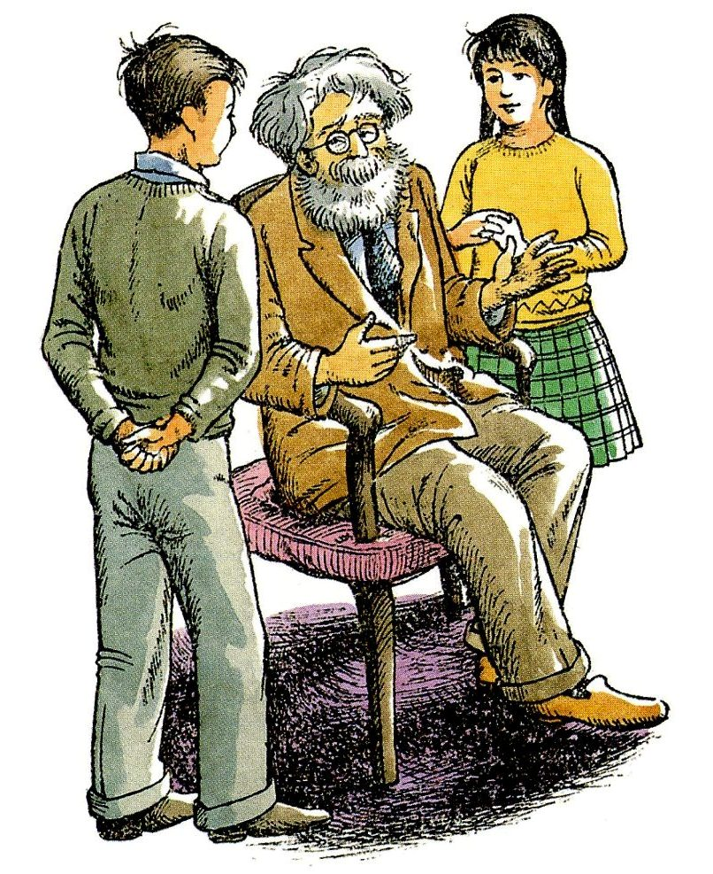
Professor Kirke
“Either your sister is telling lies, or she is mad, or she is telling the truth. You know she doesn’t tell lies and it is obvious that she is not mad. For the moment then and unless any further evidence turns up, we must assume that she is telling the truth.”

Slide 45
YouTube on C. S. Lewis Doodles
https://www.youtube.com/watch?v=bxzuh5Xx5G4

Slide 46
Nicol Cross
The Principal of Manchester College at Oxford University, Nicol Cross, a Unitarian, didn’t like the logic of Lewis in one of his talks over the BBC.
Cross called himself a Unitarian—a creed sometimes defined as “one God, no devil, and twenty shillings in the pound.”

Slide 47
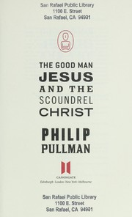
Nicol Cross
Principal Nicol Cross wanted to believe that Jesus was a good man, but nothing more.

Slide 48
Nicol Cross
He said at a meeting of the Socratic Club on November 11, 1946, that “he must allude to the ‘vulgar nonsense’ that ‘a man who said the things that Jesus said, and was not God would be either a lunatic or a devil.’”
He said that this represented such a simplification of the possibilities as only a naïve person could perpetrate, who combined a triple ignorance of New Testament criticism, of psychology, and of elementary logic.

Slide 49
Lewis on the BBC
Nicol Cross was referencing Lewis’s BBC address, entitled “The Shocking Alternative,” first delivered on Feb. 1, 1942, an address that later became Chapter Three of Book Two in Mere Christianity. Elton Trueblood, professor of philosophy and chaplain at both Stanford University and Earlham College, had a much different and more accurate perspective on this most powerful chapter:

Slide 50
Elton Trueblood
“In reading Lewis I could not escape the conclusion that the popular view of Christ as being a Teacher, and only a Teacher, has within it a self-contradiction that cannot be resolved. I saw, in short, that conventional liberalism cannot survive rigorous and rational analysis.” (Elton Trueblood, While It Is Day: An Autobiography, 99)
Read “only a Teacher” as “a good man, but nothing else.”

Slide 51
Elton Trueblood
“C. S. Lewis reached me primarily because he turned the intellectual tables. I was wholly accustomed to a world in which the sophisticates engaged in attack, while the Christians sought bravely to be on the defense, but Lewis turned this around and forced the unbeliever into a posture of defense….

Slide 52
Elton Trueblood
…. In the Screwtape Letters dated July 5, 1941, at Magdalen College, Oxford, Lewis, who up to that time had been an inconspicuous academician, inaugurated a new Christian strategy.”

Slide 53
Book III
Eight Talks
Practical advice: “Christian Behaviour”
September 20 through November 8, 1942
Focus: Chapters 1 and 10

Slide 54
“The Three Parts of Morality”
Harry Emerson Fosdick: “Tell me what kind of a God you don’t believe in. Perhaps I don’t believe in that kind of God either.”
Fair play and harmony between individuals.
Harmonizing the things inside each individual
The general purpose of human life as a whole.
In that third and last part of morality, we find an opening for witness.

Slide 55
The Argument from Desire
“If I find in myself a desire …”

Slide 56
Mere Christianity, “Hope”
The Christian says, “Creatures are not born with desires unless satisfaction for those desires exists. A baby feels hunger: well, there is such a thing as food. A duckling wants to swim: well, there is such a thing as water. Men feel sexual desire: well, there is such a thing as sex. If I find in myself a desire which no experience in this world can satisfy, the most probable explanation is that I was made for another world. If none of my earthly pleasures satisfy it, that does not prove that the universe is a fraud….
Notes:
Book III, Chapter 10

Slide 57
Mere Christianity, “Hope”
… Probably earthly pleasures were never meant to satisfy it, but only to arouse it, to suggest the real thing. If that is so, I must take care, on the one hand, never to despise, or be unthankful for, these earthly blessings, and on the other, never to mistake them for the something else of which they are only a kind of copy, or echo, or mirage. I must keep alive in myself the desire for my true country, which I shall not find till after death; I must never let it get snowed under or turned aside; I must make it the main object of life to press on to that other country and to help others to do the same.”

Slide 58
Book IV
Seven Talks
“Beyond Personality: The Christian View of God”
February 22 through March 30, 1944
Focus: Chapter 8

Slide 59
“Is Christianity Hard or Easy?”
Christ says both “Take up your Cross” and “My yoke is easy and my burden light”?
Is this a contradiction?
Likewise, witnessing is both hard and easy.
A pastor’s sermon to a married couple …
“You have come here to die.”
Notes:
Chapter 8

Slide 60
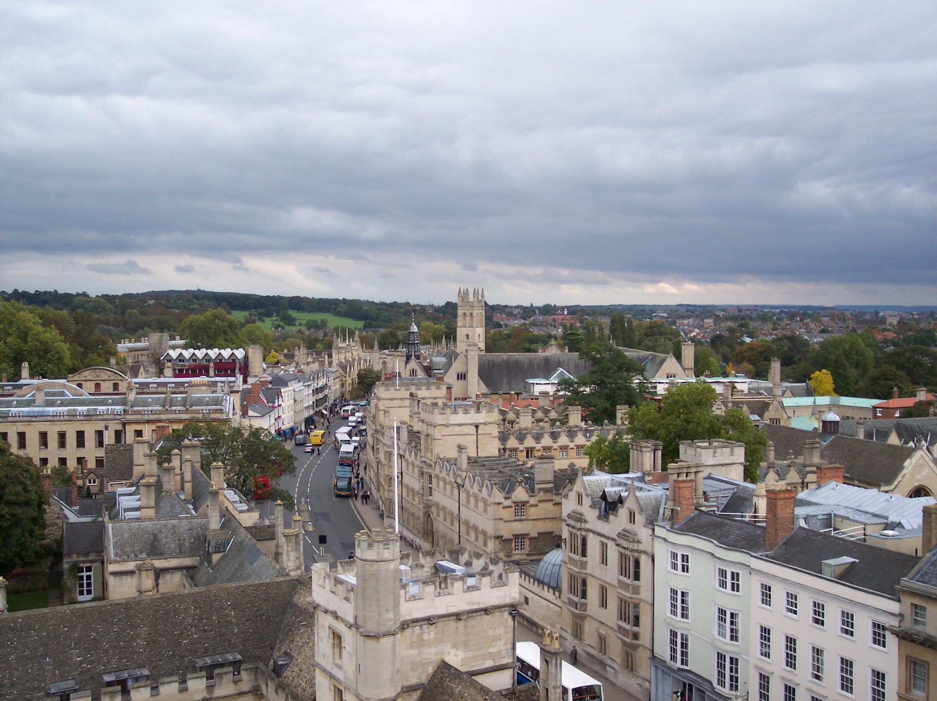
Notes:
Looking east from the top of St. Mary the Virgin Church in Oxford. Magdalen College tower is in the center in the distance.

Slide 61
Concluding Lessons
Speak the language of the person to whom you are speaking.
Avoid controversial issues: the main thing is to keep the main thing the main thing (avoiding eschatology, denominational differences, etc.).
Wherever you can, use a clear and basic word instead of a complicated word.
Use stories (e.g., Narnia, Ransom Trilogy, “Shadowlands”) and analogies wherever you can. The Gospel is story, as is your life.
Notes:
My set of discussion questions.

Slide 62
Concluding Lessons
Sometimes go places and do things for the sake of the Gospel.
Perhaps even give a copy of Mere Christianity to an interested person.
You might even get yourself a copy to assist you in being prepared to give an answer.
Teach a Bible Class on Mere Christianity (using discussion questions?!?).
Notes:
My set of discussion questions.

