Slide 1
The Legacy of C. S. Lewis, His Significance
Joel D. Heck, Concordia Lutheran Seminary, Edmonton

Slide 2
How he has made an impact
The most frequently quoted Christian writer today (sermons, conversations, articles, the Alpha course, etc.). More then forty books, 200+ poems, and 176 articles and letters to the editor written by Lewis have been published—a total of 324 published pieces, 14 of them after his death!
An effective writer in a variety of types of literature whose books have sold more than 250,000,000 copies. The Chronicles of Narnia have sold more than 125 million copies. More than fifty million of all his works in the last ten years!

Slide 3
How he has made an impact
A master of clarity of thought and the analogy; both left-brained and right-brained.
Produced a significant change in children’s literature through The Chronicles of Narnia.
Influential on the resurgence of the writings of Edmund Spenser, George MacDonald, Charles Williams, John Milton, and others.
Films and plays are frequently being made about Lewis.

Slide 4
How he has made an impact
The single most important literary influence on J. R. R. Tolkien.
The Narnia movies reached millions, “The Lion, the Witch and the Wardrobe,” which earned more than $745 million (44th all-time), and “Prince Caspian,” which earned more than $419.6 million, and “The Voyage of the ‘Dawn Treader’,” which earned more than $415.6 million. Total: $1,580,200,000 (billion)! See NarniaWeb for the latest on Narnia movies.
There are more than 200 C. S. Lewis Reading Groups or Societies around the world.
Many C. S. Lewis courses are taught on university and seminary campuses.
Lots of books and other materials have been written about C. S. Lewis—lots of hits on Google.

Slide 5
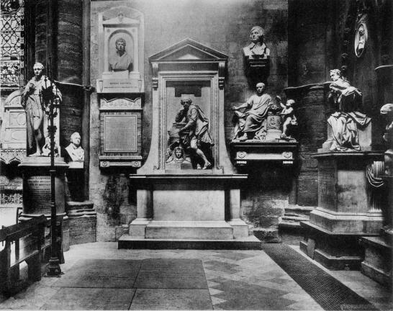
Poets’ Corner, Westminster Abbey
William Shakespeare (to the right), Geoffrey Chaucer, Charles Dickens, George Frideric Handel, Samuel Johnson, Rudyard Kipling, Edmund Spenser, Alfred Tennyson, Jane Austen, W. H. Auden, Lewis Carroll, Samuel Taylor Coleridge, T. S. Eliot, John Keats, Henry Wadsworth Longfellow, John Milton, Alexander Pope, Percy Bysshe Shelley, Walter Scott, Oscar Wilde, William Wordsworth
And C. S. Lewis!!
Added on Friday, Nov. 22, 2013
Notes:
Lewis added on the 50th anniversary of his death.

Slide 6
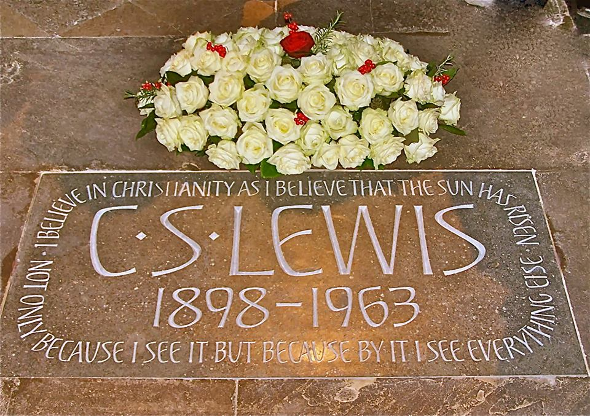
“I believe in Christianity as I believe that the sun has risen: not only because I see it, but because by it I see everything else.”
Notes:
“I believe in Christianity as I believe that the sun has risen: not only because I see it, but because by it I see everything else.” (“Is Theology Poetry?”)

Slide 7
Evelyn Underhill & J. I. Packer
Evelyn Underhill, an authority on Christian mysticism: Lewis’ remarkable “capacity for giving imaginative body to the fundamental doctrines of Christianity.”
J. I. Packer, Anglican theologian: on the two sides of Lewis’ brain, “left for the logical and linear and right for the romantic and imaginative, were thoroughly developed, so that he was as strong in fantasy and fiction as he was in analysis and argument.”

Slide 8
Literary Genres
In The Surprising Imagination of C. S. Lewis: An Introduction, Lewis scholars Jerry Root and Mark Neal list seventeen different literary genres in which Lewis wrote: (1) Apologetics; (2) autobiography; (3) educational philosophy; (4) essays; (5) fairy stories; (6) journals; (7) letters; (8) literary criticism; (9) literary history; (10) lyric poetry; (11) narrative poetry; (12) novels; (13) religious devotion; (14) satire; (15) science fiction; (16) short story; and (17) translations.
Notes:
(Jerry Root and Mark Neal, The Surprising Imagination of C. S. Lewis: An Introduction. Nashville: Abingdon Press, 2015.

