Slide 1
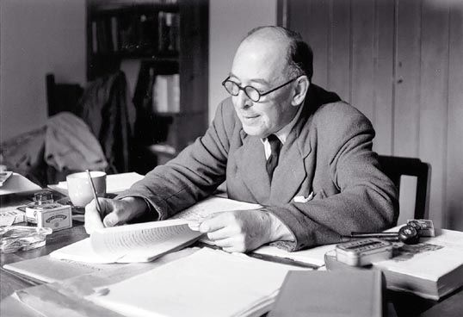
The Life of c. s. Lewis

Slide 2
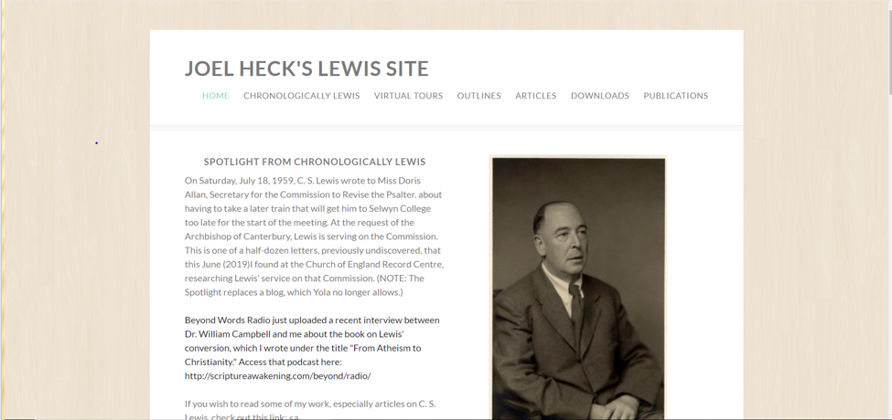
For Everything you want to know …

Slide 3
I. His parents
Flora Hamilton Lewis (1862-1908) earned a degree in math and logic from Queen’s College, Belfast, a clergyman’s daughter.
Albert James Lewis (1863-1929), a Belfast solicitor, was also a Queen’s graduate.
The Lewis brothers later dedicated a stained glass window to them in their home church.

Slide 4
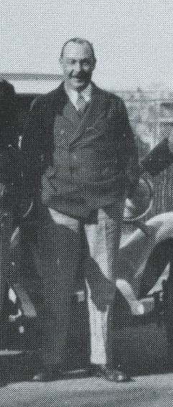
Shanghai, 1929

Slide 5
II. The Early & teen Years
The name “Jack”
Beatrix Potter
Little Lea (next slide)
Death of his mother (1908)
Campbell College
Malvern College and Harry Wakelyn Smith, a master of the Classics (1913-1914)
Poetry, i.e. “how it should be savored and mouthed in solitude.”
Campbell College, Belfast (1910)

Slide 6
Notes:
Little Lea from Circular Road

Slide 7
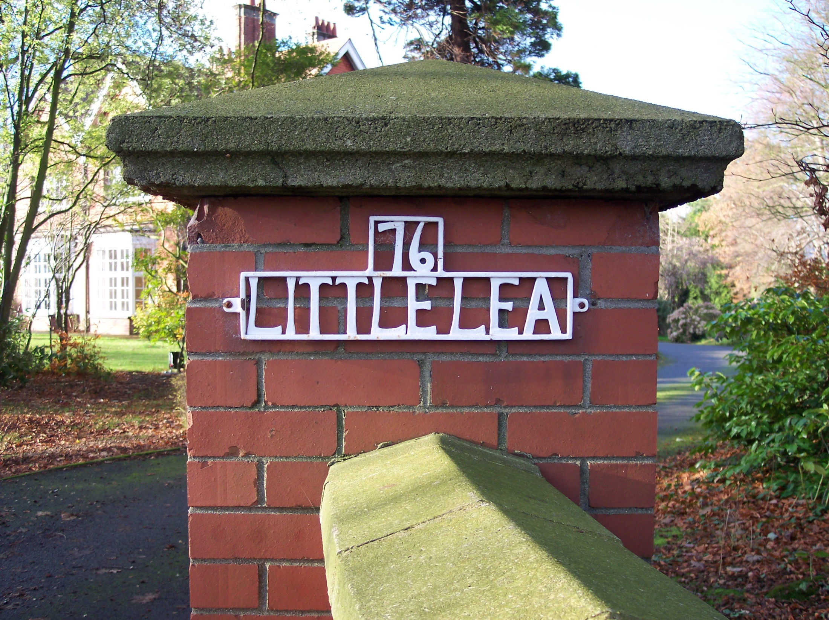
Epitaph

Slide 8
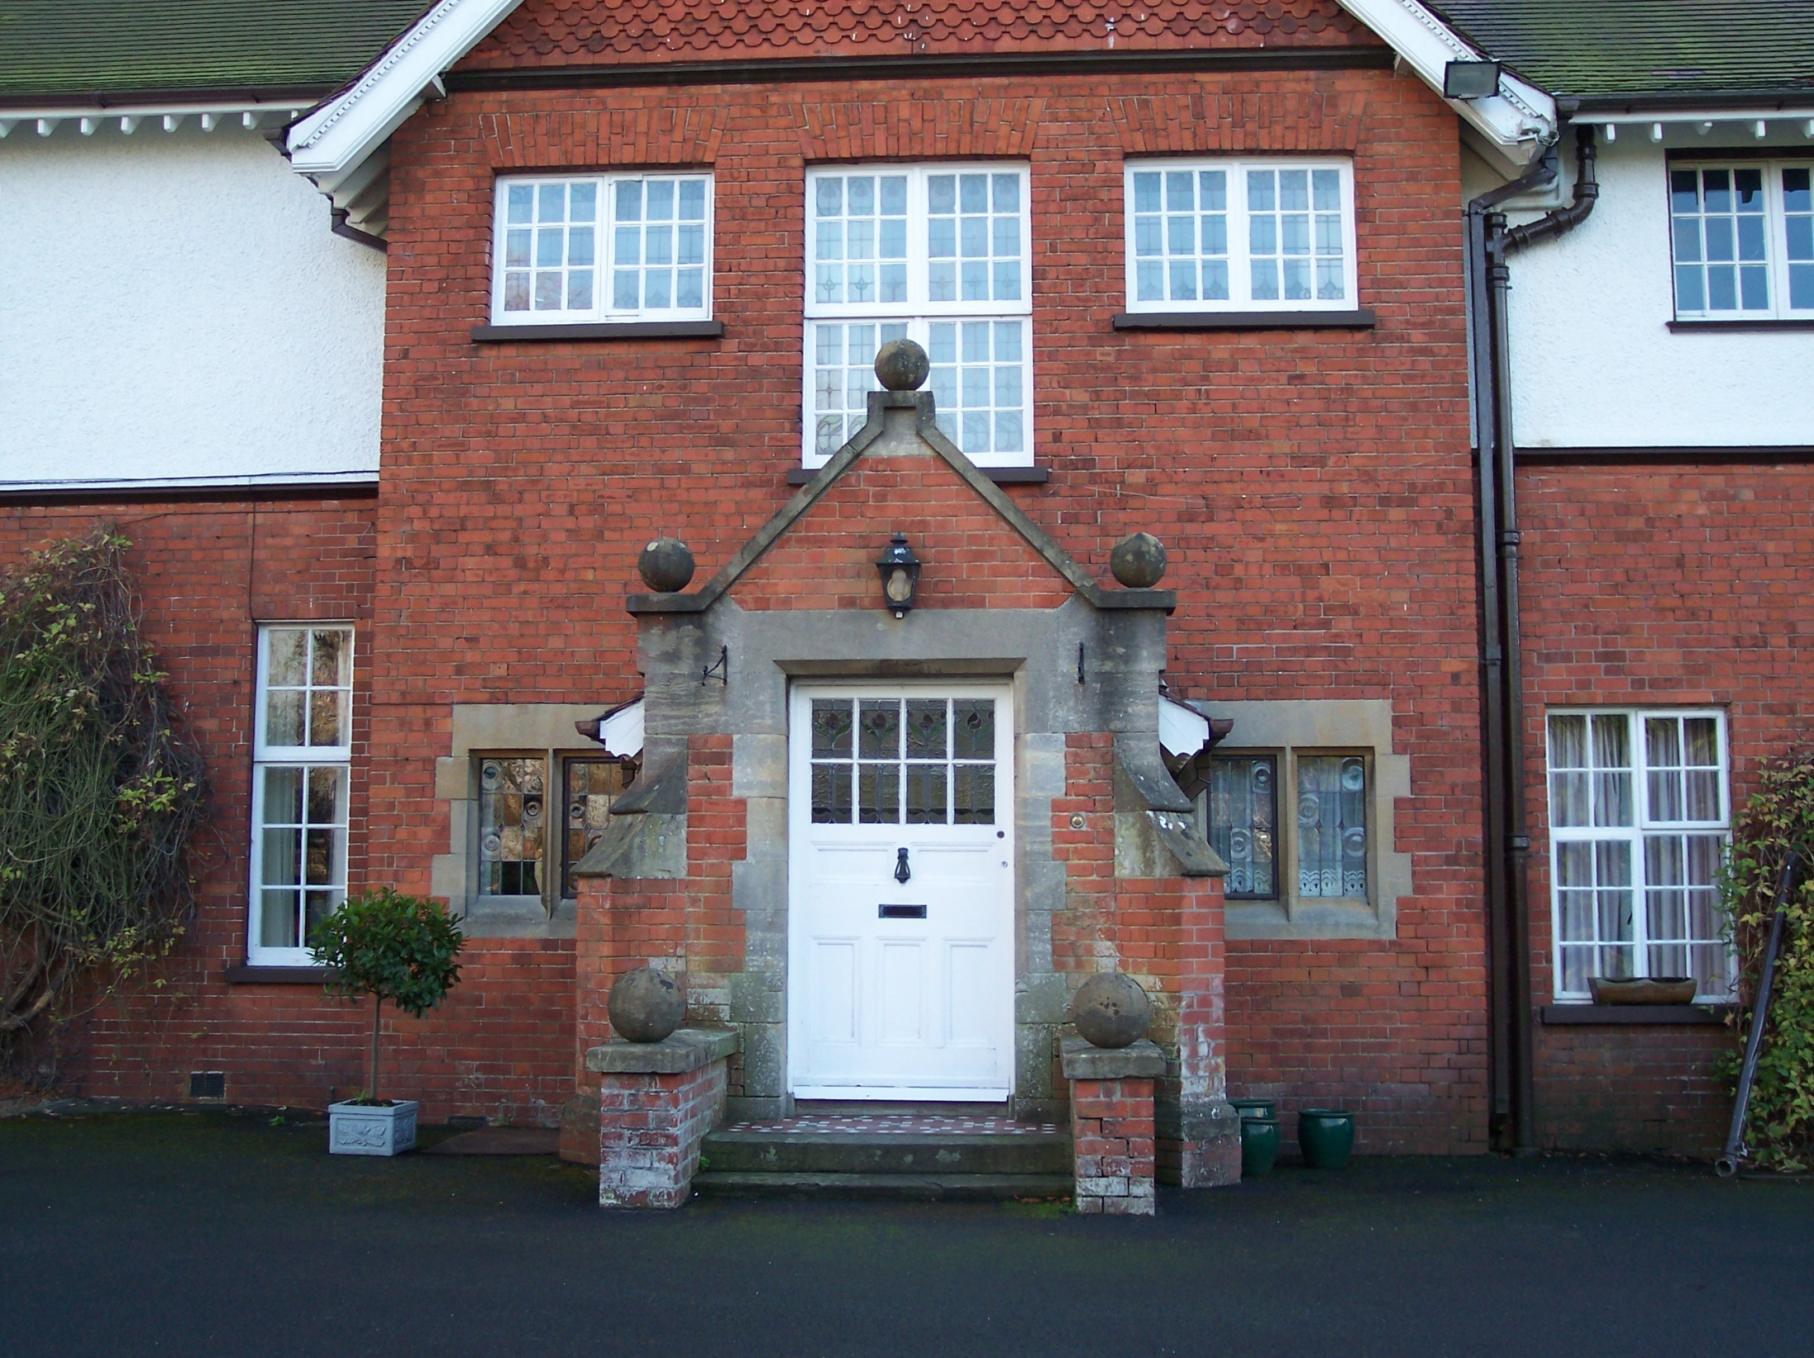

Slide 9
Family group on doorstep of Little Lea, Belfast, Northern Ireland, 1905. From left to right, first row: Warren Lewis, Jack Lewis, Leonard Lewis (cousin), and Eileen Lewis (cousin). Second row: Agnes Young Lewis (aunt), maid, maid, Flora Hamilton Lewis (mother), and Albert Lewis (father), holding the dog Nero.

Slide 10
Lewis grades his schools
1908-1910, Wynyard School: F
Fall, 1910, Campbell College: B
1911-1913, Cherbourg House: C
1913-1914, Malvern College: D
1914-1917, Private Tutoring with Kirkpatrick: A+
1917-1923, Oxford University: A-

Slide 11
Surprised by Joy
Little Lea: “I am a product of long corridors, empty sunlit rooms, upstairs indoor silences, attics explored in solitude, distant noises of gurgling cisterns and pipes, and the noise of wind under the tiles. Also, of endless books.”
Mother’s Death: “With my mother’s death all settled happiness, all that was tranquil and reliable, disappeared from my life. There was to be much fun, many pleasures, many stabs of Joy; but no more of the old security. It was sea and islands now; the great continent had sunk like Atlantis.”

Slide 12
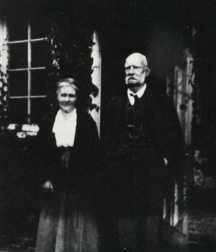
Teenage Years
His private tutor W. T. Kirkpatrick, “The Great Knock”
From Sept. 19, 1914 to April 25, 1917, “red beef and strong beer”
Preparation for Oxford University
“If ever a man came near to being a purely logical entity, that man was Kirk.” Born later, he would have been a Logical Positivist.
A man who “thought not about you but about what you said.”
George MacDonald, who “baptized his imagination”
George MacDonald

Slide 13
George Macdonald (from early 1916)
“I have never concealed the fact that I regarded him as my master; indeed I fancy I have never written a book in which I did not quote from him.”
After purchasing Phantastes, “A few hours later I knew that I had crossed a great frontier.”
Notes:
George MacDonald: An Anthology, Preface, xxxii. And George MacDonald: An Anthology, Preface, xxxiii.

Slide 14
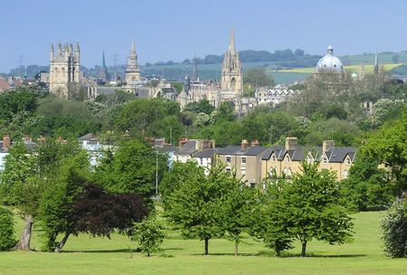
iii. oxford
“Dreaming spires” (Matthew Arnold)
University College, April 26, 1917
“Paddy” Moore
Wounded, returned to Oxford in January 1919
Excused from Responsions
Spirits in Bondage

Slide 15
IV. Mrs. Moore and oxford
Promise kept: Mrs. Moore (Paddy’s mother)
Maureen
Honour Mods (1920)
A letter to a friend in 1921: “The trouble about God is that he is like a person who never acknowledges your letters and so in time you come to the conclusion either that he does not exist or that you have got his address wrong.”
Exams for Greats (June 8-14, 1922) lasted six days—six hours of writing each day!
Another degree in English Language and Literature (1923)
Three first-class honors, two degrees
Notes:
Exams for Greats are described in “The New Look,” a chapter in SBJ.

Slide 16
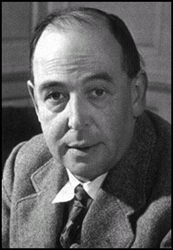
v. poverty
A one-year position (1924-1925) as a philosophy tutor
May 20, 1925 telegram to his father: “Elected fellow Magdalen. Jack.”
Albert: “I went to his room and burst into tears of joy. I knelt down and thanked God with a full heart. My prayers have been heard and answered.”

Slide 17
An interesting quotation
“I have come to think that if I had the mind, I have not the brain and nerves for a life of pure philosophy. A continued search among the abstract roots of things, a perpetual questioning of all the things that plain men take for granted, a chewing the cud for fifty years over inevitable ignorance and a constant frontier watch on the little tidy lighted conventional world of science and daily life⎯is this the best life for temperaments such as ours? Is it the way of health or even of sanity?” (A letter to his father, Aug. 14, 1925)

Slide 18
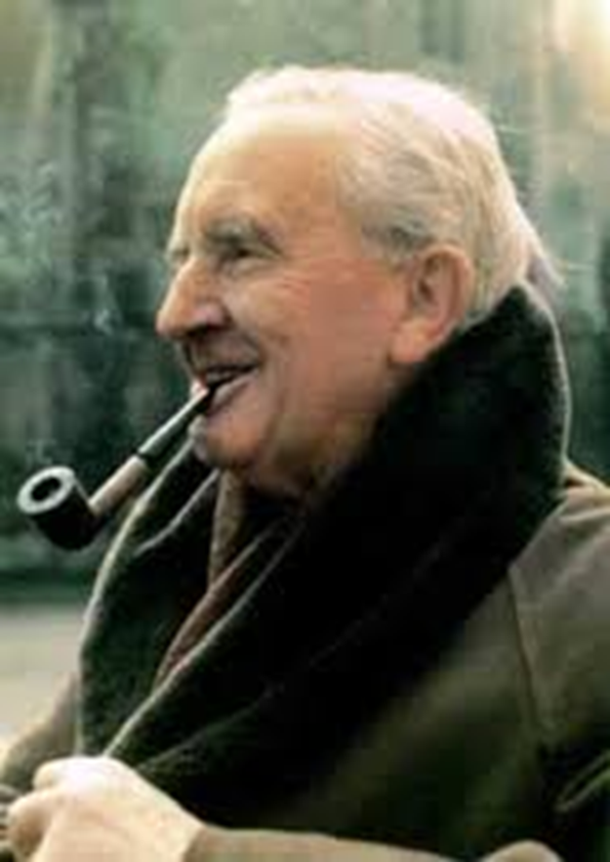
vi. Fellow and tutor
Magdalen College, Oxford, 1925-1954 (photos in next slide)
Meets J. R. R. Tolkien (1926)
The Coalbiters, an early precursor to the Inklings

Slide 19
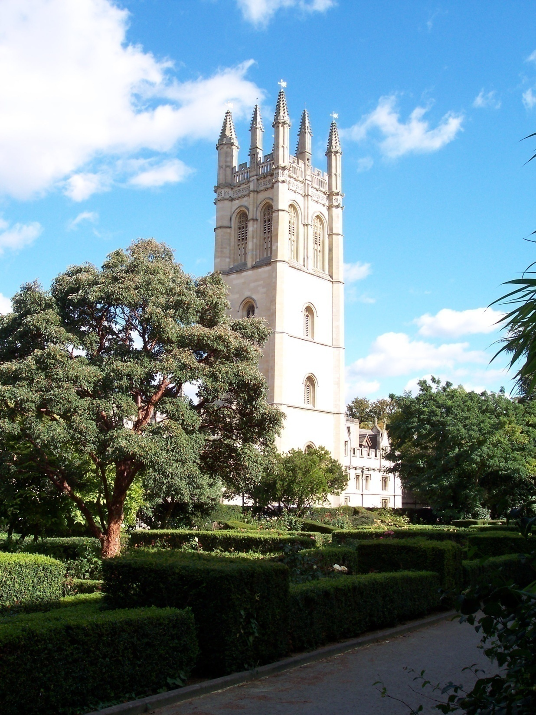
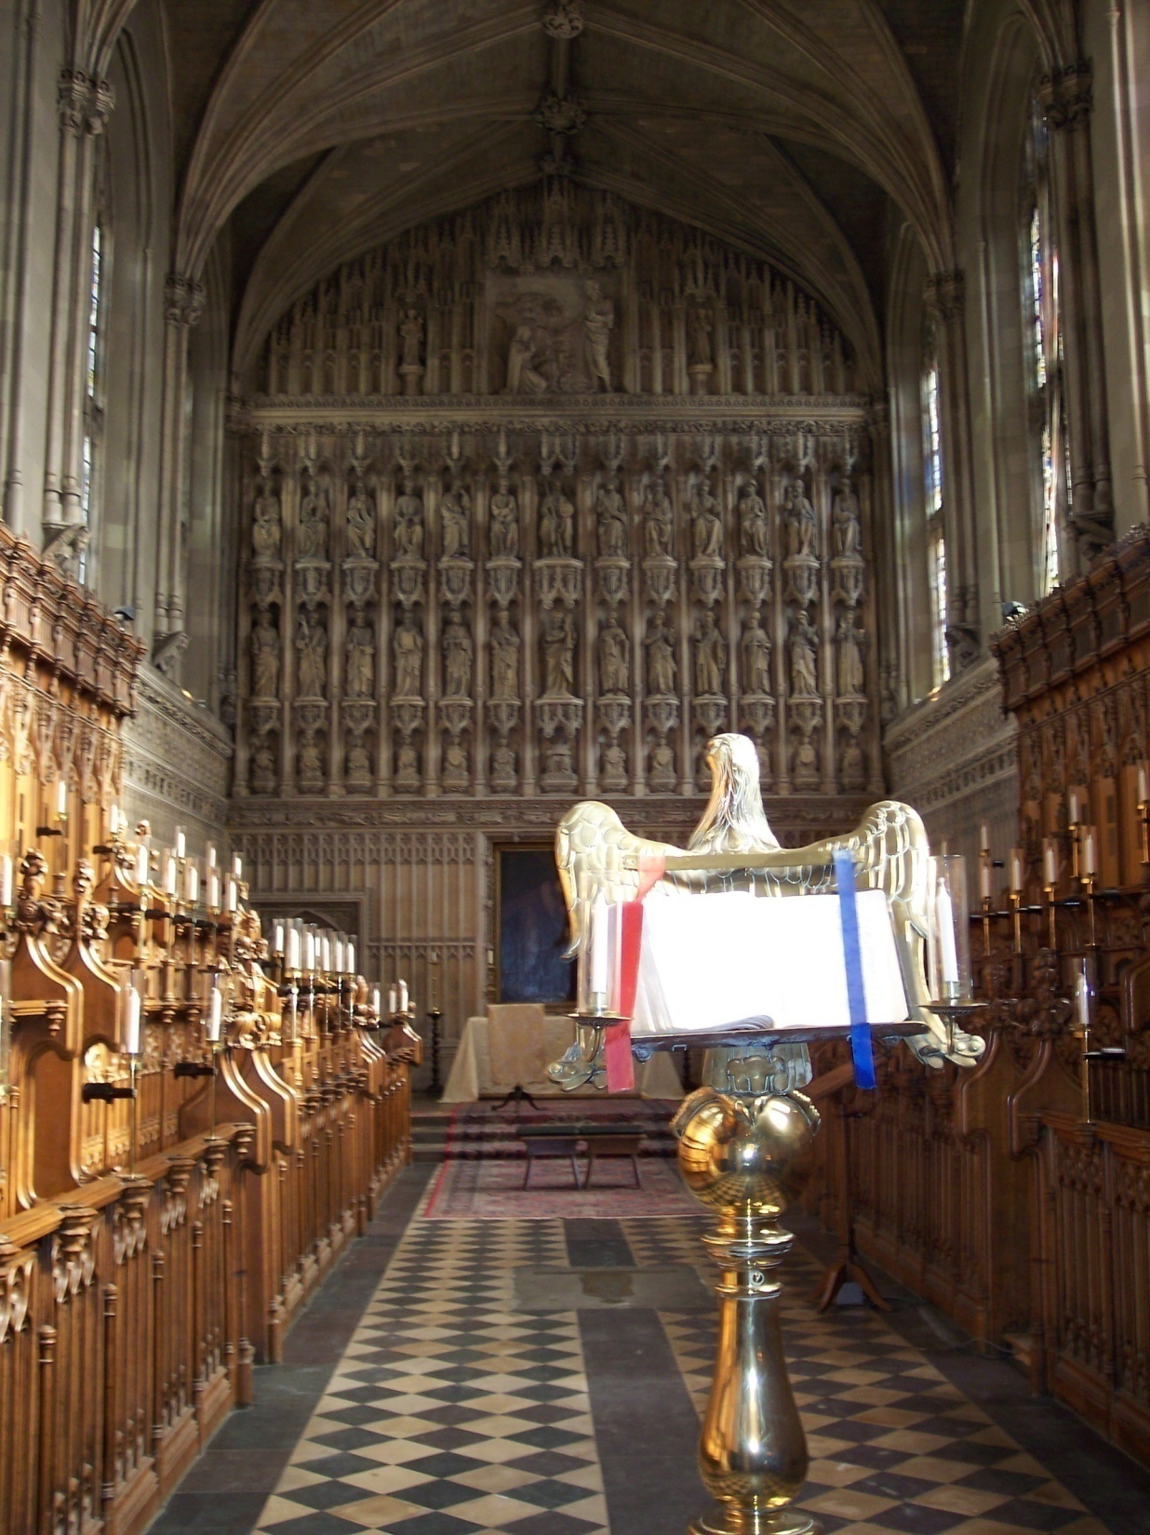

Slide 20
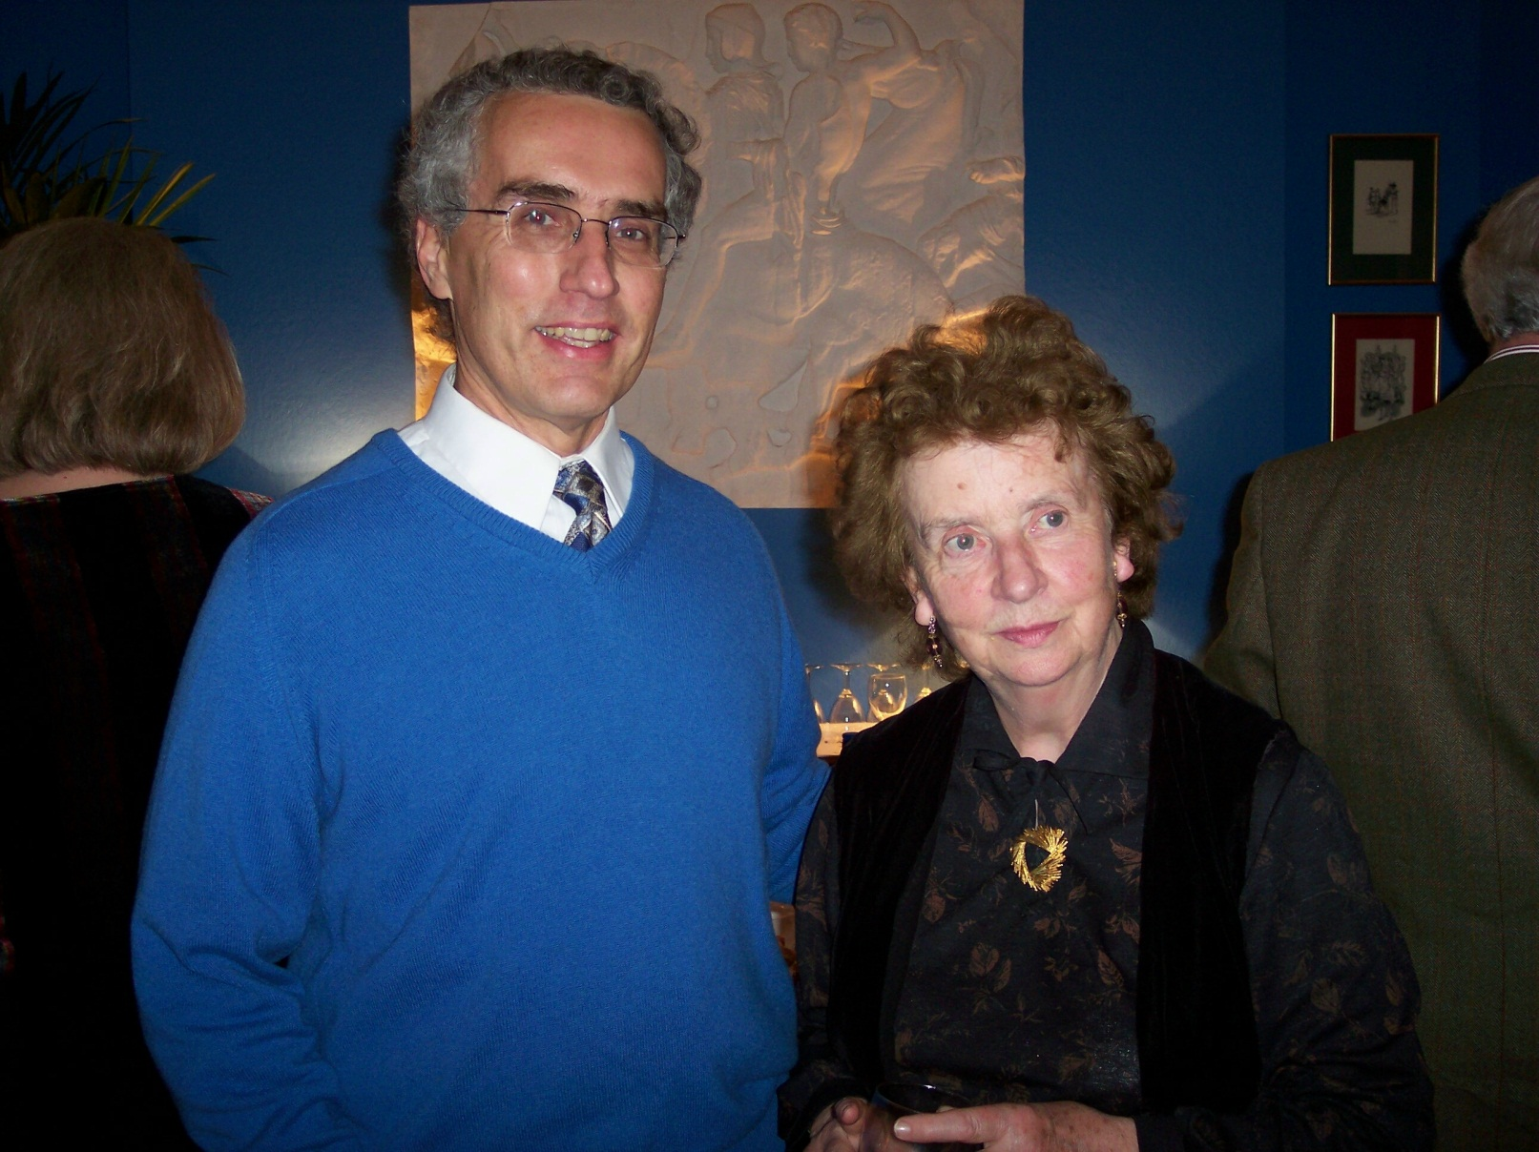
On an oxford Sabbatical

Slide 21
vii. dymer
His second published work (1926)
A long, narrative poem, powerful but unusual
The self-portrait of a rebel who begets a beast, rebels against the state, and is later killed by that beast
Sayer: “Its main subject, the dangers of fantasy or excessive daydreaming, is of lasting importance.”
This poem helps to explain why he later turned to prose, or at least why his writing success came with prose and not poetry

Slide 22
Owen Barfield’s Three Lewises
Literary Criticism
Poetry & Imaginative Fiction
Christian Apologetics & Spiritual Autobiography
Owen Barfield: “What he thought about everything was secretly present in what he said about anything.”
Notes:
Owen Barfield on C. S. Lewis, G. B. Tennyson and Jane Hipolito, editors, 94, 121. And Ibid., 122.

Slide 23
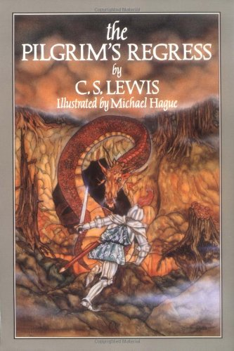
viii. The pilgrim’s regress (1926-1933)
His first Christian book
Autobiographical
Written in just two weeks
The “stages” in Lewis’s conversion to Christianity

Slide 24
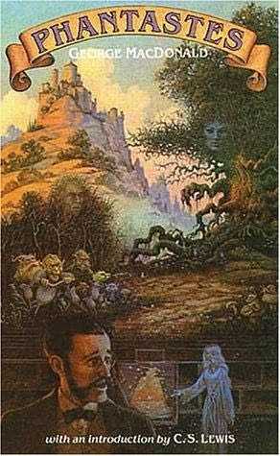
Stage one: Atheism to Realism
1912
Lewis becomes an atheist and a materialist while at Cherbourg House (he says he was 14 at the time)
1916
Lewis reads George MacDonald’s Phantastes
Early 1920s
Lewis adopts Realism (philosophical system)

Slide 25
Stage two: Idealism and Upset
1924
Lewis adopts Idealism (philosophical system)
(Hegel, Bosanquet, T. H. Green, F. H. Bradley)
1926
T. D. Weldon comment; Lewis reads the Gospels

Slide 26
Stages 3 & 4: Theism and Christianity
1930 (“Checkmate”)
Lewis adopts Theism
“I gave in, and admitted that God was God, and knelt and prayed; perhaps, that night, the most dejected and reluctant convert in all England.”
1931
Lewis becomes a Christian (September 22)

Slide 27
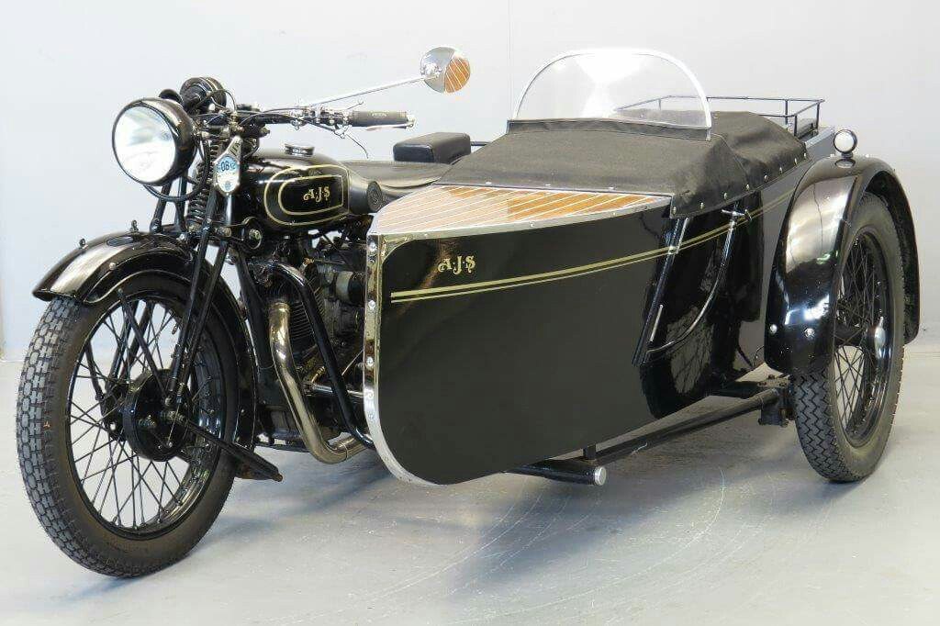
The “Daudel”: an A. J. S. Combination
Notes:
Purchased from Longman’s in Salisbury while Warren was stationed with the RASC in Bulford, eight miles northeast of Salisbury.

Slide 28
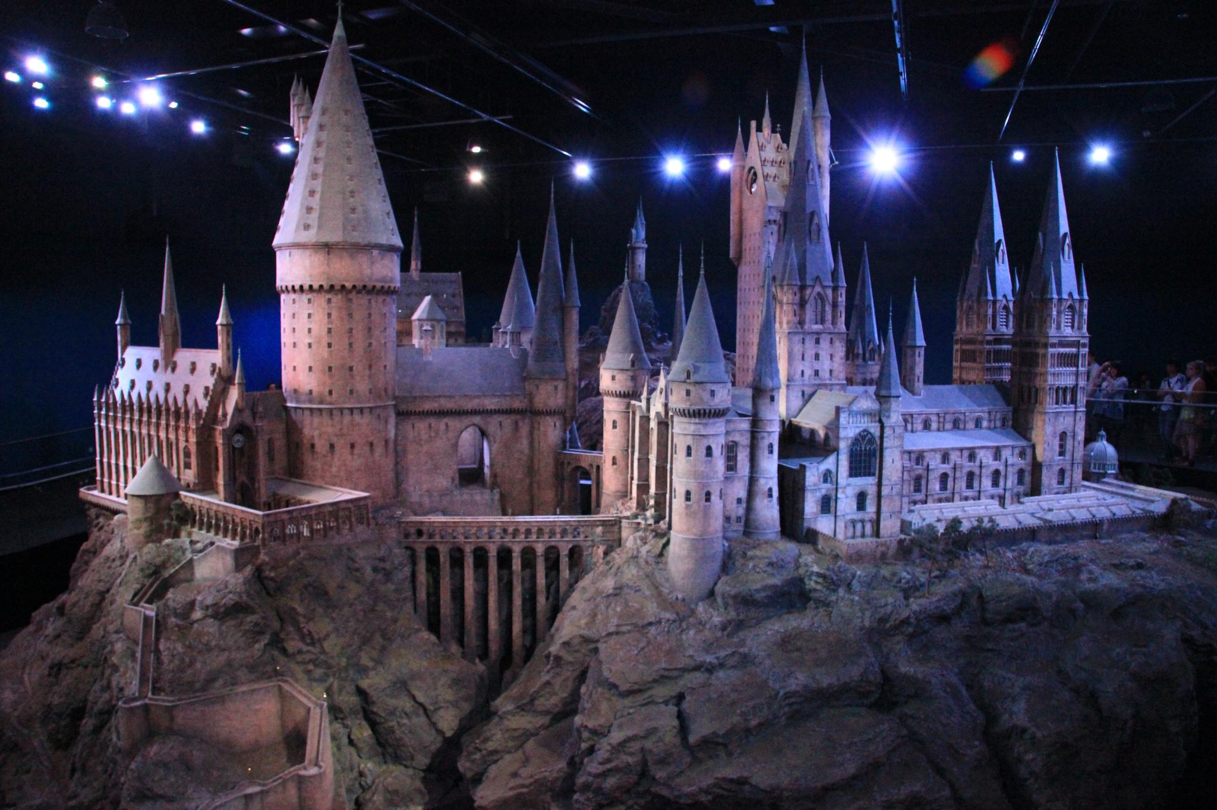
ix. The kilns
Purchased in July 1930
Jack & Warren
Mrs. Moore & Maureen
Fred Paxford
Maids
Dogs and cats

Slide 29
X. The Inklings, 1933-1963
The Inklings, Humphrey Carpenter, 1978
The Company They Keep, Diana Pavlac Glyer, 2007
Especially C. S. Lewis, Warren Lewis, J. R. R. Tolkien, Humphrey Havard, Hugo Dyson, Austin Farrer, Owen Barfield, Colin Hardie, Charles Williams (later), but also a dozen others at various times.

Slide 30
Dedications of the chronicles of narnia
TLWW: Lucy Barfield
PC: Mary Clare Havard
VDT: Geoffrey Barfield
SC: Nicholas Hardie
HHB: David and Douglas Gresham
TMN: The Kilmer Family
TLB: No dedication
Children of Inklings

Slide 31
The potential of myth
Before he wrote the Chronicles of Narnia, perhaps around the time he made his first unsuccessful attempt to write one of them, he stated in a letter:
“If there was only someone with a richer talent and more leisure I think that this great ignorance might be a help to the evangelization of England; any amount of theology can now be smuggled into people’s minds under cover of romance without their knowing it.”
Notes:
To Sister Penelope, Collected Letters, II, 262, August 9, 1939.

Slide 32
Summer 1939
Out of obscurity into the limelight
In his biography of Lewis, George Sayer writes, “The Second World War broke out within a few months of the publication of Rehabilitations and The Personal Heresy. Jack was then a man of forty. He had published seven books, of which only two were moderately successful. No one could have guessed that within a few years his would become a household name.”

Slide 33
St. Cross Cemetery: Dyson & Farrer

Slide 34
Also Charles Williams

Slide 35
Xi. World war ii
Eligibility for military service if you are between the ages of 18 and 41
A letter to Warren on July 20, 1940 that contains the germ of an idea that eventually becomes The Screwtape Letters
Lewis’s royalties

Slide 36
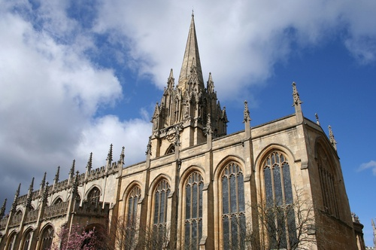
xii. Preacher and broadcaster
The Problem of Pain, 1940
The BBC radio talks that became Mere Christianity (2 of 3)
“The Weight of Glory,” delivered on June 8, 1941
St. Mary, the Oxford University Church

Slide 37
The Socratic Club
The Oxford Socratic Club, founded in 1941 by Stella Aldwinckle
Lewis as President, 1942-1954
The Anscombe Debate, Feb. 2, 1948, on “The Self-Contradiction of the Naturalist”
The rerun of the debate in the 1960s: John Lucas vs. Elizabeth Anscombe
Notes:
See the work of Christopher Mitchell on this topic (C. S. Lewis: Lightbearer in the Shadowlands).

Slide 38
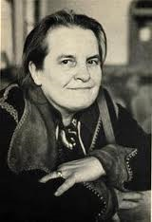
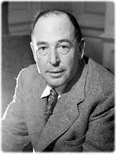
G.E.M. Anscombe vs. C.S. Lewis

Slide 39
The socratic club
At the Socratic Club, Lewis often fought two erroneous views:
(1) that there was no objective morality
(2) that Christianity was fundamentally a moral or ethical system. He fought the latter by saying that Christian ethics were far from unusual and were common to most religions and civilized people.
Many of the talks were published in the Socratic Digest.

Slide 40
xiii. writing
Six major works between 1941 and 1946
A Preface to “Paradise Lost” (1942)
The Screwtape Letters (1942) (Max McLean)
The Abolition of Man (1943)
Perelandra (1943)
That Hideous Strength (1945)
The Great Divorce (1945) (Tony Lawton)
A draft of another book (Mere Christianity, 1941-1944)
Numerous articles and papers
And thousands of letters

Slide 41
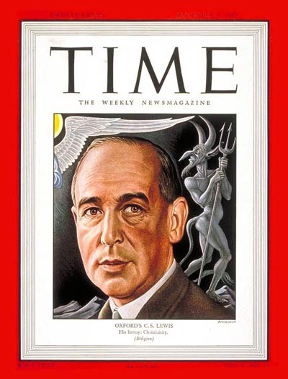
The Screwtape Letters

Slide 42
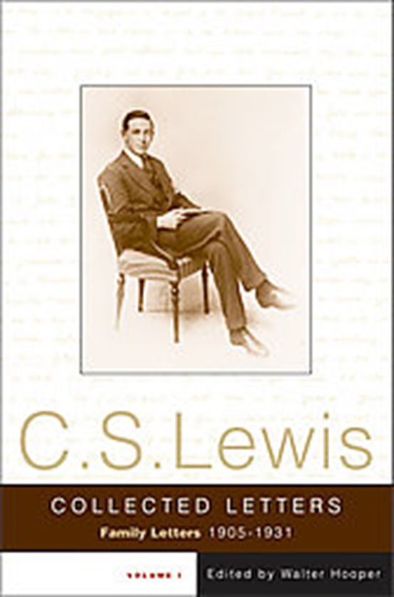
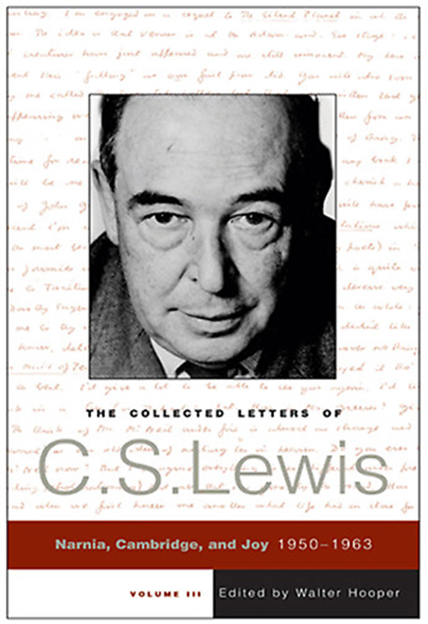
Collected Letters

Slide 43
XIV. Narnia
Tolkien’s reaction:
“Because Aslan, the fauns, the White Witch, Father Christmas, the nymphs, and Mr. and Mrs. Beaver had quite distinct mythological or imaginative origins, Tolkien thought that it was a terrible mistake to put them together in Narnia, a single imaginative country.”
Notes:
Jack, Sayer, p. 312.

Slide 44
Aslan
The character Aslan is considered by many (e.g., Paul Ford) to be Lewis’s supreme literary achievement.
“It All Began with a Picture”
A faun
“At first I had very little idea how the story would go. But then suddenly Aslan came bounding into it.”

Slide 45
XV. Problems
Mrs. Moore’s health
Jack’s exhaustion (Acland, summer 1949)
Warren’s drinking
Jack’s exorcising personal demons in Surprised by Joy
Missing out on a professorship: “Let’s go and cast our votes against Jack Lewis.”
Mrs. Moore’s death, Jan. 12, 1951

Slide 46
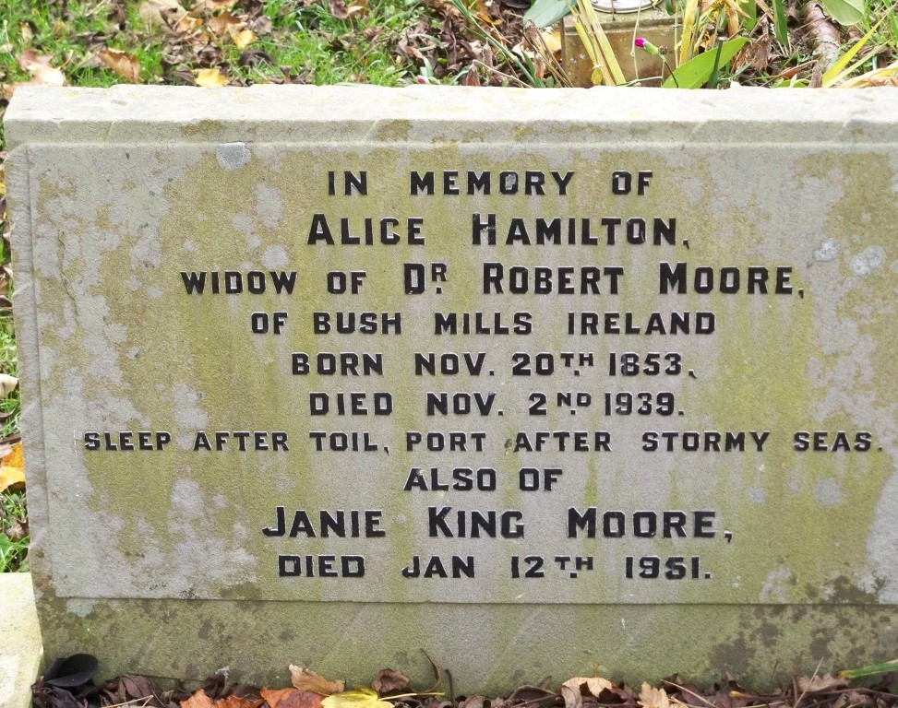

Slide 47
XVi. Joy
And God Came In
A Love Observed
Authored by Lyle Dorsett, former curator of the Wade Center
See also Don King, editor, Out of My Bone: The Letters of Joy Davidman

Slide 48
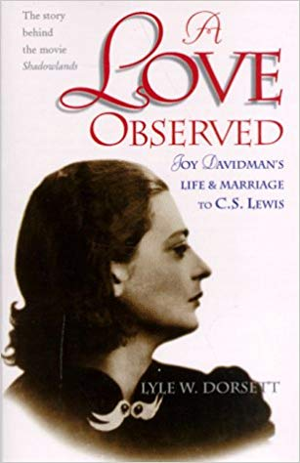
Joy

Slide 49
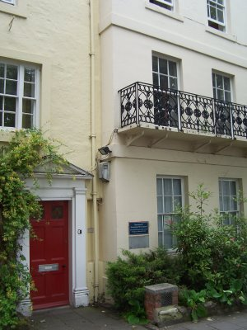
Joy
10 Old High Street, Headington

Slide 50
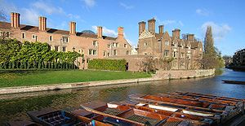
xvii. Cambridge
Accepted position in 1954
Inaugural lecture on his birthday in 1954
“The Last of the Dinosaurs”
Began teaching there in 1955

Slide 51
XVIII. More Joy
Books Inspired by Joy Davidman
Till We Have Faces: his best novel, 1956
The Four Loves: affection, friendship, Eros, and charity, 1958
Reflections on the Psalms: Autumn 1958
A Grief Observed: 1961 (N. W. Clerk)
“But go to Him when your need is desperate, when all other help is vain, and what do you find? A door slammed in your face, and a sound of bolting and double bolting on the inside. After that, Silence.”

Slide 52
XIX. Last Years
Commission to Revise the Psalter (1958-1963)
An Experiment in Criticism (1961)
July 16, 1963 heart attack and coma, kidney damage
Resigned his position in August
Around this time Walter Hooper was invited to be his private secretary
Nov. 22, 1963
Died the same day as John F. Kennedy and Aldous Huxley

Slide 53
How Jack Described It: The Last Battle
“Then Aslan turned to them and said: ‘. . . you are⎯as you used to call it in the Shadowlands⎯dead. The term is over: the holidays have begun. The dream is ended: this is the morning . . .”
“And for us this is the end of all the stories, and we can most truly say that they all lived happily ever after. But for them it was only the beginning of the real story. All their life in this world and all their adventures in Narnia had only been the cover and the title page: now at last they were beginning Chapter One of the Great Story which no one on earth has read: which goes on for ever: in which every chapter is better than the one before.”

Slide 54
How Warren Described it: Warnie’s Diary
Friday 22 November began no differently from any other day for some weeks past. I looked in on Jack soon after six, got a cheerful “I’m all right” and then went about my domestic tasks. He got up at eight and as usual breakfasted in the kitchen in his dressing-gown, after which he took a preliminary survey of his crossword puzzle.

Slide 55
How Warren Described it: Warnie’s Diary
By the time he was dressed I had his mail ready for him and he sat down in his workroom where he had been finding great difficulty in keeping awake, and finding him asleep in his chair after lunch, I suggested that he would be more comfortable in bed. He agreed and went there. At four o’clock I took him in his tea and had a few words with him, finding him thick in his speech, very drowsy, but calm and cheerful. It was the last time we ever spoke to each other.

Slide 56
How Warren Described it: Warnie’s Diary
At five-thirty I heard a crash in his bedroom, and running in, found him lying unconscious at the foot of the bed. He ceased to breathe some three or four minutes after. The following Friday would have been his sixty-fourth [sic] birthday.

Slide 57
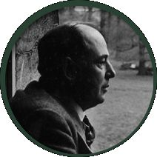
November 22, 1963

Slide 58
Walter Hooper, Hon.D.
Private secretary to Lewis
Literary Executor
Author
Editor of the works of Lewis (19 on my shelves)
Honorary Doctorate from Concordia University Texas (2007)
Heck Sabbatical 2004
The Old Parsonage, Oxford, 2008

Slide 59
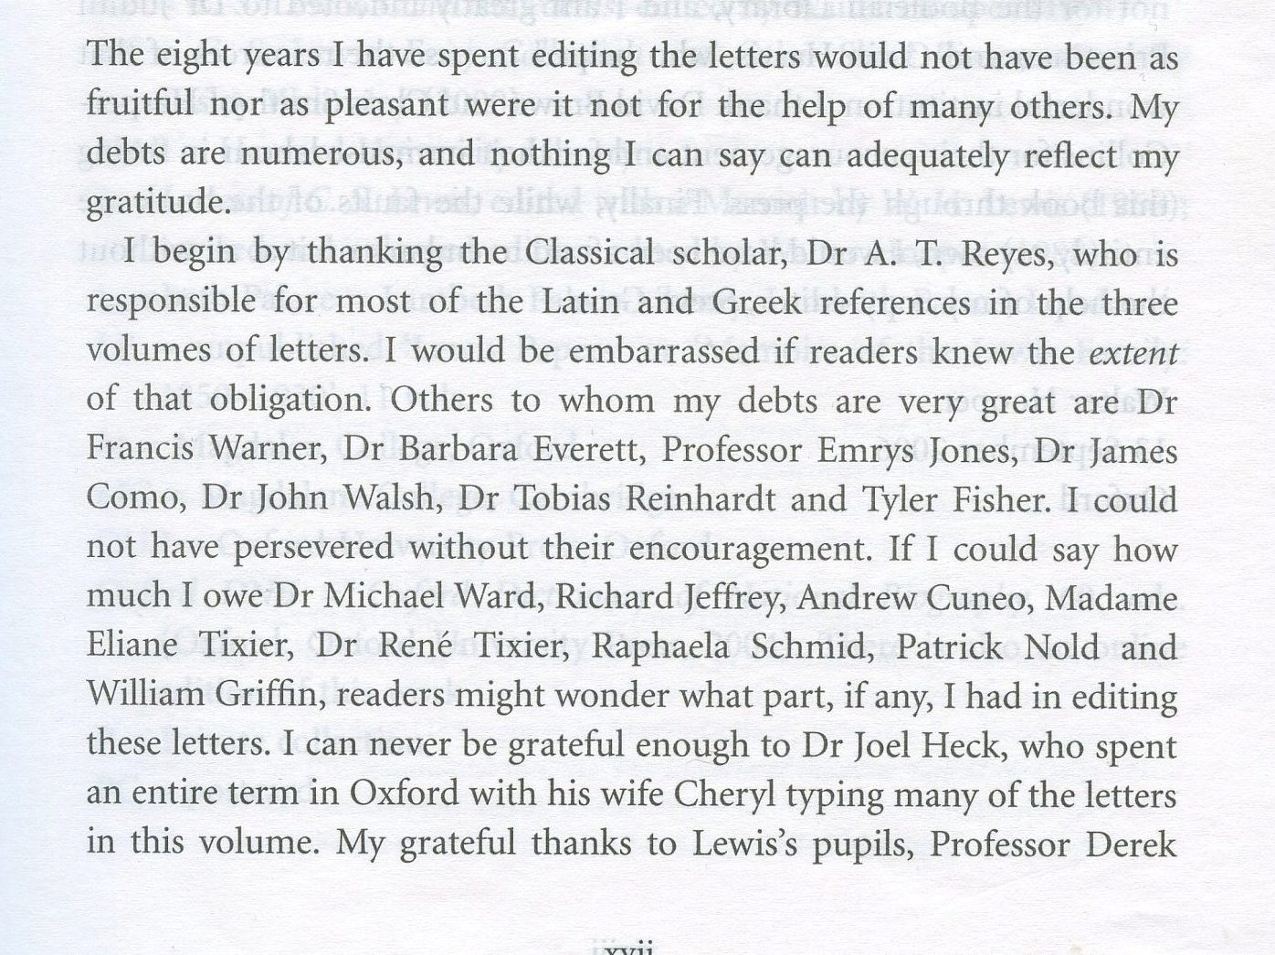
2004 Sabbatical
Preface, page xvii

Slide 60
How he has made an impact
The most frequently quoted (and misquoted) Christian writer today (sermons, conversations, articles, the Alpha course, etc.).
An effective writer in a variety of types of literature whose books have sold more than 250,000,000 copies. The Chronicles of Narnia have sold more than 125 million copies. More than fifty million of all his works in the last ten years!
A master of clarity of thought and the analogy; both left-brained and right-brained.
Produced a significant change in children’s literature through the Chronicles of Narnia.
The single most important influence on the writings of J. R. R. Tolkien.

Slide 61
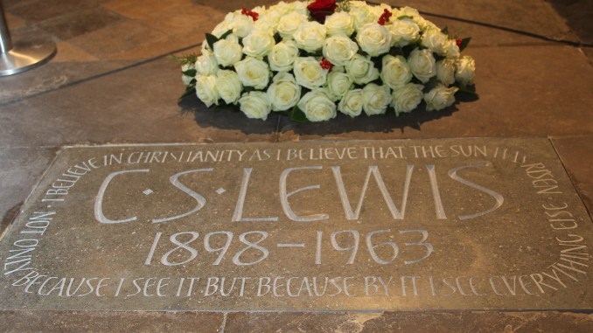
Poets’ Corner, Westminster Abbey

Slide 62
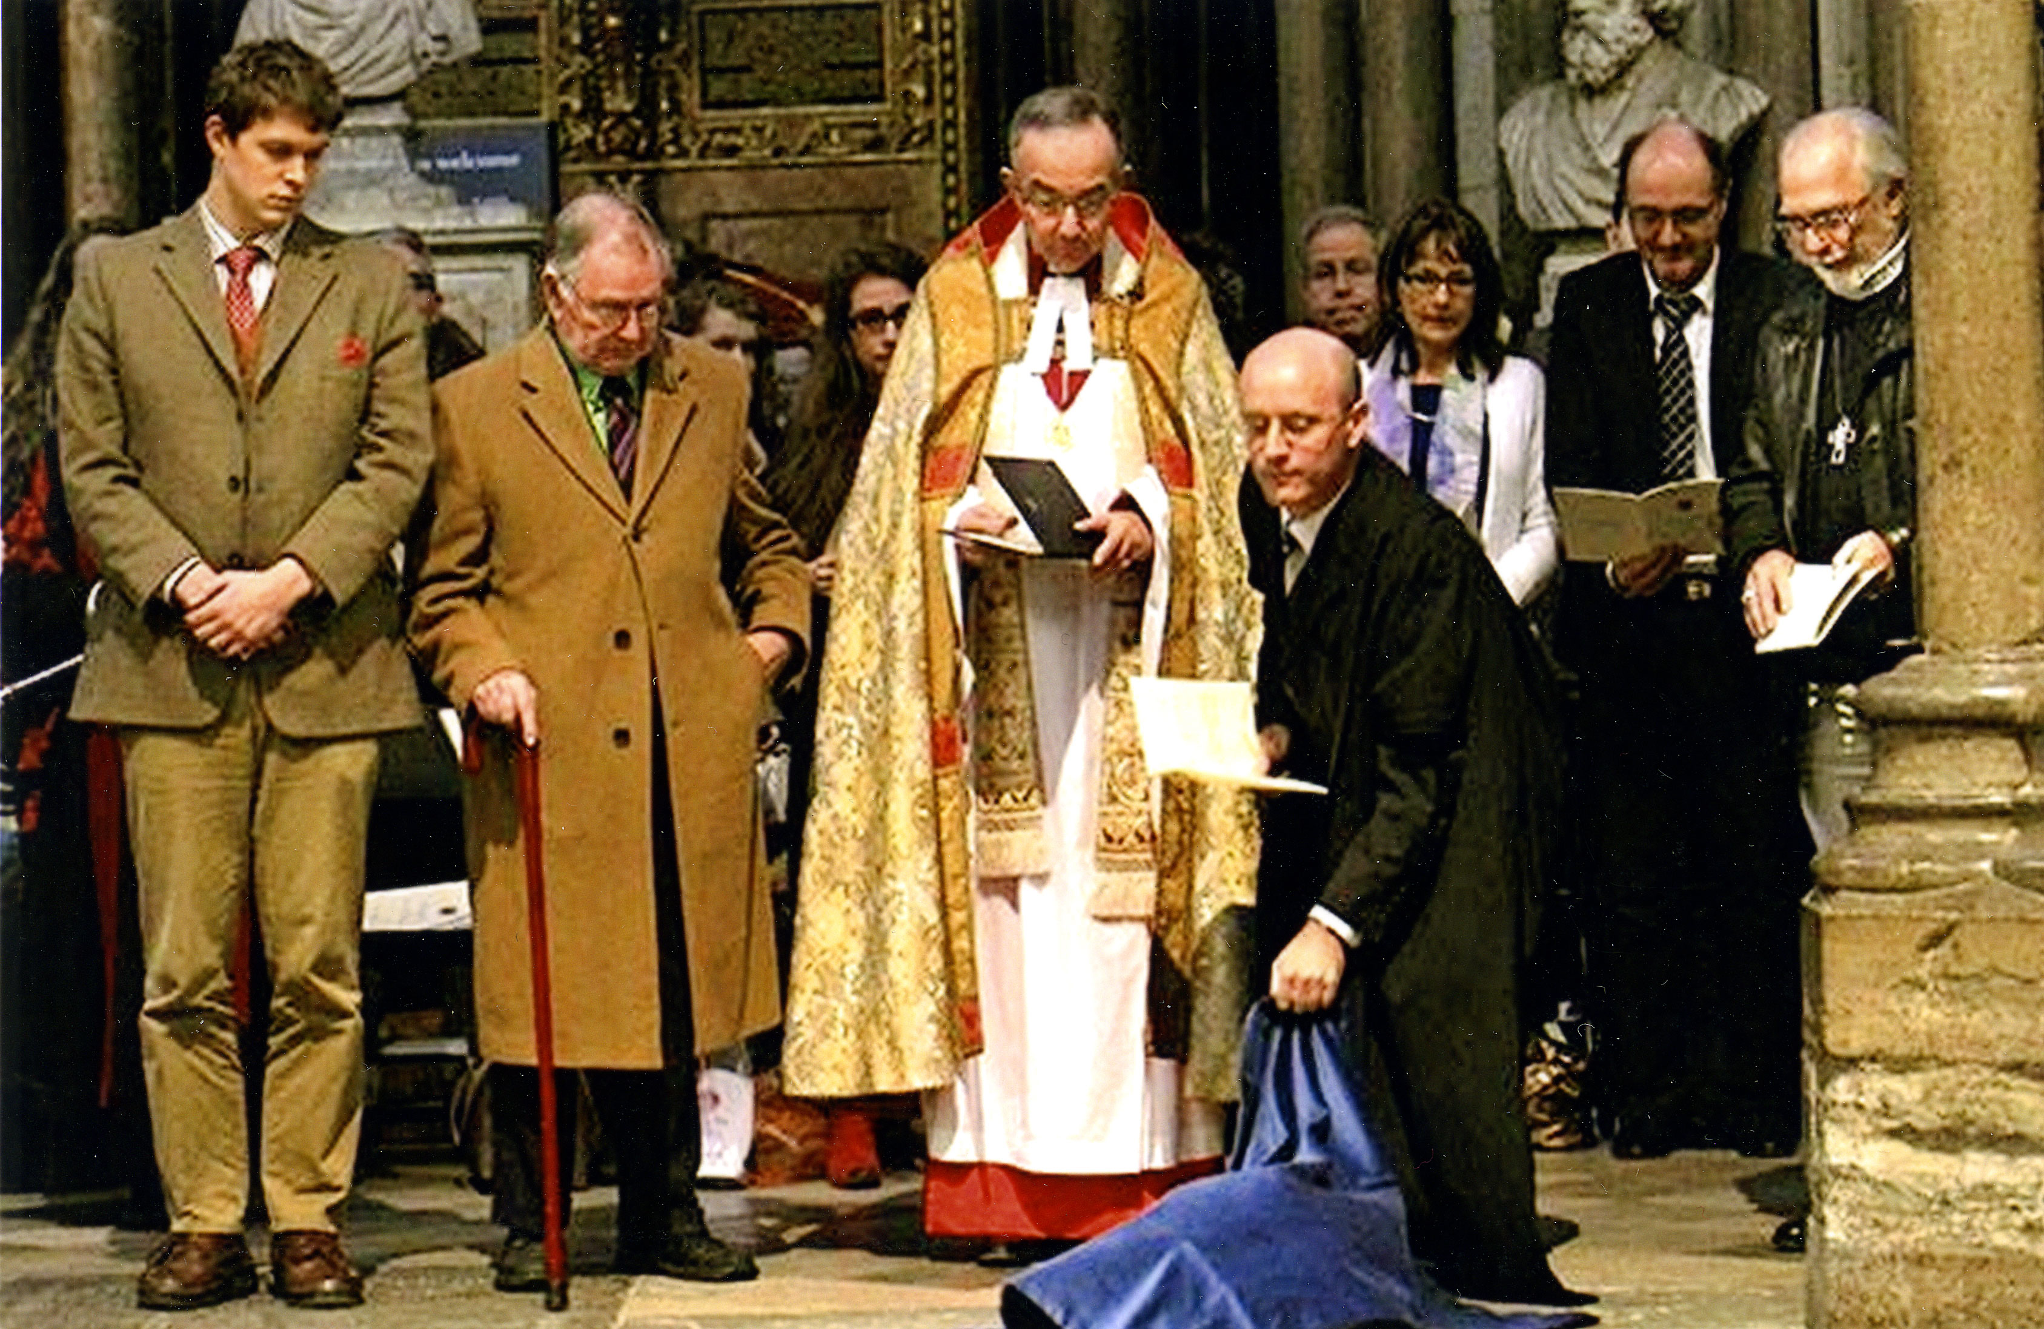
Notes:
Gregory Lippiatt, Walter Hooper, Dean of Westminster Abbey, Michael Ward (and others)

Slide 63
For Everything you want to know …

