Slide 1
From Atheism to Christianity
.
The Story of C. S. Lewis
1912-1931

Slide 2
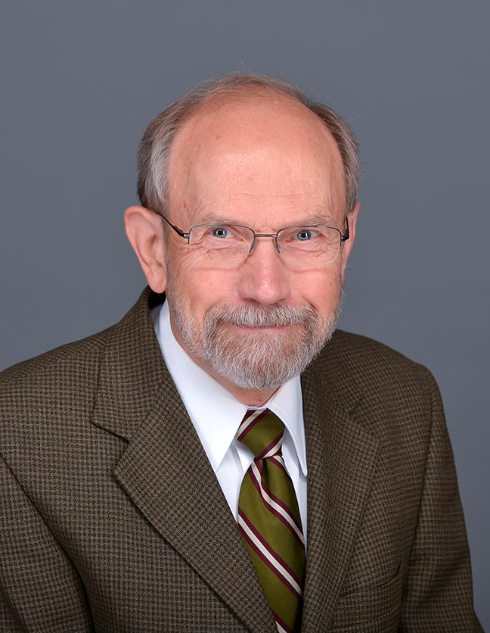
But first …
An idea while at the Wade Center in 2004
I was reading Peter Schakel’s book, Imagination and the Arts in C. S. Lewis: Journeying to Narnia and Other Worlds.
Hope College, Hope, Michigan
In walked Peter Schakel!

Slide 3
Chronologically Lewis
The “go-to” place for historical information …
A fourteen-year project thus far—an estimated 2,500 hours of work
Everything you might want to know about what happened in the life of C. S. Lewis and his brother Warren (and a lot you don’t care to know, but someone else might)
Currently a searchable pdf nearly 1,300 pages, single-spaced
More than 700,000 words
More than 3,800 footnotes
176 resources (bibliography)

Slide 4
Features
Chronological by day, month, and year
Lists the number of entries for each year
Lists the location of each brother at the start of each month
Places in bold type important events
Underlines the name of Jack and Warren the first time they are used in each date
Includes some brief biographical information about many names
Includes the year of publication of many books that Jack read

Slide 5
Features
Contains dates and details of meetings with the Commission to Revise the Psalter
Contains details about the honorary doctorate he received in absentia on October 6, 1962 from the University of Dijon, Dijon, France.
Information about serving for four-and-a-half years on the Council of Westcott House, Cambridge.
The military record of Warren Lewis
The dates that C. S. Lewis signed contracts for Dymer and for The Pilgrim’s Regress

Slide 6
Spin-Offs
From Atheism to Christianity: The Story of C. S. Lewis
No Ordinary People: Fifteen Friendships of C. S. Lewis
“C. S. Lewis Serendipities: Things You Never Knew about Jack and Warren,” CSL: The Bulletin of the New York C. S. Lewis Society, Vol. 47, No. 4, July/August 2016, 1-11,
“The Year of Narnia: 1950,” The Chronicle of the Oxford University C. S. Lewis, Vol. 7, Issue 2, April 2010. (And several similar articles)
Don W. King’s forthcoming biography of Warren Lewis

Slide 7
Atheists Get A Lot of Things Right
There are atheists in foxholes.
Many atheists experience a sense of relief when they adopt atheism.
Many Christians are hypocritical.
Much suffering makes little or no sense (cancer, war, tsunamis, pain, hell as fire).
We need to care for our environment.
Nature is beautiful, but also cruel (extremes in temperature, natural disasters, etc.) and, therefore, hard to reconcile with a good God.
Too often our prayers seem to go unanswered.
Pessimism about death.

Slide 8
The Early Years (1898-1912)
C. S. Lewis grew up in a nominally Christian family.
A childhood lacking the nurture of faith by adults.
Warren Lewis’s comment: “the dry husks of religion.”
“My real life—or what memory reports as my real life—was increasingly one of solitude.”
His early teens: a time (1911-1912) when he experienced genuine Christianity, but lacked mature spiritual guidance, as reflected in this quotation:
Notes:
Bullet Four: The gregarious Lewis in later life was the solitary Lewis in early life.

Slide 9
“Sometimes Fairy Stories May Say Best What’s to be Said”
Quotation 1: “I thought I saw how stories of this kind [such as The Lion, the Witch and the Wardrobe] could steal past a certain inhibition which had paralyzed much of my own religion in childhood. Why did one find it so hard to feel as one was told one ought to feel about God or about the sufferings of Christ? I thought the chief reason was that one was told one ought to. The whole subject was associated with lowered voices; almost as if it were something medical.…”
Notes:
The essay was written in 1956.

Slide 10
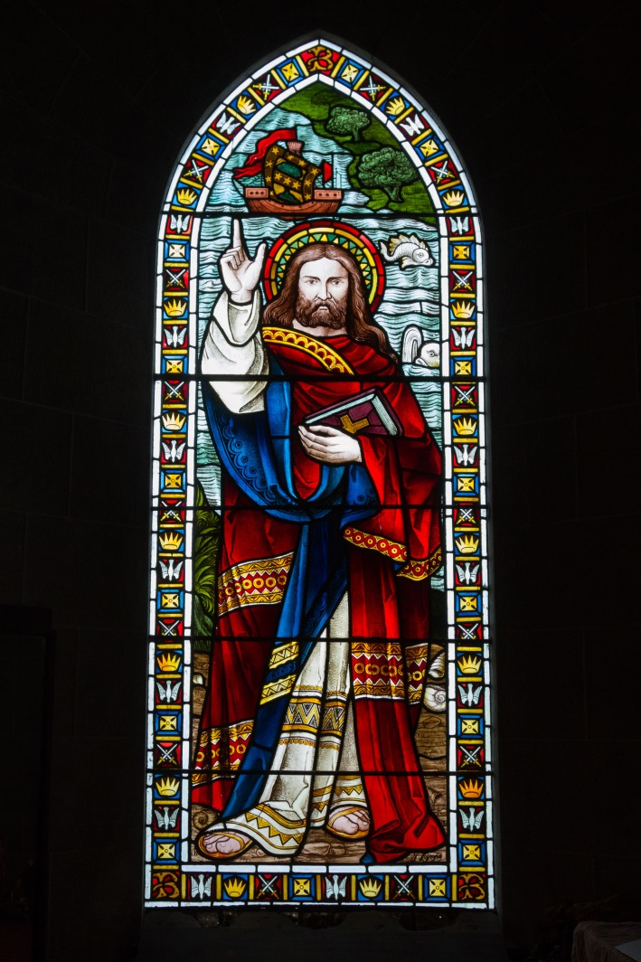
“Sometimes Fairy Stories May Say Best What’s to be Said”
“… But supposing that by casting all these things into an imaginary world, stripping them of their stained-glass and Sunday school associations, one could make them for the first time appear in their real potency? Could one not thus steal past those watchful dragons? I thought one could.”

Slide 11
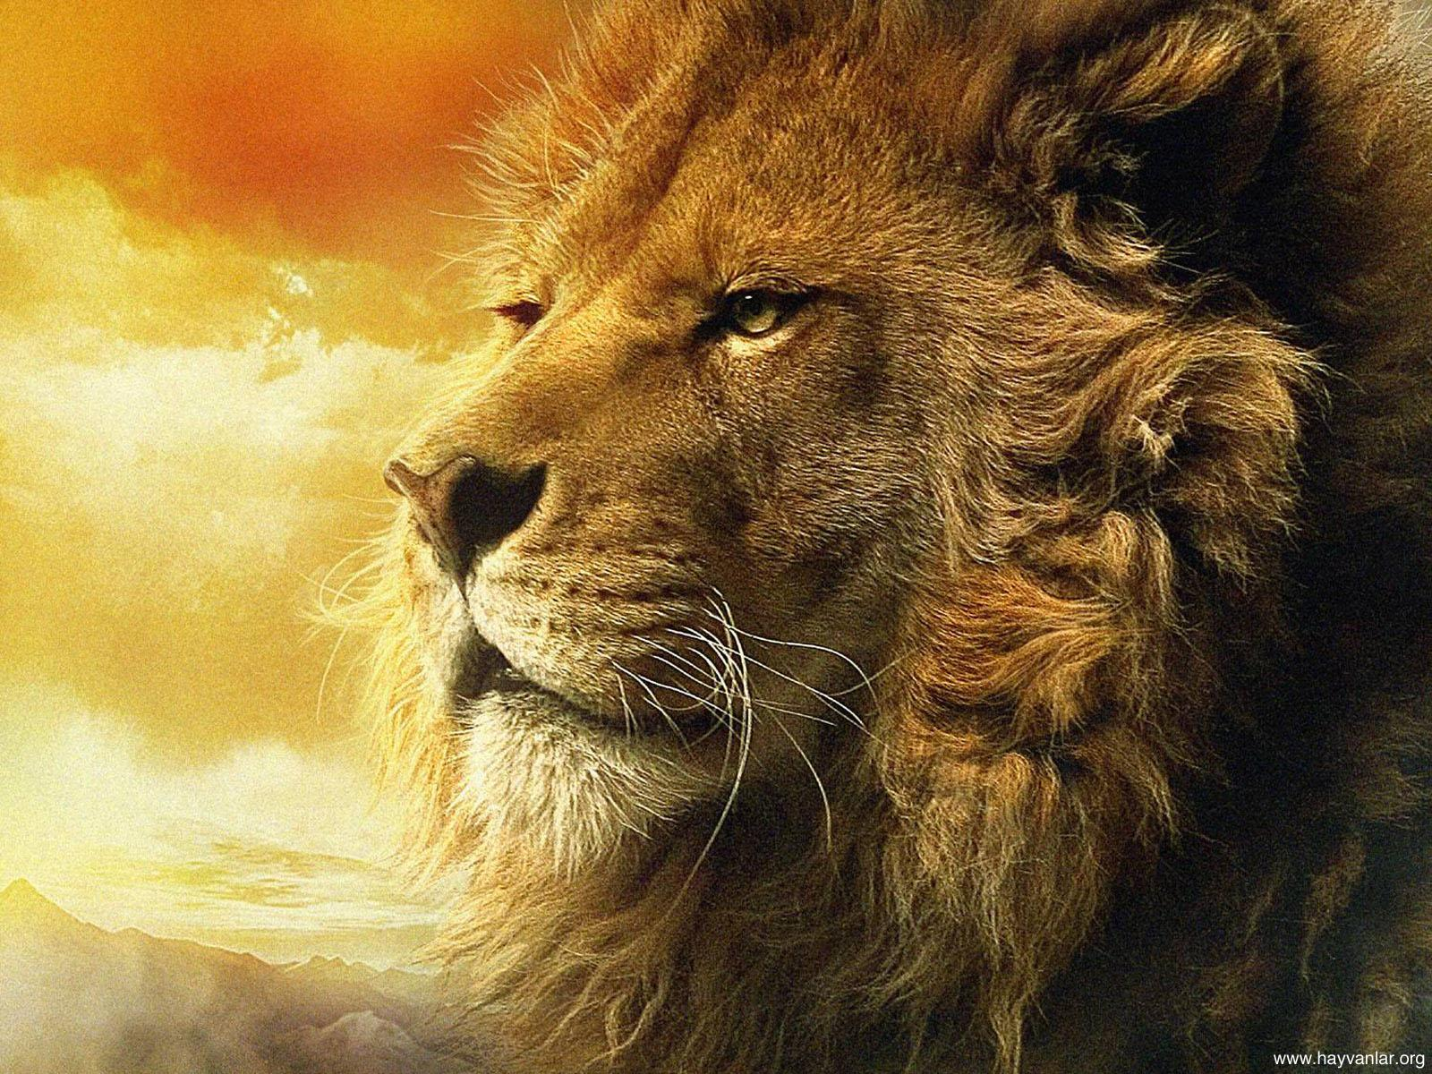
And as one of the results …
… he desired to prevent a similar religious paralysis in children in this way:
Aslan, the lion of Judah (Rev. 5:5)

Slide 12
Major Reasons for Adopting Atheism
Lewis became an atheist in 1912. He later stated why: “The early loss of my mother, great unhappiness at school, and the shadow of the last war and presently the experience of it, had given me a very pessimistic view of existence. My atheism was based on it….”
His Reasons:
The loss of his mother when Lewis was nine years old;
A father who was devastated by her death;
Bad experiences in early schooling;
An impending (“the shadow of”) World War I: an atheist in a foxhole (1917-1918); and
A world with creatures who seemed to enjoy inflicting pain on one another.
Notes:
The letter to Alan Richard Griffiths cited above was written on Dec. 20, 1946 (Collected Letters, Vol. II). Last bullet: The Problem of Pain, p. 2.

Slide 13
A Grief Observed (1961)
Lewis even understood the frustration of the Christian:
“Go to [God] when your need is desperate, when all other help is vain, and what do you find? A door slammed in your face, and a sound of bolting and double bolting on the inside. After that, Silence…. There are no lights in the windows. It might be an empty house. Was it ever inhabited?”
Notes:
Lewis understood the frustrations of atheists, because he had had them as an atheist and even had them as a Christian.

Slide 14
C. S. Lewis, Atheist
Quotation 2: “What mattered most of all was my deep-seated hatred of authority, my monstrous individualism, my lawlessness. No word in my vocabulary expressed deeper hatred than the word Interference.” (Surprised by Joy)
Later, he admitted that during his atheistic years he had entertained “some willful blindness.” (SBJ)

Slide 15
C. S. Lewis, Atheist
“I maintained that God did not exist. I was also very angry with God for not existing. I was equally angry with Him for creating a world.” (1914)
Quotation 3: “All religions, that is, all mythologies to give them their proper name are merely man’s own invention—Christ as much as Loki….” (Letter to Arthur Greeves, 1916)
“Had God designed the world, it would not be
A world so frail and faulty as we see.” (Lucretius, 1919)
Quotation 4: “The trouble about God is that he is like a person who never acknowledges your letters and so in time you come to the conclusion either that he does not exist or that you have got his address wrong” (1921).
Notes:
See SBJ for first quotation. Lucretius: a first-century B.C. Roman poet and philosopher, also an atheist. The fourth quotation was written to Lewis’ brother Warren.

Slide 16
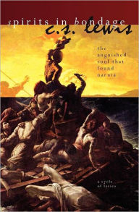
Spirits in Bondage (1919)
Lewis’s first book
Lewis described these poems to Arthur Greeves:
“Mainly strung round the idea that … nature is wholly diabolical & malevolent and that God, if he exists, is outside of and in opposition to the cosmic arrangements.”
He complained about a God he did not believe in!
Ambivalence

Slide 17
The Relief of Atheism
“This ludicrous burden of false duties in prayer provided, of course, an unconscious motive for wishing to shuffle off the Christian faith.” (SBJ)
“And oh, the relief of it!” (SBJ)
“… there was nothing to be obeyed, and nothing to be believed except what was either comforting or exciting.” (SBJ)
Dostoyevsky: If God does not exist, everything is permitted.
Notes:
Fyodor Dostoyevsky, The Brothers Karamazov, Part 4, Book 11, Chapter 4.

Slide 18
The Relief of Atheism
“The materialist’s universe had the enormous attraction that it offered you limited liabilities. No strictly infinite disaster could overtake you in it. Death ended all. And if ever finite disasters proved greater than one wished to bear, suicide would always be possible. The horror of the Christian universe was that it had no door marked Exit.” (SBJ)

Slide 19
C. S. Lewis on Atheism
Lewis wrote of “the good atheist.”
The good atheist denies the existence of God, but is open to hearing an explanation of suffering.
In addition, as a Christian, Lewis admitted that there were times when he doubted the truths of the Christian faith he had just defended, just as there had been times when, as an atheist, he had similar doubts about his atheism. He had been a good atheist! Here is the quote:
“Now that I am a Christian I do have moods in which the whole thing looks very improbable: but when I was an atheist I had moods in which Christianity looked terribly probable.”
Notes:
“the good atheist”: C. S. Lewis, “De Futilitate,” Christian Reflections, Grand Rapids: Eerdmans, 1967, 70. Latter quote from Mere Christianity.

Slide 20
The Journey to Christianity
1916-1931

Slide 21
Overview: The Chess Moves of God
The loss of Lewis’s first bishop
The loss of Lewis’s second bishop
Check
Checkmate

Slide 22
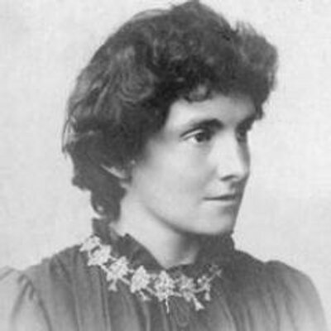
However, before God’s first move …
The children’s books of Edith Nesbit and Beatrix Potter
The music of Richard Wagner (1911)
W. B. Yeats’ other-worldly poetry (from 1914)
The captivating novels of William Morris, especially The Well at the World’s End, that created a sense of longing, which he called Joy (1914)
Edith Nesbit

Slide 23
As well as …
The compelling romance of Sir Thomas Malory’s King Arthur and the Knights of the Round Table
The beauty (and cruelty) of nature: “How can it be so beautiful and also so cruel, wasteful and futile?” (SBJ)

Slide 24
The Journey Begins
On March 4, 1916, Lewis found and read George MacDonald’s fairy story, Phantastes, which baptized his imagination.
He read the poet William Wordsworth (1918).
G. K. Chesterton (first in 1918)
He read Henri Bergson in 1918 (purpose).
And all the other authors mentioned earlier, Yeats, Malory, Wordsworth, MacDonald, etc.

Slide 25
We Have Cause to be Uneasy
Already an atheist, as he returned from the war to Oxford University in 1919 he resolved to be a consistent materialist, who believed in …
“atoms and evolution and military service.”
However, many of his friends believed in the supernatural, people like Nevill Coghill.
Many of the authors he read were Christian, and the atheist authors seemed to him rather thin.
His good friends Barfield and Harwood adopted Anthroposophy in 1923, which unsettled him.
Notes:
“We Have Cause to be Uneasy” is the title of Book I, Chapter 5, Mere Christianity

Slide 26
The First Move
The loss of his first bishop: Lewis read Euripides’ Hippolytus
Date: March 6, 1924
A retreat from materialism, which was already shaky, and the return of Joy (longing)
Notes:
Especially in reading literature, listening to music, and enjoying the world of nature. Was this his adoption of absolute idealism? Probably.

Slide 27
Euripides’ Hippolytus (428 B.C.)
A myth about Theseus, king of Athens, and his son Hippolytus:
“Oh God, bring me to the end of the seas
To the Hesperides, sisters of evening,
…
Let me escape to the rim of the world
Where the tremendous firmament meets
The earth, and Atlas holds the universe
In his palms.”
27/54
Notes:
See The Lewis Papers VIII: 191, where Lewis states that this was what he was reading at the time.

Slide 28
The Second Move
The loss of his second bishop: Lewis reads Samuel Alexander’s Space, Time and Deity.
Date: March 8, 1924
This book distinguished between “enjoyment” and “contemplation.”

Slide 29
Enjoyment vs. Contemplation
Experiencing something vs. thinking about it, such as the difference between driving a car and reading a book about driving a car. You “enjoy” driving a car, but you “contemplate” the car by reading a book about driving.
Or the difference between being in love (enjoyment) and studying the emotion of love (contemplation).
He had previously thought that he just wanted to “enjoy” the Joy, or desire, or longing (the emotional experience).
As he “contemplated” the desire, it disappeared so he now saw Joy as a pointer to something else.

Slide 30
Pointers
Nature as a channel through which Joy comes rather than the thing itself.
That’s why we stand in awe before the vast night skies (Ps. 19:1).
Likewise beauty as a means …
Great music, great poetry, and art as means …
Also mythical story (Malory, Wordsworth, etc.)
As well as “… moral action, and … knowing.”
And human love and travel
Notes:
On nature and art as pointers: CL, III, 583f. On travel: see Mere Christianity, III, Chapter 10 (p. 135).

Slide 31
About Pointers
“It was not in them, it only came through them, and what came through them was longing.” (“The Weight of Glory”)
“If they are mistaken for the thing itself they turn into dumb idols.”
“For they are not the thing itself; they are only the scent of a flower we have not found, the echo of a tune we have not heard, news from a country we have never yet visited.”
Notes:
“it was not in them, it only came through them, and what came through them was longing.” From “The Weight of Glory.” On “spilled religion” see C. S. Lewis, “Christianity and Culture,” 23, n. 1. See also Gal. 3:24-26 in the King James Version.

Slide 32
About Pointers
He even described these experiences as “spilled religion” and certain aspects of culture as schoolmasters and as roads into Jerusalem.
He began to ask, “To what does Joy point?”
He was no longer searching for a subjective state of mind, but for something outside himself.
Notes:
“it was not in them, it only came through them, and what came through them was longing.” From “The Weight of Glory.” On “spilled religion” see C. S. Lewis, “Christianity and Culture,” 23, n. 1. See also Gal. 3:24-26 in the King James Version.

Slide 33
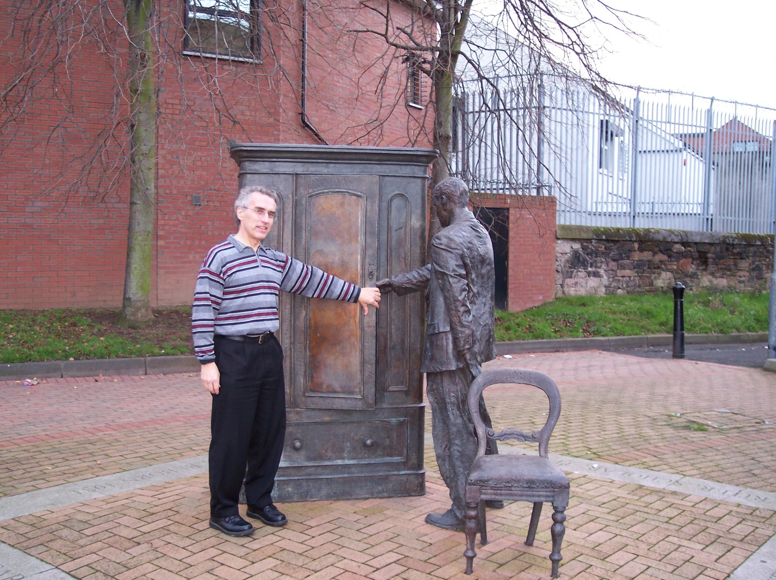
Notes:
In the fall of 2004 during my Oxford sabbatical. Statuary erected in 1998 on the hundredth anniversary of Lewis’s birth.

Slide 34
Between the second and third moves
In the 1924-1925 school year, Lewis taught philosophy for E. F. Carritt and had to teach Idealism, which stated that there was a Mind behind the universe, which he called “the Absolute.”
In 1925, Lewis became a Fellow of Magdalen College.
By August, he had set aside the evolutionism of Charles Darwin and Herbert Spencer as based “on a foundation of sand; of gigantic and irreconcilable contradictions an inch below the surface.”
Notes:
Collected Letters, I, 649. The date of the letter on Darwin and Spencer is August 14.

Slide 35
Words, Weldon, and Whiskey
Shortly thereafter, “… I had not long finished The Everlasting Man when something far more alarming happened to me. Early in 1926 the hardest boiled of all the atheists I ever knew sat in my room on the other side of the fire and remarked that the evidence for the historicity of the Gospels was really surprisingly good.”
Quotation 5: On April 27, 1926, T. D. Weldon said, “Rum thing … All that stuff of Frazer’s about the Dying God. Rum thing. It almost looks as if it had really happened once.”
Notes:
SBJ, 223f.

Slide 36
Words, Weldon, and Whiskey
Lewis: “To understand the shattering impact of it, you would need to know the man (who has certainly never since shown any interest in Christianity). If he, the cynic of cynics, the toughest of the toughs, were not—as I would still have put it—‘safe,’ where could I turn? Was there then no escape?”
Notes:
SBJ, 223f.

Slide 37
As a result, Lewis reexamined the New Testament Gospels, especially the Gospel of John.
“The Great War” with Owen Barfield about the nature of truth and the role of the imagination
The death of Albert Lewis on September 25, 1929, whom he and his brother Warren had treated abominably
Remorse over the way he had treated his father, and even more so a year later when he saw how lovingly a friend treated his own father

Slide 38
A “zoo of lusts” experience, especially his pride—January 1930
Later he would write that spiritual sins are far worse than the sins of the flesh and state that a prostitute might be far closer to heaven than a self-righteous prig who regularly attends church. (Mere Christianity)

Slide 39
Unbuckling
Probably on January 30, 1930.
“I was going up Headington Hill on the top of a bus.”
“I was holding something at bay.”
A choice: unbuckle the armor or keep it on.
He chose to unbuckle, a completely free choice.
Then a melting at the imaginative level.
Similar to the decision to apologize or stand my ground when I know I am wrong.

Slide 40
Sidebar: Alan Griffiths
Lewis’s former student (1927-1929) and “chief companion” on the road to faith.
Because of the long-standing “Great War” between Owen Barfield and Lewis, Lewis wrote a defense of his Idealist position.
He lent this defense to Griffiths in 1928, and that defense convinced Griffiths to become an Idealist, which holds that there is a Mind behind the universe.
Griffiths was also an atheist who was taking the same steps Lewis was taking at this time.

Slide 41
The Third Move
Check: Lewis connected his idea of Joy with the Absolute
Date: February 3, 1930
Lewis wrote to Owen Barfield: “Terrible things are happening to me. The ‘Spirit’ or ‘Real I’ is showing an alarming tendency to become much more personal and is taking the offensive, and behaving just like God. You’d better come on Monday at the latest or I may have entered a monastery.”
41/54

Slide 42
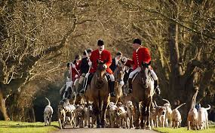
From Chess Game to a Fox Hunt
“The fox had been dislodged from Hegelian Wood and was now running in the open.”
In other words, Lewis (the fox) could no longer hide in the woods (confusion) of Hegel’s Idealism.
Shortly after the unbuckling.

Slide 43
The Fourth Move
Checkmate: Lewis connected “the Absolute” (the Mind in Idealism) with a personal God
Date: early June 1930
“The same year and the same month I learned an art which I had been trying to learn since boyhood. I learned how to dive.”
Notes:
At some point during the first six days of June. See “Early Prose Joy.”

Slide 44
Chess Game, Fox Hunt, and Fishing
One more analogy:
“And so the great Angler played His fish and I never dreamed that the hook was in my tongue.”
In each analogy, God is the Initiator.
Notes:
Lutheran theology: God is the Initiator. “I Was Decided Upon.” Sherwood Wirt, Decision magazine, 1963.

Slide 45
Lewis on Idealism
A philosophy that “… enabled one to get all the conveniences of Theism, without believing in God.”
The Absolute was impersonal and, therefore, expected nothing.
“The emotion that went with all this was certainly religious. But this was a religion that cost nothing. We could talk religiously about the Absolute; but there was no danger of Its doing anything about us … There was nothing to fear, better still nothing to obey.”
“And my watered Hegelianism wouldn’t serve for tutorial purposes. A tutor must make things clear.”

Slide 46
Surprised by Joy, “Checkmate”
Quotation 6: “You must picture me alone in that room in Magdalen, night after night, feeling, whenever my mind lifted even for a second from my work, the steady, unrelenting approach of Him whom I so earnestly desired not to meet. That which I greatly feared had at last come upon me. In the Trinity Term of 1929 [1930] I gave in, and admitted that God was God, and knelt and prayed: perhaps, that night, the most dejected and reluctant convert in all England….”
Notes:
This seems to me to be very much against the Freudian depiction of theism as wishful thinking.

Slide 47
Surprised by Joy, “Checkmate”
“… I did not then see what is now the most shining and obvious thing; the Divine humility which will accept a convert even on such terms. The Prodigal Son at least walked home on his own feet. But who can duly adore that Love which will open the high gates to a prodigal who is brought in kicking, struggling, resentful, and darting his eyes in every direction for a chance of escape?”
Lewis had become a theist … reluctantly.

Slide 48
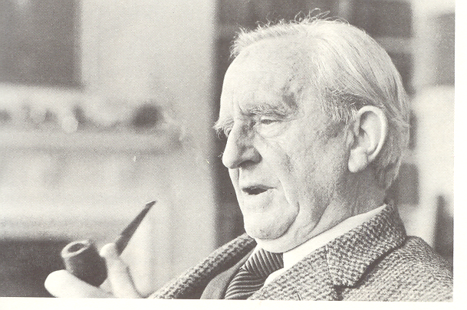
The Midnight Conversation
J. R. R. Tolkien, Hugo Dyson, and C. S. Lewis
September 19, 1931
Myth as “a real though unfocused gleam of divine truth falling on human imagination.”
The historical nature of the Gospels
A myth that really happened in history
Not “lies breathed through silver”
J. R. R. Tolkien
Notes:
Some think the “lies breathed through silver” was stated on Addison’s Walk, i.e., Sept. 19, 1931.

Slide 49
The Last Step: Christianity
September 28, 1931
On this date, the Lewis brothers traveled to the Whipsnade Zoo in Warren’s motorcycle. This was the day when Lewis rode in Warren’s sidecar to the zoo. He later wrote,
“When we set out I did not believe that Jesus Christ is the Son of God, and when we reached the zoo I did…. It was more like when a man, after long sleep, still lying motionless in bed, becomes aware that he is now awake.” (SBJ)
Notes:
Perhaps it was Warren’s driving!

Slide 50
The “Daudel”: an A. J. S. Combination
Notes:
Purchased from Longman’s in Salisbury while Warren was stationed with the RASC in Bulford, eight miles northeast of Salisbury.

Slide 51
Summary
Lewis’s reasons for atheism were genuine, though with some “willful blindness,” i.e. pride.
He expressed uncertainty about his atheism, especially later in his atheistic period.
His road to Christianity was long and complicated.
The books he read and the friends he made influenced him a great deal.

Slide 52
Summary
He realized that he had been working hard to keep God out.
After his father’s death, he finally saw his need for God when he saw his own disrespectful behavior toward his father and recognized the “zoo of lusts” inside him.
He unbuckled, adopting an attitude open to considering truth.
He had used Idealism as a way of avoiding a personal God.
God reached out to him, he did not reach out to God.

Slide 53
Therefore
Lewis was a genuinely convinced atheist, even a “good atheist.”
He was an intellectually honest scholar, willing to face and consider contrary evidence.
Lewis’ atheism and his intellectual honesty are two reasons for his effectiveness as a writer, leading to an approximate 250,000,000 copies of his books being sold. He was able to write about the atheism he had once believed.
His experience gives us insight into understanding atheists and appreciation for many of them. And a message that we can share with them.
Many Christians are former atheists, and God still speaks to atheists today.

Slide 54
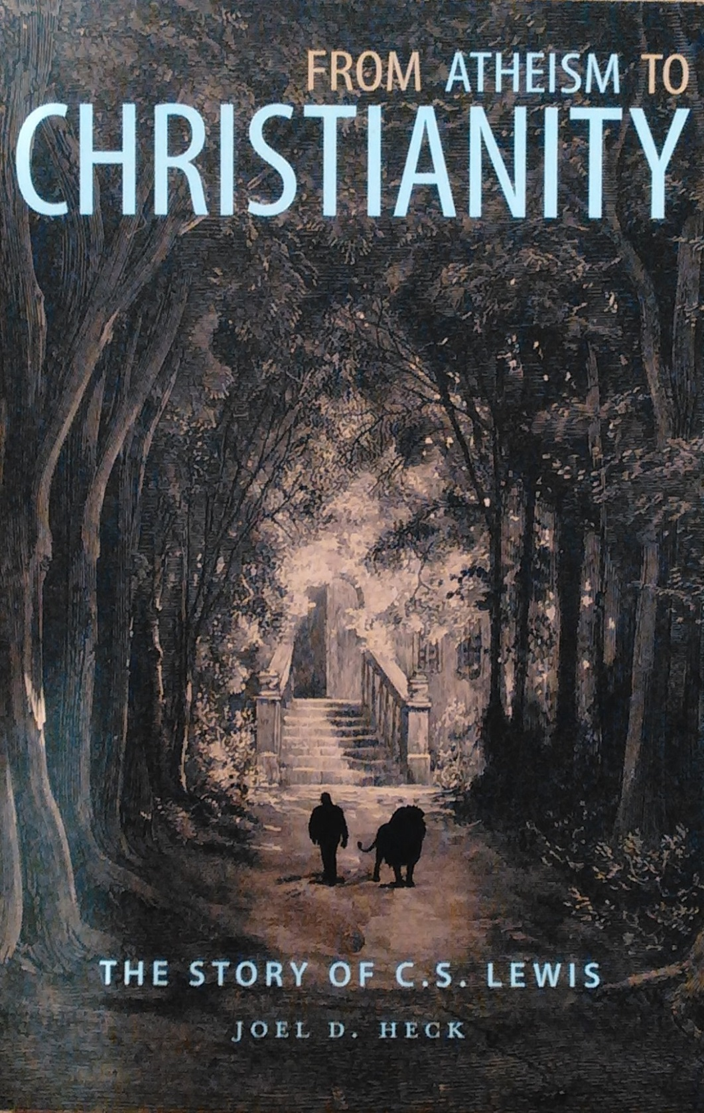
www.joelheck.com
I brought a few copies.
Notes:
Released on Jan. 17, 2017. Cite www.joelheck.com.

