Slide 1
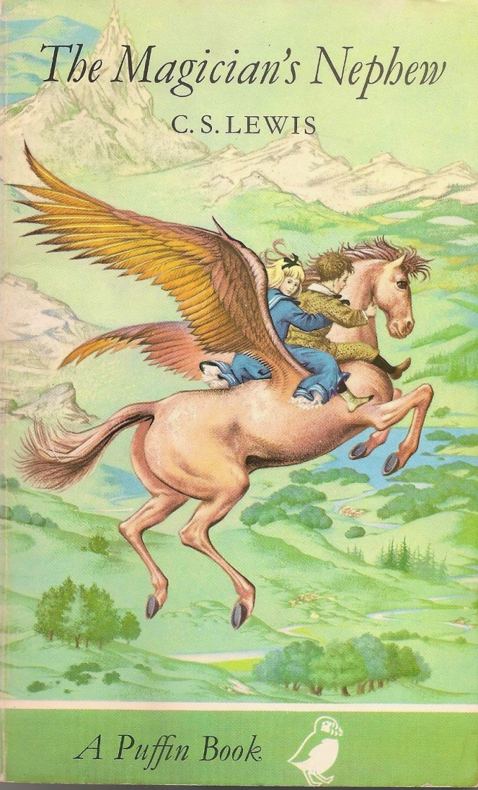
The Magician’s Nephew
Kathryn Lindskoog’s theme:
From weakness to power

Slide 2
“Variation in Shakespeare and Others”
“Shakespeare behaves rather like a swallow. He darts at the subject and glances away; and then he is back again before your eyes can follow him. It is as if he kept on having tries at it, and being dissatisfied. He darts image after image at you and still seems to think that he has not done enough. He brings up a whole light artillery of mythology, and gets tired of each piece almost before he has fired it. He wants to see the object from a dozen different angles; if the undignified word is pardonable, he nibbles, like a man trying a tough biscuit now from this side and now from that.”
Notes:
C. S. Lewis in an essay in Selected Literary Essays. Ca. 1936. This is how Lewis writes in The Magician’s Nephew.

Slide 3
Lewis and Other Worlds
William Morris’s The Well at the World’s End (read in 1914)
William Morris’s The Wood beyond the World (read at least by 1932)
An essay collection entitled Of Other Worlds (1966)
Narnia itself
A great deal of literature: Malory, Spenser, MacDonald, Yeats, etc.

Slide 4
Lewis and Other Worlds
The Ransom Trilogy is about journeys to Mars and Venus.
And here in The Magician’s Nephew: The Wood between (not “beyond”) the Worlds, plus Charn and Narnia
“But suddenly it flashed upon his mind that he now knew … that there really were other worlds and that he himself had been in one of them. At that rate there might be a real Land of Youth somewhere. There might be almost anything.”

Slide 5
The Plot
The story begins in 1900 in London.
Polly Plummer meets Digory Kirk, who has come with his mother to live with his Aunt Letty and Uncle Andrew.
Digory’s mother is very ill and near death.
They get into Uncle Andrew’s room and find him doing magic.
He had received some magic dust from Mrs. Lefay, whose name means “the fairy,” before she died. Uncle Andrew had turned the dust into two sets of yellow and green rings.

Slide 6
The Plot
Uncle Andrew tricks Polly into taking a magic ring, which transports her to another world.
Digory is forced to go after her with a second set of rings.
Digory finds himself in a “wood between the worlds” with entrance possible into many other worlds through pools of water.

Slide 7
The Plot
Digory finds Polly, and they decide to explore other pools.
They end up in Charn, a dying world, where they meet the last Queen, Jadis, of that world in suspended animation.
Digory wakens her.

Slide 8
The Plot
They put on their rings and return to the wood between the worlds and then to London.
They discover that the witch had grabbed one of them and had come along with them.
She meets Uncle Andrew and demands transportation.

Slide 9
The Plot
Uncle Andrew orders a horse and carriage for the witch.
She wreaks havoc, tearing off a piece of lamppost as a weapon, until Digory grabs her and puts on his ring.
Digory, Polly, the witch, Uncle Andrew, the horse Strawberry, and the cabby end up in Narnia while it is being created.
Aslan sings Narnia into existence, creating talking animals.

Slide 10
The Plot
The witch throws the lamppost at Aslan, it bounces off, sticks in the ground, and begins to grow.
She runs into the woods.
Digory asks Aslan to help his sick mother.
The animals mistake Uncle Andrew for a tree and plant him.

Slide 11
The Plot
Aslan calls the cabby’s wife from London and makes them the first king and queen of Narnia.
Aslan sends Digory on a quest to bring an apple back from the Western Wild so he can plant a tree to protect Narnia.

Slide 12
The Plot
Digory rides Strawberry, who becomes Fledge, a flying horse, and Polly goes with him.
They come to a green hill with a garden on top.
He is tempted to eat an apple.
“But I think Digory would not have taken an apple for himself in any case. Things like ‘Do not Steal’ were, I think, hammered into boys’ heads a good deal harder in those days than they are now.”
The witch tempts Digory, but he resists.

Slide 13
The Garden and the Apple
Come in by the gold gates or not at all,
Take of my fruit for others or forbear.
For those who steal or those who climb my wall
Shall find their heart’s desire and find despair.
Notes:
The right tree is in the center of the garden. “There, on a branch above his head, a wonderful bird was roosting…. The tiniest slit of one eye was open.” According to one website, the peacock is a symbol of integrity. In history and legend, it carries portents of nobility, holiness, guidance, protection, and watchfulness. “In Christianity the Peacock symbolism represents the ‘all-seeing’ church, along with the holiness and sanctity associated with it. Additionally, the Peacock represents resurrection, renewal and immortality within the spiritual teachings of Christianity.”

Slide 14
The Plot
They return to Aslan and plant the tree, which grows rapidly.
Aslan crowns King Frank and Queen Helen.
Aslan sends Digory to pluck an apple to take home to his mother.
Aslan sends Digory, Polly, and Uncle Andrew back to London, and they arrive at the same time they left.
Digory feeds his mother the apple, and she recovers.

Slide 15
The End of the Plot
Digory buries the apple core in the backyard, and it results in an apple tree.
Digory and Polly bury the magic rings in a circle around the apple tree.
Years later a storm blows down the apple tree, and they make a wardrobe from its wood.

Slide 16
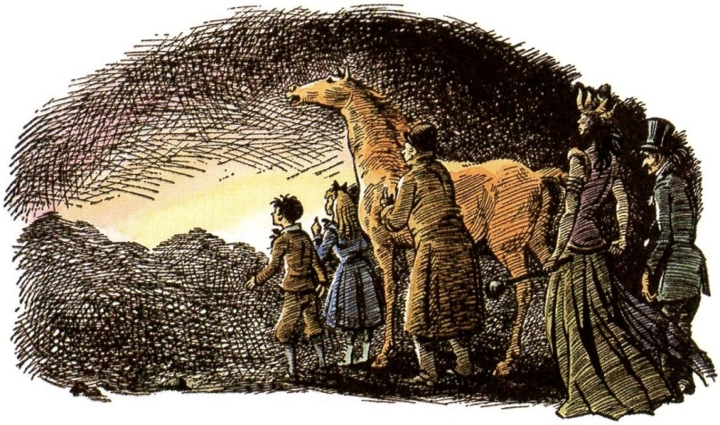
What Origins? (At least 14 of them)

Slide 17
The Origins (or First Mention) of . . .
Narnia (with similarities to the Genesis account of creation, such as the creation of light, a tree, temptation, the promise of many children), including some geography
The White Witch
Evil in Narnia (human responsibility for the fall)
The lamppost
Talking animals
The idea that talking animals can return to the Dumb Beasts (TLB)
The wardrobe
Professor Kirke
The professor’s house
Aslan
Monarchy
Fauns, Satyrs, Dwarfs, etc.
Wood gods, river gods
The prophecy of the children

Slide 18
Insightful Quotations
About Uncle Andrew: “For what you see and hear depends a good deal on where you are standing: it also depends on what sort of person you are.”
About Uncle Andrew: “Now the trouble about trying to make yourself stupider than you really are is that you very often succeed.”
Uncle Andrew: “But what about me? They don’t seem to think of that. No one thinks of me.”
“A dozen different things that he might say flashed through Digory’s mind, but he had the sense to say nothing except the exact truth.”
Aslan: “And as Adam’s race has done the harm, Adam’s race shall help to heal it.”
Notes:
The last quotation appears when Aslan asks Digory to tell the animals how the witch came to be in Narnia.

Slide 19
Late in the Story
“But please, please—won’t you—can’t you give me something that will cure Mother?” Up till then he had been looking at the Lion’s great front feet and the huge claws on them; now, in his despair, he looked up at its face. What he saw surprised him as much as anything in his whole life.”

Slide 20
Late in the Story
“For the tawny face was bent down near his own and (wonder of wonders) great shining tears stood in the Lion’s eyes. They were such big, bright tears compared with Digory’s own that for a moment he felt as if the Lion must really be sorrier about his Mother than he was himself.”

Slide 21
And a couple of lighter moments …
Digory, speaking of the countries that will eventually exist: “And then they’ll have histories, you know.”
Polly: “Well, it’s a jolly good thing they haven’t now because nobody can be made to learn it. Battles and dates and all that rot.”
When Digory, Polly, and Fledge had stopped on their errand and were going to eat some toffee: “Some grownups (you know how fussy they can be about that sort of thing) would rather have gone without supper altogether than eaten those toffees.”
“The Bear was especially kind.” (to Uncle Andrew)

Slide 22
And a few more
“We are the Empress Jadis.”
“Ho! Hempress, are you? We’ll see about that,” said a voice. Then another voice said, “Three cheers for the Hempress of Colney ‘Atch.”
Colney Hatch: Friern Hospital was a psychiatric hospital in Colney Hatch in what is now the London Borough of Barnet.
The Cabby sings: “He had a fine voice and the children joined in; it was very cheering. Uncle Andrew and the Witch did not join in.”
“Oh, I don’t mind two, not when they’re little ones,” said Fledge. “But I hope the Elephant doesn’t want to come as well.”

Slide 24
Fledge
We talked about Lewis’ facility with language. Why does he rename Strawberry as Fledge?
“fledge” comes from Middle English “flegge,” Old English “fleogan” to fly, verb, of a bird (1566): to acquire the feathers necessary for flight. 1. to rear until ready for flight or independent activity, 2. to cover with or as if with feathers or down, 3. to furnish (as an arrow) with feathers. (Webster's 9th New Collegiate Dictionary)

Slide 26
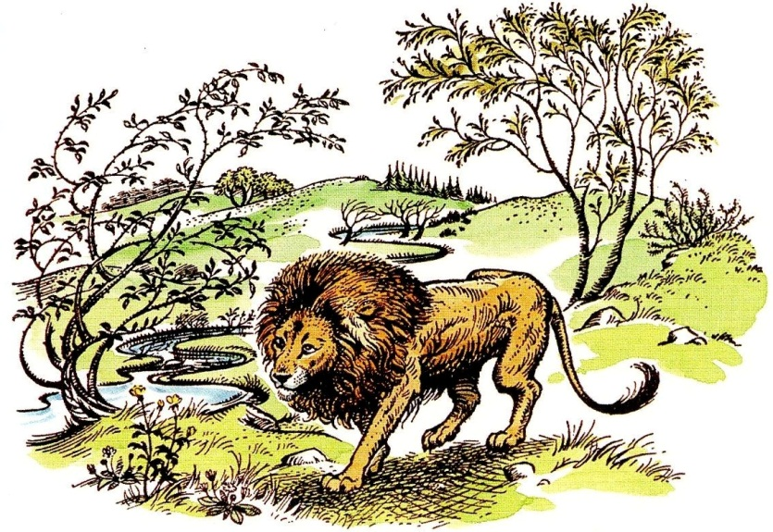
Biblical Theme I: Aslan’s Song
For the Witch and Uncle Andrew an ominous dread.
For the others shock and thrill.
Tolkien’s Ilúvatar began Middle Earth with a song.
Gen. 1:27
Job 38:4-7
Rom. 11:36

Slide 27
Biblical Theme I: Aslan’s Song
From the end of Chapter IX, “The Founding of Narnia”:
“Far overhead from beyond the veil of blue sky which hid them the stars sang again: a pure, cold, difficult music.”

Slide 28
Biblical Theme II: All Get What They Want
Aslan, “That is what happens to those who pluck and eat fruits at the wrong time and in the wrong way. The fruit is good, but they loathe it ever after.”
“All get what they want; they do not always like it.”

Slide 29
Biblical Theme II: All Get What They Want
Unlike the Witch, Digory would get what he wanted and he would like it!
Gen. 3:4-5
Prov. 14:12
Deut. 30:19-20
“There are only two kinds of people in the end: those who say to God, ‘Thy will be done,’ and those to whom God says, in the end, ‘Thy will be done.’”

Slide 30
Discussion Questions
What does the garden on the high hill remind you of?
How does Digory learn the importance of honesty and confession of sin?
How does Digory learn obedience? How does Digory’s choice result in greater blessing than a selfish choice would have brought?

Slide 31
Discussion Questions
What are the five things that Aslan expects of the cabby and his wife as the first King and Queen of Narnia? See the end of Chapter XI, “Digory and His Uncle in Trouble.”
What was Aslan’s reaction when he heard of the illness of Digory’s mother?
End of Chapter XIII, “An Unexpected Meeting”: “… but whenever he remembered the shining tears in Aslan’s eyes he became sure.”
Chapter XIV, “The Planting of the Tree”: first page, “This time he found he could look straight into the Lion’s eyes.” Why?
(1) Grow food, (2) rule fairly, (3) raise family, (4) no favorites, (5) fight enemies
“great shining tears”
Notes:
Third bullet occurs as Digory and Polly head toward the garden on a hill.

Slide 32
Moral Development, Negatively
Uncle Andrew, “Men like me who possess hidden wisdom, are freed from common rules just as we are cut off from common pleasures. Ours, my boy, is a high and lonely destiny.”
Queen Jadis, “You must learn, child, that what would be wrong for you or for any of the common people is not wrong in a great Queen such as I. The weight of the world is on our shoulders. We must be freed from all rules. Ours is a high and lonely destiny.”

Slide 33
Moral Development, Positively
Polly watches her manners: “’At any rate I do wash my face,’ said Polly. ‘Which is what you need to do; especially after—’ and then she stopped. She had been going to say ‘After you’ve been blubbing,’ but she thought that wouldn’t be polite” (Chapter I).

Slide 34
Narnia for Adults
“like a pantomime demon coming up out of a trap door” refers to a theatrical prop in an on-stage production
Uncle Andrew of Mrs. Lefay, “She had got to dislike ordinary, ignorant people, you understand. I do myself.”
“The Weight of Glory”: “There are no ordinary people. You have never talked to a mere mortal…. Next to the Blessed Sacrament itself, your neighbor is the holiest object presented to your senses.”

Slide 35
New Words
“curvetted”: (of a horse) perform a series of jumps on the hind legs.
Sal volatile: smelling salts (used after the witch threw Aunt Letty)
counterpane: bedspread (last chapter)

Slide 36
By the way …
The Planet: Venus
Metal: copper (Fledge’s wings are “copper”) Venus’ beautiful and maternal influence is evident in the fecund birth of Narnia and in the story of Digory’s revivified mother, Mrs Kirke.
Venus’ “breasts and brow, and her breath’s sweetness / Bewitch the worlds”, much like Jadis does.

Slide 37
Factual Quiz Just for Fun
Polly Plummer’s secret place was (a) Narnia, (b) under the roof of some London row houses, (c) her back garden.
The way to the green Wood Between the Worlds was (a) a green ring, (b) a guinea pig, (c) any pool, (d) a yellow ring.
The door to the hall of images, the little arch on the pedestal, the bell in the arch, and the hammer, were all apparently (a) gold, (b) silver, (c) iron, (d) lead.
Queen Jadis destroyed Charn with (a) slaves and soldiers, (b) the Deplorable Word, (c) a nuclear explosion.
Which of these did Jadis not do in London? (a) steal pearls, (b) throw Aunt Letty across the room, (c) turn people into dust, (d) wreck a cab, (e) madden a cab horse, (f) break an iron bar, (g) attack the police.

Slide 38
Factual Quiz Just for Fun
At the dark empty place the good Cabby (a) prayed, (b) sang a harvest hymn, (c) cursed his fate.
As the Lion sang the new world into existence, which two observers hated him and his song? (a) Strawberry and the Cabby, (b) Uncle Andrew and Jadis, (c) Polly and Digory.
Nellie, the Cabby’s wife, came to Narnia (a) by magic rings, to find her husband, (b) by Aslan’s call, to be a queen, (c) pulled there by Jadis to be her servant.
After Digory picked the silver apple in the magic garden he was tempted twice; which was not one of his temptations? (a) to eat one of the apples because of hunger and thirst for it, (b) to plant the apple and grow a silver apple tree for himself, (c) to take the apple home to cure his dying mother.
Which of the following did not grow in the story? (a) a toffee tree, (b) a lamppost, (c) money trees, (d) ring trees, (e) magic apple trees.

Slide 39
About the tree Digory planted
“… it was proved later that there was still magic in its wood. For when Digory was quite middle aged (and he was a famous learned man, a Professor, and a great traveler by that time) and the Ketterleys’ old house belonged to him, there was a great storm all over the south of England which blew the tree down. He couldn’t bear to have it simply chopped up for firewood, so he had part of the timber made into a wardrobe, which he put in his big house in the country. And though he himself did not discover the magic properties of that wardrobe, someone else did. That was the beginning of all the comings and going between Narnia and our world, which you can read of in other books.”

Slide 40
Benediction
Like Digory, we fear the loss of our securities and loves.
Like Digory, we want to be good sports and good friends.
Like Frank, we wish to return to a simpler way of life.
Like Strawberry, we would like to escape drudgery and grow wings.
In all of this, protect us from wrong use of gold bells and silver apples.
Create in us clean and obedient hearts.
Next: The Last Battle

