Slide 1
Chronologically Lewis
A Database on the Lives of the
Lewis Brothers
Notes:
One thing about my life—I am not much of a golfer…. So I stopped, turned towards the pro shop and yelled, “Will the gentleman in the pro shop please let me take my second shot?”

Slide 2
Testimony
Dr. Jerry Root, Wheaton College:
“Chronologically Lewis is one of the best sources for fact checking dates and events in the life of C. S. Lewis. Joel Heck has provided the world of Lewis scholarship and enthusiasts a valuable resource.”

Slide 3
Testimony
Chronologically Lewis “is the single most important resource in Lewis scholarship. I not only have it bookmarked; I usually have that tab open.” Diana Pavlac Glyer, Azusa Pacific University.

Slide 4
Testimony
“Recently a fellow Lewis scholar and I were wondering aloud which Tolstoy books Lewis read and when he read them. Where to look for answers? ‘Chronologically Lewis,’ of course! This is an indispensable reference work for students of Lewis, as it is impressively thorough and highly reliable—covering all of Lewis’s life, not just his period of fame and distinction….”

Slide 5
Testimony
“… ‘Chronologically Lewis’ is also fun just to browse, as it gives a sense of what Lewis’s daily life was like, providing a glimpse into the rich texture of his life, both on landmark days and ordinary ones.” David C. Downing, Co-Director of the Marion E. Wade Center, Wheaton, Illinois

Slide 6
Testimony
“Chronologically Lewis is the first search engine I go to anytime I need a Lewis question answered. As a resource for Lewis scholarship, it’s that important; it’s that good.” Charlie W. Starr, author of Light: C. S. Lewis’s First and Final Short Story and the Lewis handwriting expert.

Slide 7
Testimony
“Heck has given Lewis scholars an incalculable gift with ‘Chronologically Lewis.’ What was once a 100,000-piece puzzle of trying to piece together the details of C. S. Lewis’s life story is now a much more manageable 1,000-piece puzzle. It’s really a brilliant aid.” Dr. Adam Barkman, Associate Professor of Philosophy, Redeemer University College (Canada)

Slide 8
For example …
When New Zealander Christopher Marsh discovered (as did Stephanie Derrick before him) Lewis’s previously unnoticed “A Christmas Sermon for Pagans,” published in The Strand in 1946, he contacted me to ascertain the exact date and the authenticity of the article. We published our findings collaboratively in Volume 34 of VII in 2017.
Notes:
“Discovering ‘A Christmas Sermon for Pagans.’” VII, Vol. 34 (2017):51-56.

Slide 9

For example …
When in early 2023 German university professor Norbert Feinendegen found numerous newspaper articles related to Lewis, he contacted me to see if I would be interested in including information from these articles in “Chronologically Lewis.” Indeed I was and as a result produced the Feinendegen Updates.

Slide 10
Billy Graham
Norbert Feinendegen enabled me to document the date, time, and place when Lewis met Billy Graham.

Slide 11
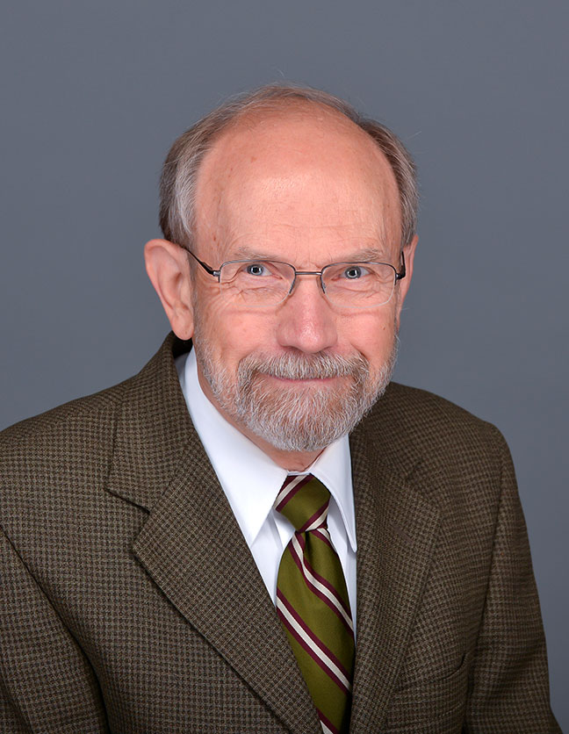
Beginnings
An idea while at the Wade Center in 2004
I was reading Peter Schakel’s book, Imagination and the Arts in C. S. Lewis: Journeying to Narnia and Other Worlds.
Hope College, Hope, Michigan
In walked Peter Schakel!
We had never met, nor have we met since.

Slide 12
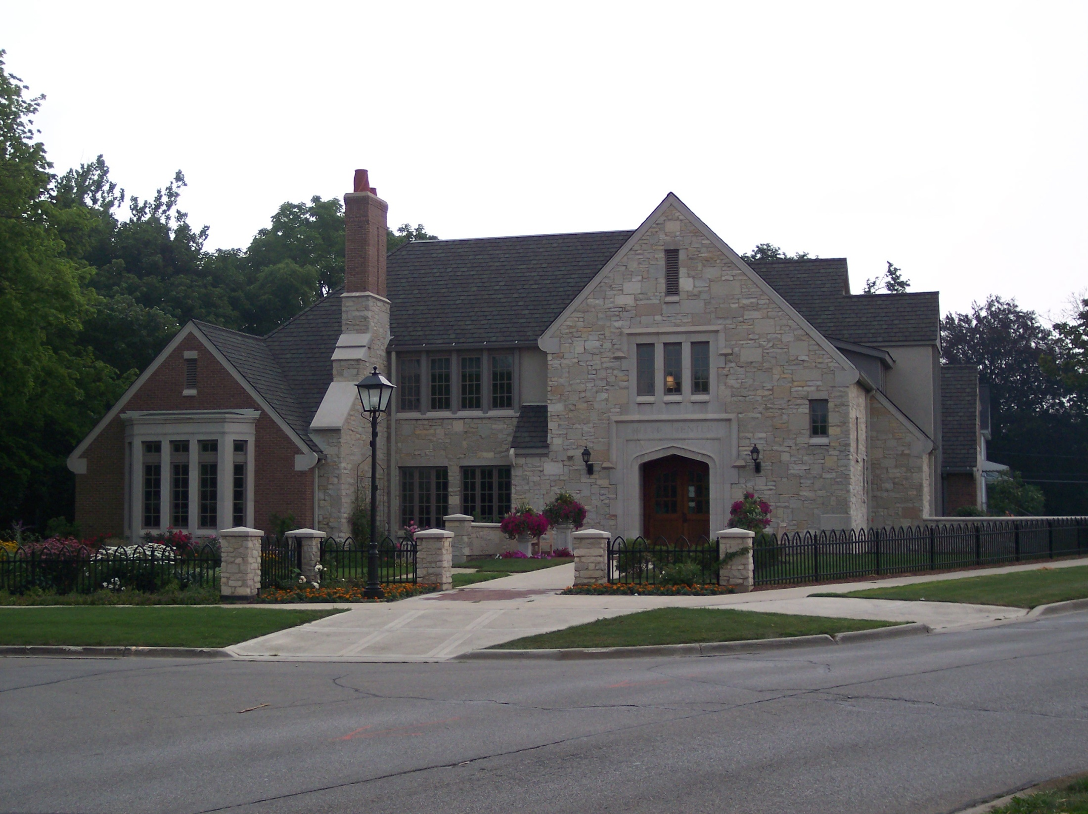

Slide 13
In Summary
The “go-to” place for historical information …
A nineteen-year project thus far—an estimated 2,500 hours of work
Everything you might want to know about what happened in the life of C. S. Lewis and his brother Warren (and a lot you don’t care to know, but someone else might)
Currently a searchable and downloadable Word document at 1,356 pages, single-spaced
More than 743,000 words
Nearly 5,000 footnotes
213 resources (bibliography)

Slide 14
In by Inch
Robert Schuller once said, “Inch by inch anything’s a cinch.”
An old Chinese proverb from the Tao Te Ching around 400 B.C. says, “A journey of a thousand miles begins with a single step.”
Or think of Aesop’s story (ca. 600 B.C.) of the tortoise and the hare.
I once heard that anyone could learn to play the guitar by practicing 15 minutes a day.

Slide 15
Features
Chronological by day, month, and year
Lists the number of entries for each month and each year
Lists the geographical location of each brother at the start of each month
Places important events in bold type
Underlines the name of Jack and Warren the first time they are used on each date
Includes some brief biographical information about many names
Includes the year of publication of many books that Jack read

Slide 16
My Opening Paragraph
This chronology, begun in 2004, is the world’s best source of information on the lives of C. S. Lewis and Warren Lewis. Every year in Lewis’s life appears in the following searchable format: “The Year 1943.” Every month appears in this format: “January 1941.” Each letter of Lewis starts with the phrase “Jack writes to” followed by the full name of the recipient.

Slide 17
My Opening Paragraph
After each year I have put a number in parentheses, which indicates the number of entries for that year. I also list the geographical location of the two brothers at the start of any given month, so that the reader can easily tell where they are on the morning of the first day of each month. The location is not always certain.

Slide 18
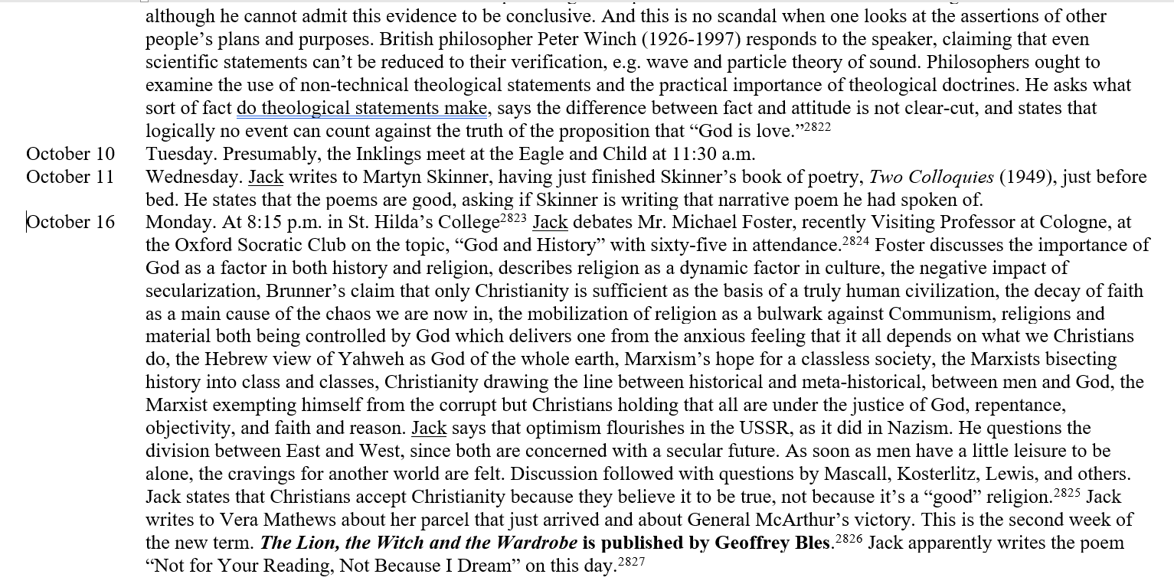
1950
Notes:
1950

Slide 19
Historical Features
Contains dates and details of meetings with the Commission to Revise the Psalter
Contains details about the honorary doctorate he received in absentia on October 6, 1962, from the University of Dijon, Dijon, France.
Information about serving for four-and-a-half years on the Council of Westcott House, Cambridge.
Contains the military record of Warren Lewis
Spotlight on my home page
The dates that C. S. Lewis signed contracts for Dymer and for The Pilgrim’s Regress
Has information about the Skemp Memorial Lecture, “Addison,” at the University of Bristol on October 7, 1943.

Slide 20
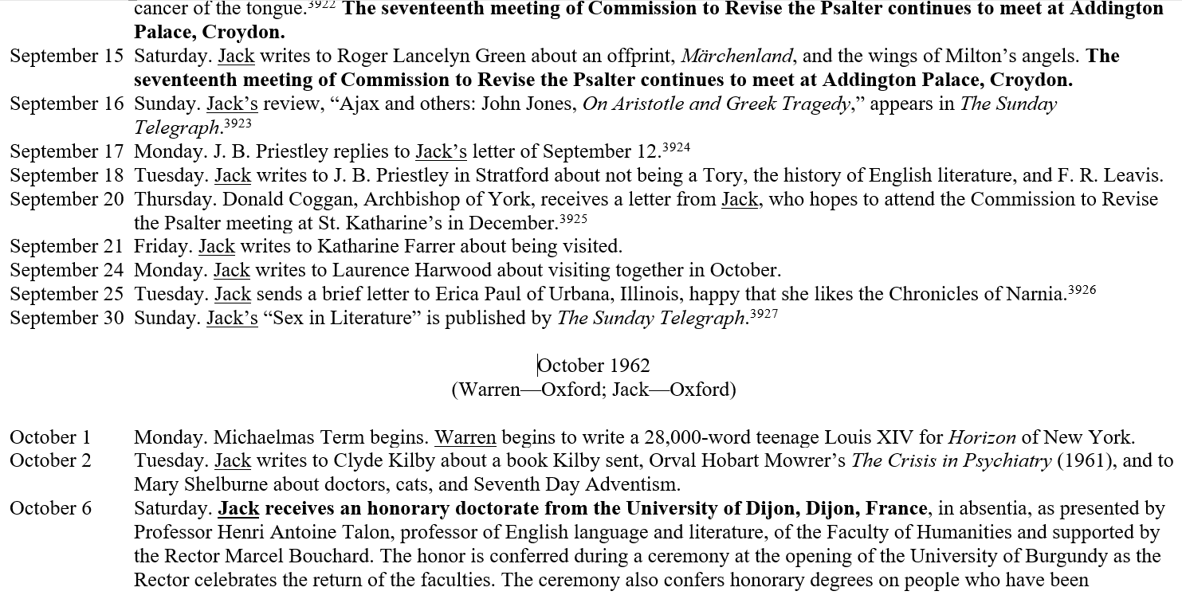
Notes:
1962

Slide 21
Another Gem
Did you know that on August 25, 1925, Lewis and Mrs. Moore’s daughter Maureen interviewed two black pigs?
“After tea Maureen and I had an interview with the two black pigs who were asleep in the field. They hardly looked like animals: more like big leather bottles with curiously shaped stoppers. They lie on their sides and grunt to each other alternately as fast as the ticking of a grandfather clock. Each grunt shakes the whole body. I tickled one with my foot and it made to roll over on its back like a cat. They are perfectly clean.”
Notes:
All My Road Before Me, 366.

Slide 22
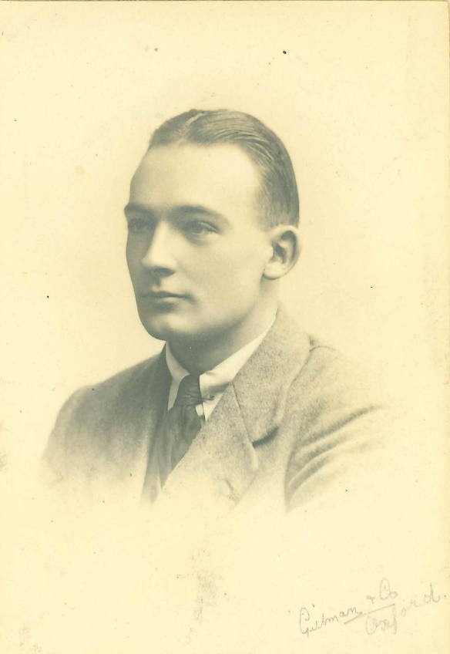
T. D. Weldon

Slide 23
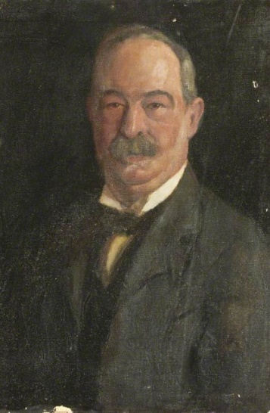
Albert Lewis

Slide 24
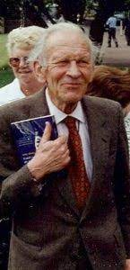
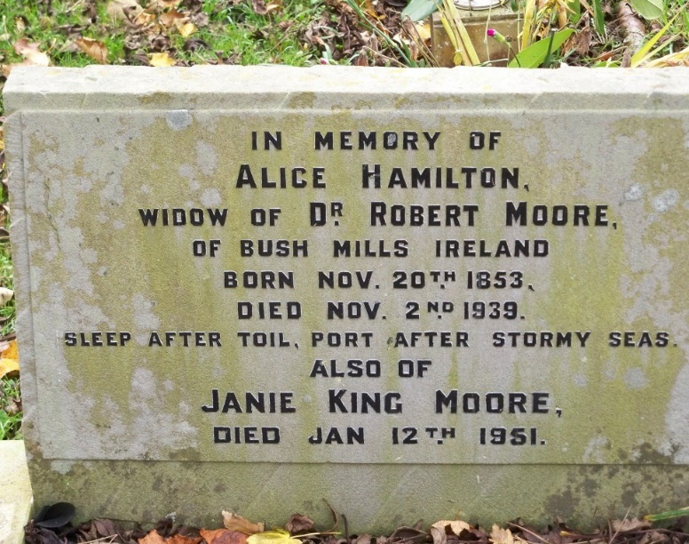
Seldom Seen Images
George Sayer
Janie Moore

Slide 25
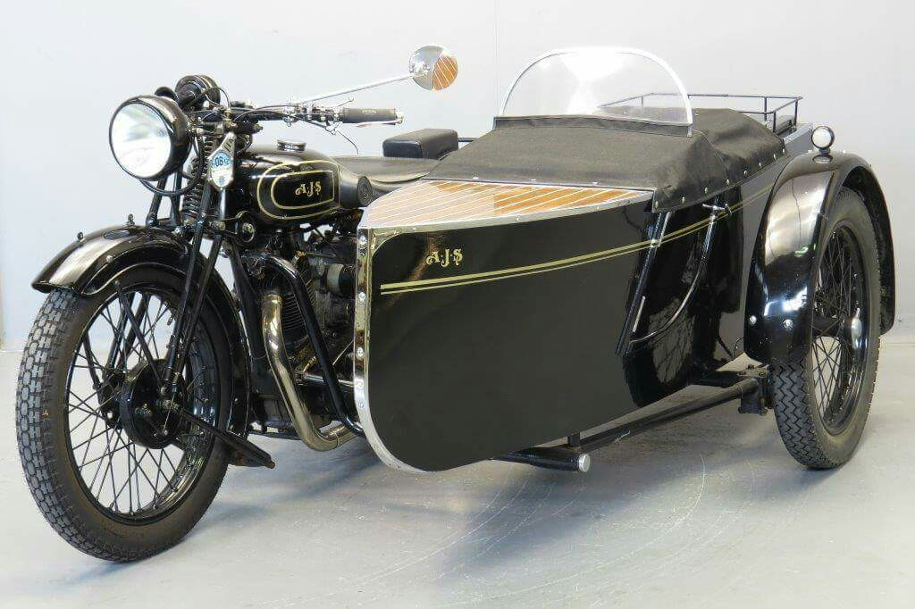
Warren’s A. J. S. Combination
Purchased from Longman’s in Salisbury while Warren was stationed with the RASC in Bulford, eight miles northeast of Salisbury.
Notes:
Purchased from Longman’s in Salisbury while Warren was stationed with the RASC in Bulford, eight miles northeast of Salisbury.

Slide 26
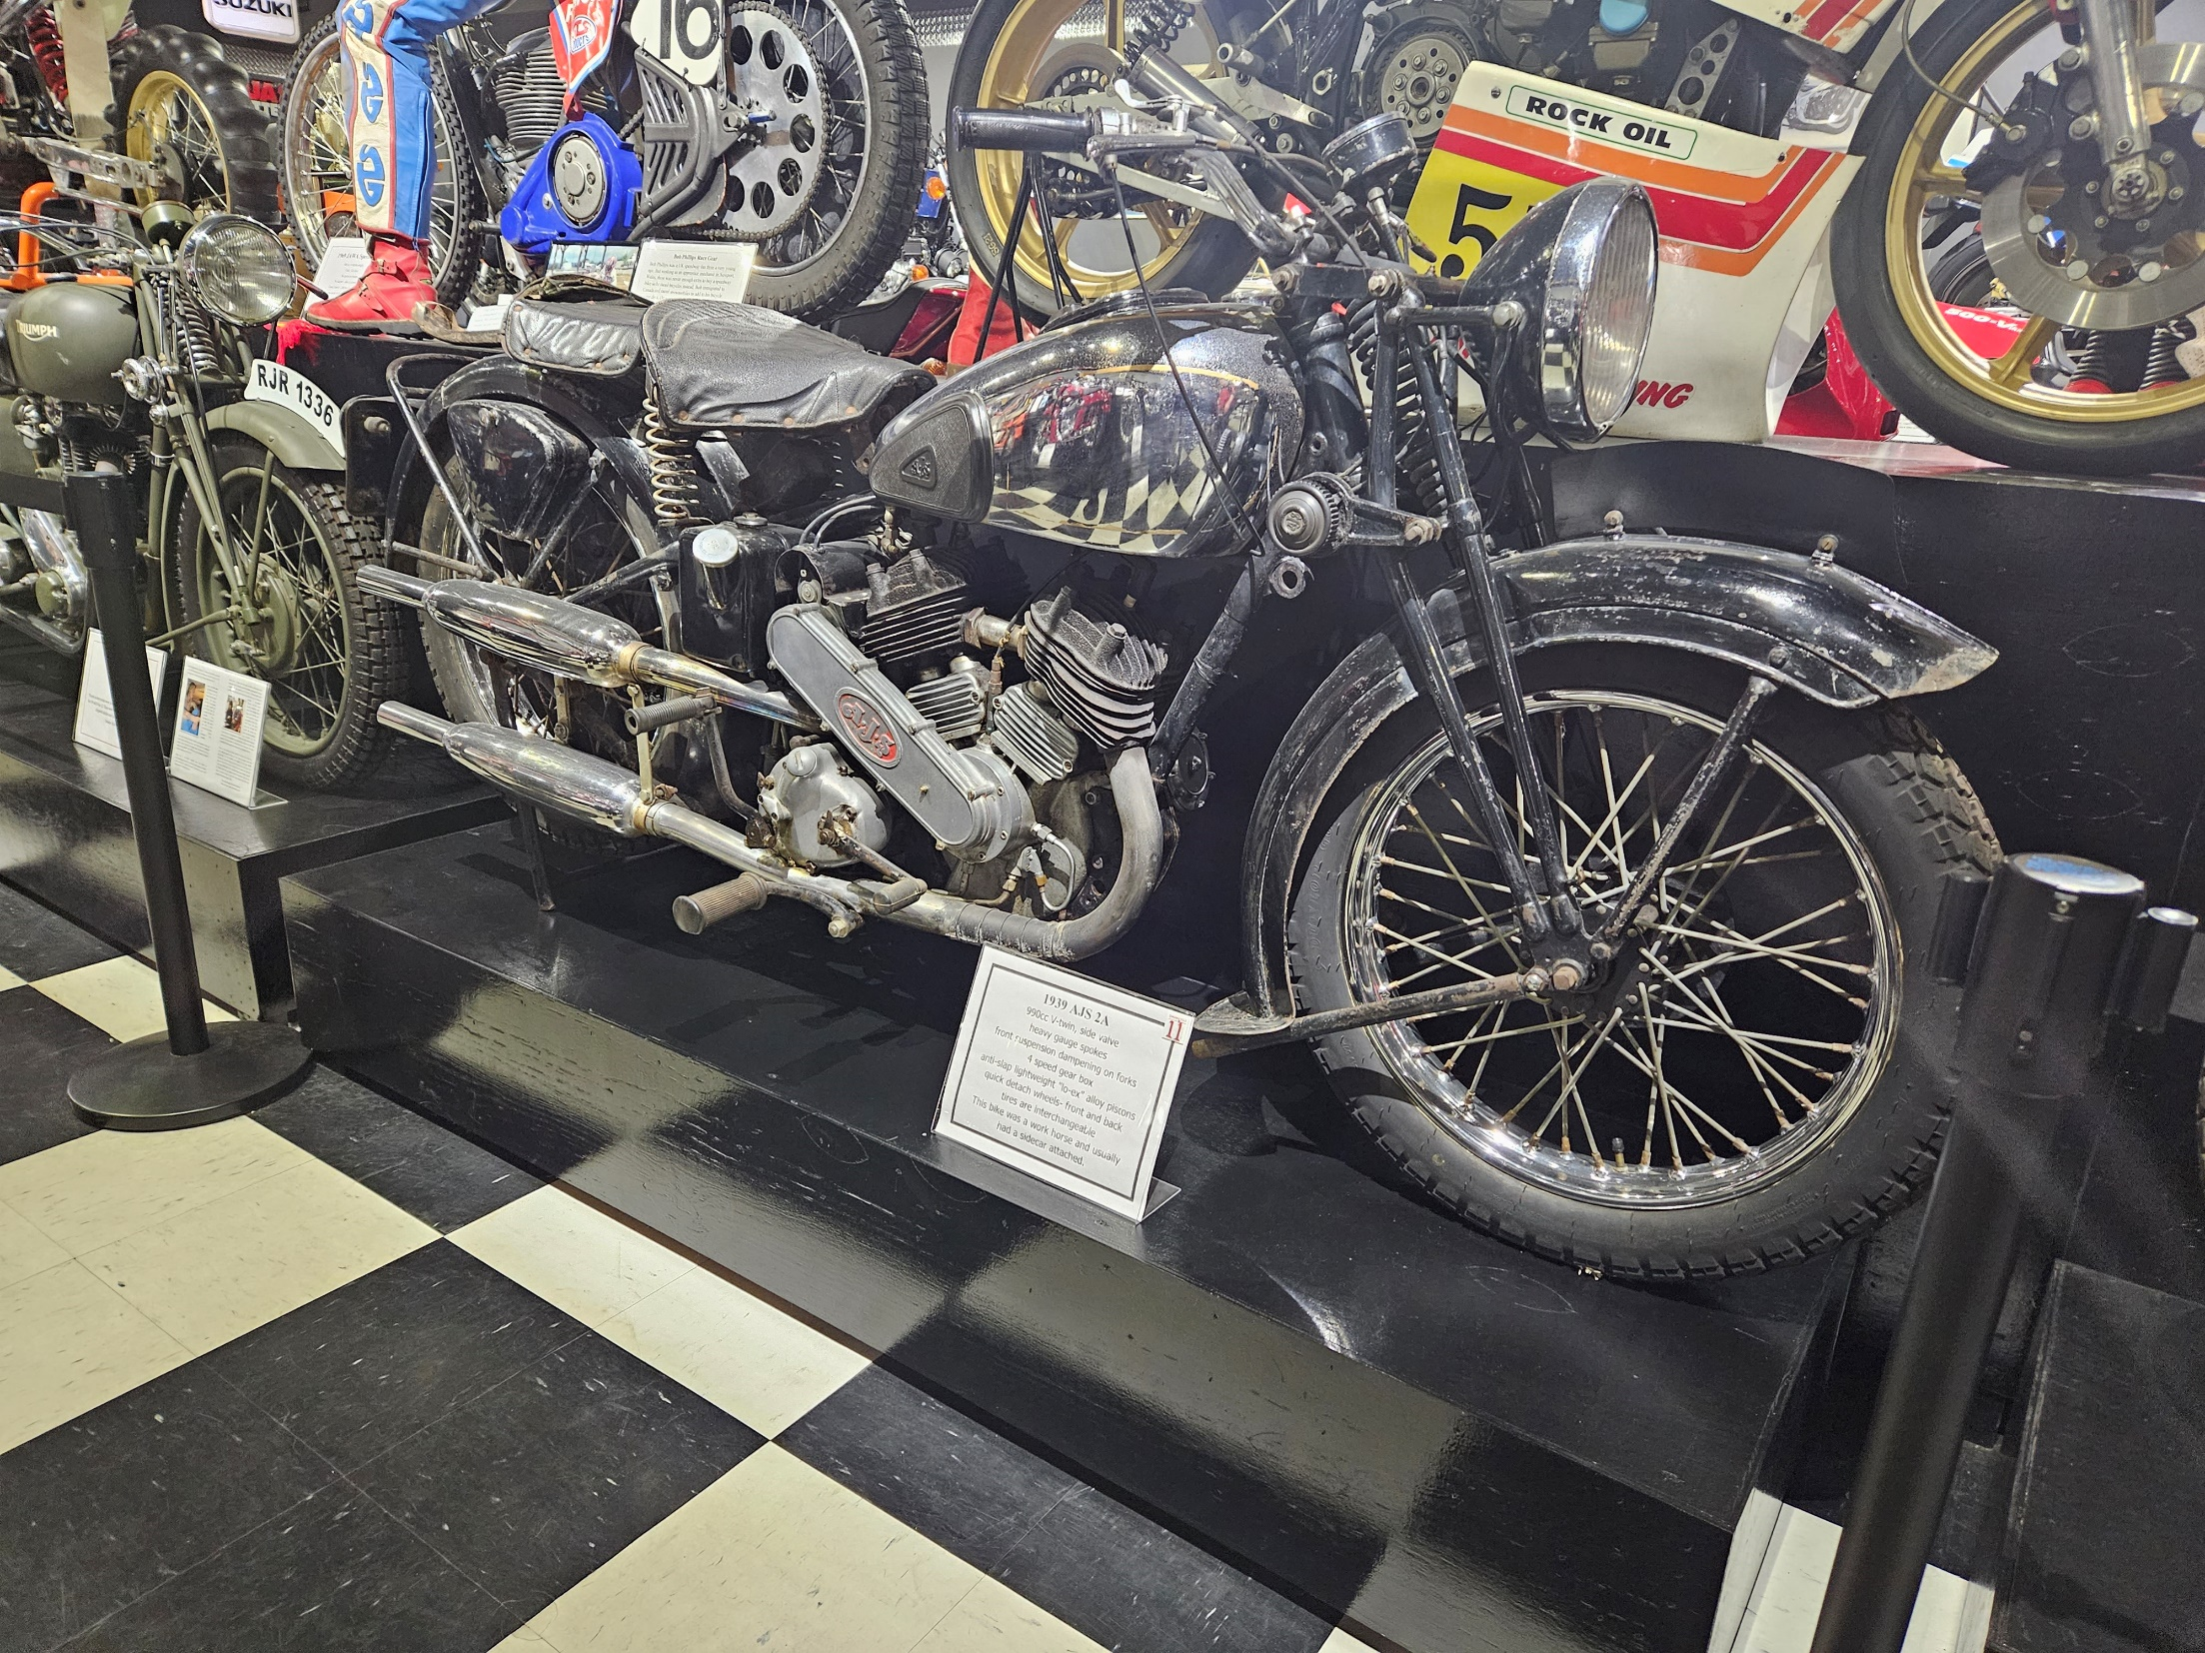

Slide 27
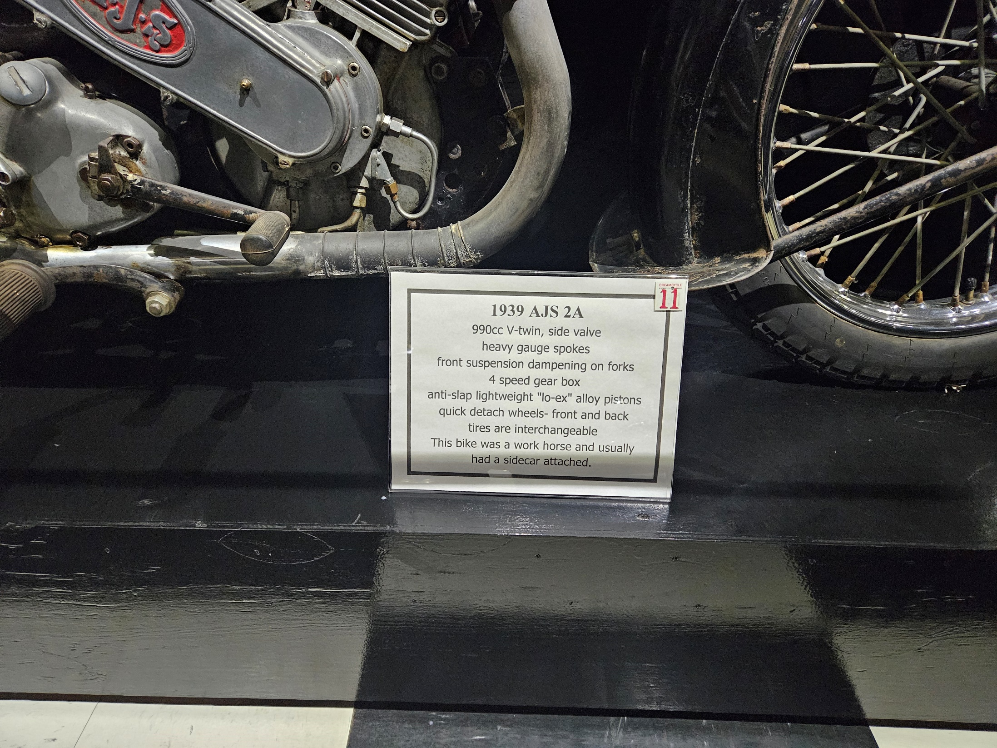

Slide 28
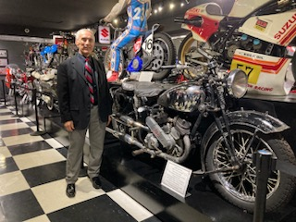

Slide 29
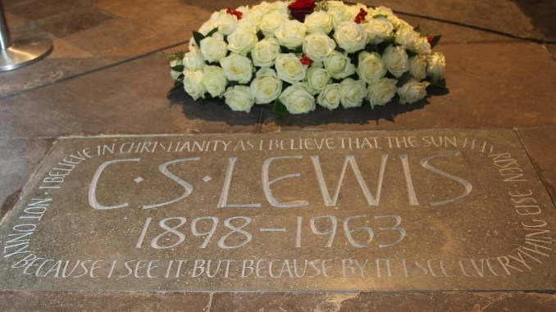
Poets’ Corner, Westminster Abbey
Notes:
November 22, 2013, the fiftieth anniversary of Lewis’s death.

Slide 30

By the way … at Lulu.com

Slide 31
Available Online
As stated earlier, in Word format
At www.joelheck.com
Fairly regular updates
All major sources have been incorporated.
Nearing completion, but who knows?
E.g., more from Out of My Bone because of the insights in Harry Poe’s biographical trilogy on the life of Lewis.
As stated earlier, it’s searchable!

Slide 32
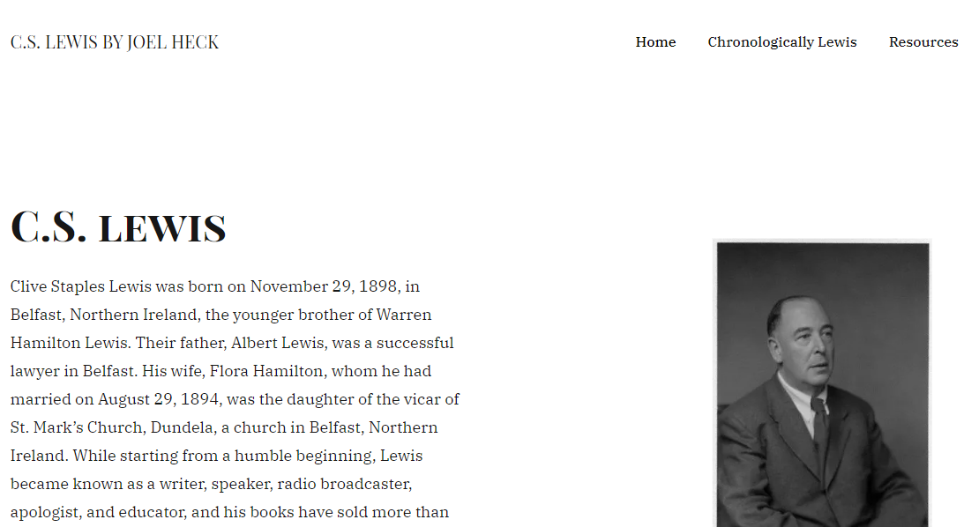
www.joelheck.com

Slide 33
