Slide 1
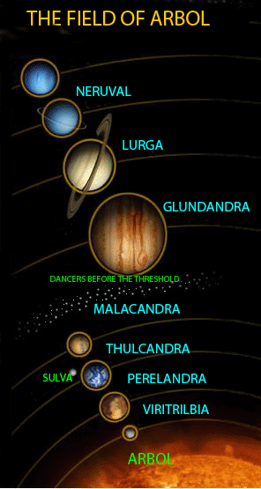
The Ransom Trilogy
What Lewis once described as “theological science fiction.”

Slide 2
But first …
In an East African newspaper: “A new swimming pool is rapidly taking shape since the contractors have thrown in the bulk of their workers.”
In a car rental firm in Tokyo: “When passenger of foot heave in sight, tootle the horn. Trumpet him melodiously at first, but if he still obstacles your passage then tootle him with vigor.”
A Slovakian tourist agency: “Take one of our horse-driven city tours—we guarantee no miscarriages.”
Detour sign in Kyushu, Japan: “Stop: Drive Sideways.”

Slide 3
In a Swiss mountain inn: “Special today—no ice cream.”
In an Austrian hotel catering to skiers: “Not to perambulate the corridors in the hours of repose in the boots of ascension.”
In a Hong Kong supermarket: “For your convenience, we recommend courteous, efficient self-service.”
At a Budapest zoo: “Please do not feed the animals. If you have any suitable food, give it to the guard on duty.”

Slide 4
“Religion and Rocketry”
Originally published in April 1958 in the Christian Herald and entitled “Will We Lose God in Outer Space?”
The essay was written in partial response to the writings of Professor Fred B. Hoyle, the Cambridge astronomer and founder of the Institute of Astronomy at Cambridge.

Slide 5
“Religion and Rocketry”
The essay itself starts with Lewis proclaiming two equal and opposite scientific proposals: one, that life only began on earth with the rarest of accidents, and another, proposed by Hoyle, that life probably began in many places. Both positions, Lewis wrote, claim to show the absurdity of the Christian belief in divine origins and the Incarnation of Christ.
The odd thing is that arguments from two very different positions would both be used to attack Christianity, but such is the desperation of the anti-religionist.

Slide 6
Lewis’ Questions
1. Are there animals anywhere else besides earth?
2. If yes, do any of these animals have what we call “rational souls”? That is, are they spiritual beings?
3. If there are such spiritual beings, are any or all of them, like us, fallen?
4. If any of them have fallen, have they been denied Redemption by the Incarnation and Passion of Christ? Christ could have come to those worlds also.
5. Finally, if all of the first four questions could be answered yes, is it certain that this is the only possible mode of Redemption?

Slide 7
For the entire article …
http://booksbycslewis.blogspot.com/2008/04/religion-and-rocketry.html

Slide 8
Out of the Silent Planet (1938)
Dr. Elwin Ransom, Edward Weston, Dick Devine
“Elwin” means “Elf friend” in Anglo-Saxon
Malacandra (Mars)
Three types of creatures: hrossa, pfifltriggi, sorns
Dr. Ransom, a Cambridge academic, is abducted and taken on a spaceship to the planet of Malacandra. His captors are plotting to plunder the planet’s treasures and plan to offer Ransom as a sacrifice to the creatures who live there. Ransom discovers he has come from the “silent planet”—Earth—whose tragic story is known throughout the universe!
An unfallen world
The Oyarsa of Malacandra

Slide 9
The Silent Planet
According to the medieval mind, the music of the spheres meant that each planet sounded a note.
If there is harmony among the planets, all planets sound a note and form a beautiful chord.
One planet is ruled by a fallen angel, who does not participate in this harmony, so it does not make a sound. It is silent. Hence, earth is “the silent planet.”
One other note: when Ransom first sees the Earth from Malacandra (Mars), he sees it upside down (next slide).

Slide 10
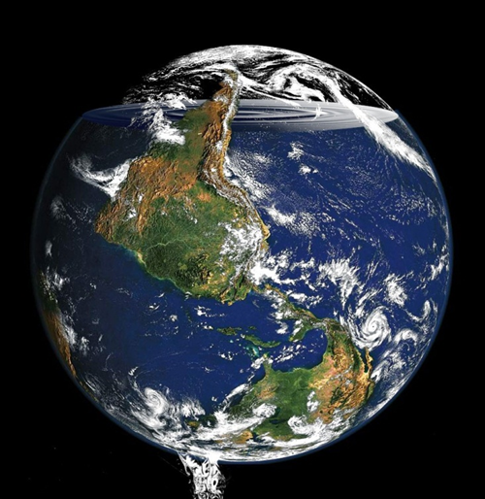

Slide 11
Perelandra as a Supposal
Have you ever wondered what might have happened if Adam and Eve had not eaten the forbidden fruit?
Lewis did too, and he wrote Perelandra to tell us, not what he thought might have happened, but to speculate about another world in a similar situation.

Slide 12
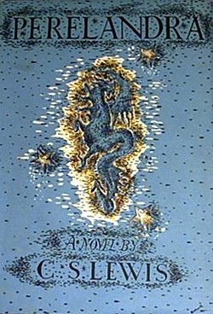
Perelandra as a Supposal
It all began with a picture . . .
. . . of floating islands
Reality in story form
“Suppose . . . In some other planet there were a first couple undergoing the same that Adam and Eve underwent here, but successfully.” (Dec. 29, 1958, in a letter to Mrs. Hook)

Slide 13
Perelandra (1943)
Lewis liked this book best among all his books.
Dr. Ransom’s voyage to the paradise planet of Perelandra, or Venus, which turns out to be a beautiful Eden-like world. He is horrified to find that his old enemy, Dr. Weston, has also arrived and is attempting to cause the first sin by Perelandra’s Eve. As the mad Weston’s body is taken over by the forces of evil, Ransom engages in a desperate struggle (during which his heel is wounded) to save the innocence of Perelandra and its first two humans, Tor and Tinidril, the Adam and Eve of Venus!

Slide 14
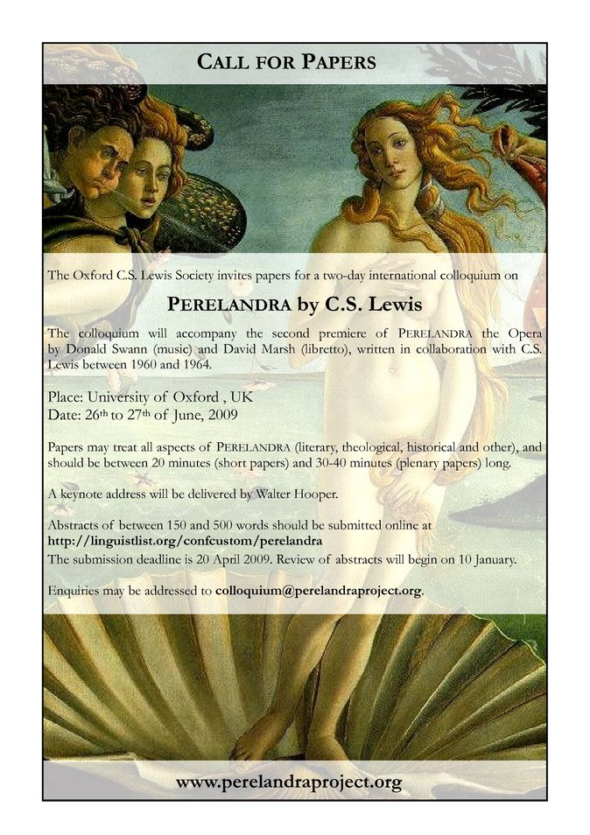
Theme
Theme: “…Lewis’s main theme in Perelandra…The question is …how can a totally free person, without unfair manipulation by God, spontaneously carry out what God most desires, and find herself a destiny which God fully intends” (Walter Hooper 222).

Slide 15
Reviews
Leonard Bacon (1946): “the poetic imagination in full blast.”
John Gilland Brunini (1944): “The book can be ranked high in the fields of creative imagination, speculative theology and engrossing adventure…far superior to other tales of interplanetary adventures.”
Victor M. Hamm (1945): “The substance of this wonderful scene (i.e., the description of the Oyarsa of Mars and the Oyarsa of Venus)…which culminates in a grand chorus of praises to Maleldil [is] an inspired litany of love and homage.”

Slide 16
That Hideous Strength (1945)
The title comes from the line of a poem written in 1555 by David Lyndsay, referring to the Tower of Babel.
Remember that this is the novelistic embodiment of Lewis’ 1943 book, The Abolition of Man.
This story is set on Earth, and tells of a terrifying conspiracy against humanity. The story centers on Mark and Jane Studdock, a newly married couple. Mark is a sociologist who is invited to join an organization called the N.I.C.E., which is not so nice, and aims to control all human life. Meanwhile, his wife has bizarre prophetic dreams about a decapitated scientist, Alcasan.

Slide 17
As Mark is drawn into the sinister organization, he discovers the truth of his wife’s dreams when he meets the literal head of Alcasan which is being kept alive by infusions of blood. Jane seeks help concerning her dreams at a community called St. Anne’s, where she meets their leader—Dr. Ransom (the main character of the previous two titles in the trilogy).
In the end the angelic spirits of the planets descend to Earth to “save the day.”
The story ends in a final spectacular scene at the N.I.C.E. headquarters where Merlin (the magician from the age of King Arthur) appears to confront the powers of Hell.

Slide 18
The Sources of Medievalism
The King Arthur stories
Chaucer, e.g., the poem Troilus and Criseyde
Beowulf (in Old English)
Dante’s The Divine Comedy
The Romance of the Rose, Guillaume de Lorris and Jean de Meun
Works by John Gower (Confessio Amantis), Thomas Usk, and John Lydgate
Thomas Aquinas’ Summa Theologica (everything in its place)
Dante’s Divine Comedy (Hell, Purgatory, Paradise)

Slide 19
The Attraction of Medievalism
Its artistic and aesthetic splendor
The personalized society
The sense of order and hierarchy
The bond between church, kings, and aristocracy
A chivalric society tied to land and nature

Slide 20
Introduction to Medievalism in Lewis
“Renaissance”
The Allegory of Love
The Discarded Image
Both the Chronicles of Narnia and the Ransom Trilogy attempt to recover some of that.
What is medieval in Lewis’s fiction: language, dress, polity, geography & transportation, weaponry, cosmology, customs, creatures, astronomy, and clothing

Slide 21
What is Medieval in Narnia?
Language: “hastilude,” “gentilesse,” “estres,” “pajock,” “seneschal,” “cantrips,” and “dromonds.”
Clothing: “silk and cloth of gold … snowy linen glancing through slashed sleeves … silver mail shirts and jeweled sword hilts … gilt helmets and feathered bonnets” in Prince Caspian.
Polity: Narnia as a medieval definition of kingdom
Geography: Narnia is flat, not spherical
Cosmology: the planets have “influences” in TSC
Astrology: planetary influence (Dr. Cornelius, the centaur Glenstorm, and the centaur Roonwit)
Cartography: “more like a medieval map than an Ordnance Survey”

Slide 22
What is Medieval in Narnia?
Buildings: castles, walled cities
Transportation: horseback, ship, bipedalism
Weaponry: catapult, crossbow, bow and arrow, sword (the same is true in Malacandra)
Creatures: fauns, satyrs, tree nymphs, giants, gnomes, dwarves, dragons, centaurs
Deities: Bacchus, Pomona
Customs: storytelling (the same is true in Malacandra)
Education: grammar, logic, and rhetoric (and the Four Cardinal Virtues)

Slide 23
The Order of Space
Earth at the center, motionless, not considered a planet because it did not wander (planet means “wanderer”)
Surrounded by seven hollow, perfect concentric circles
Lowest globe was the moon
Then Mercury, Venus, the Sun, Mars, Jupiter, Saturn, and the sphere of the Fixed Stars (7 globes)
Then the Primum Mobile
Then the Empyrean, or true Heaven
For example, Dante’s Divine Comedy
“The Great Dance”

Slide 24
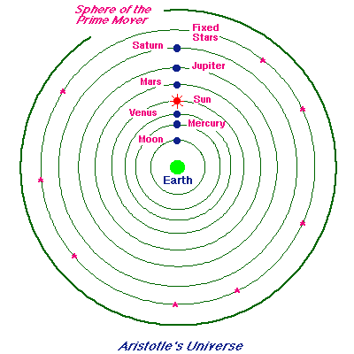
The Order of the Heavens (not "space")
The word “space” was used for the heavens only since the 17th century.

Slide 25
Also Medieval
The Great Dance: order and freedom
The Great Chain of Being (Perelandra, Malacandra)
The Old One The Old One
Maleldil the Young Maleldil the Young
Oyarsa Oyarsa
The King Eldila
The Green Lady Hnau
Animals Animals
Human Personality: concentric circles (next slide)
Nine Classes of Angels (second slide)

Slide 26
Human Personality
Imagination
Intellect
Will

Slide 27
Nine Classes of Angels
Name Orientation (3 + 3 + 3)
Seraphim closest to God
Cherubim look God-ward
Thrones contemplate the Divine essence; unconcerned with the created universe; associated with heat, burning
Dominations face God with backs to earth
Virtues responsible for general order of Nature
Powers potentially active
Principalities deal with destiny of nations
Archangels deal with individuals
Angels deal with individuals

Slide 28
Summary
The unity of spirit and matter, God and mankind, language and reality
Order and hierarchy vs. disorder (Space, Music, Dance)—everything is ordered
Vitality of space
Discipline vs. free spirit
God-centered vs. man-centered
The reality of sin
Creative majesty
Chivalry
Aesthetic splendor
C. S. Lewis: “I have made no serious effort to hide the fact that the old Model delights me as I believe it delighted our ancestors. Few constructions of the imagination seem to me to have combined splendor, sobriety, and coherence in the same degree” (The Discarded Image, 216).

