Slide 1
The Legacy of C. S. Lewis, Part II
Joel D. Heck, Concordia Lutheran Seminary
Notes:
Can’t do evangelism where I came from. The winters are so nice that …

Slide 2
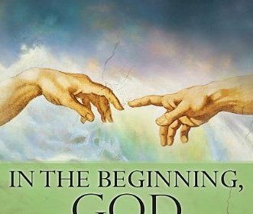

Slide 3
www.joelheck.com

Slide 4
“A Christmas Sermon for Pagans”
December 1946 issue of The Strand Magazine.
The Strand Magazine was in decline (it ceased in 1950) and published in limited numbers, which contributed to the “disappearance” of this article.
Unknown for decades until New Zealander Christopher Marsh discovered it and contacted me to authenticate the article.
We subsequently co-authored an article about it. The article was published in 2017 in VII.
Notes:
Stephanie Derrick, I think, also discovered it around the same time.

Slide 5
Themes in A Christmas Sermon
The reader sees the Lewis who loved words and their meanings. He later published Studies in Words.
The Lewis who championed an objective standard of right and wrong, echoed in The Abolition of Man and Mere Christianity, Book 1.

Slide 6
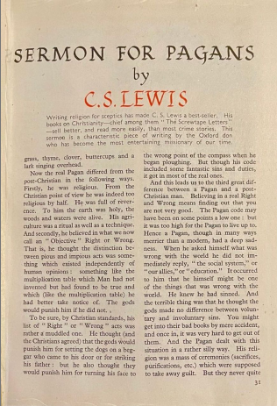
Themes in A Christmas Sermon
The idea of myth, which Lewis developed in several places, especially in The Chronicles of Narnia and his essay “Myth Became Fact.”
The distinction between the pre-Christian and the post-Christian, especially described in his inaugural lecture at Cambridge University.

Slide 7
The Gap between …
Lewis would later assert in that inaugural lecture, “De Descriptione Temporum,” at the University of Cambridge that the “gap between those who worship different gods is not so wide as that between those who worship different gods and those who do not.”
This essay is a example of Lewis’s belief that any possible Christian apologetic must render Paganism due respect.
Notes:
C. S. Lewis, De Descriptione Temporum, Selected Literary Essays. Edited by Walter Hooper. Cambridge: Cambridge University Press, 1969, 1-14.
Michael Ward. Planet Narnia Oxford, Oxford University Press, 28.

Slide 8
Pagans, Then and Now
First, the ancient Pagan believed in the reality of and due reverence toward supernatural beings.
He also held to an (albeit somewhat muddled) objective standard of right and wrong and a belief that the gods would hold him accountable for adhering to it.
The Pagan knew he knew he had frequently fallen short of this moral standard and despite his best efforts to remedy his situation, “his conscience was not at ease.” (cont’d.)

Slide 9
Pagans, Then and Now
… Lewis argues that the skeptical post-Christian is totally at odds with these views. For Lewis, the post-Christian holds to a skeptical belief that the earth is a spiritless realm of physical matter with mankind its highest level of being. What was once revered by Pagan men as a divine creation full of supernatural beings is now viewed by many post-Christians as a mere resource to be exploited.
“A mere resource to be exploited,” or, a naturalistic world devoid of any evidence of a Creator.
Notes:
P. H. Brazier C. S. Lewis –Revelation, Conversion and Apologetics Oregon: Pickwick Publications, 2012, 10.

Slide 10
The True Pagan (cf. “the good atheist”)
“A Christmas Sermon for Pagans” has sympathy for the true Pagan, acknowledging that while every bit as “sick” or sinful as the post-Christian, the Pagan had what Lewis calls a “deep sadness,” an innate awareness of his own moral failure before the divine. Lewis even half-heartedly suggests to his readers that true Paganism might be a necessary stage to becoming Christian.
We must respect the unbeliever!
And learn to what extent an awareness of his own brokenness exists in his mind and heart.

Slide 11
Approximately 1918, when he was an atheist

Slide 12
The Rephrased Gospel Message
Lewis then rephrases the Gospel message into distinctly Pagan sounding terms for a modern readership who were about to celebrate something very reminiscent of a Pagan festival, the birth of a god. For Lewis, Christ (to whom he refers as the “Mighty One”) is a god who could perform a “wonder” that no Pagan god of any age could—the removal of guilt and the reconciliation of humanity to the divine.

Slide 13
Modern Pagans are Different
Lewis makes an identical suggestion in his “Modern Man and his Categories of Thought” (October 1946).
Written around the same time as “A Christmas Sermon for Pagans,” Lewis adds, “If they were Stoics, Orphics, Mithraists, or (better still) peasants worshipping the earth, our task might be easier. That is why I do not regard contemporary Paganisms (Theosophy, Anthroposophy, etc.) as a wholly bad symptom.”
Notes:
C. S. Lewis Modern Man and His Categories of Thought in W. Hooper (Ed.), Present Concerns: Essays by C S Lewis Florida: Harcourt Brace 1986, 64. It is worth noting that in this passage Lewis does acknowledge the existence of modern Paganism (as opposed to those he considers to be trying to recreate a fictional pagan past).

Slide 14
A Footnote on Pagan “Christs”
Some claim that Christ’s incarnation, death, and resurrection bears a resemblance to the myths of Balder, Osiris, and other stories. Therefore, they claim, the Christian “myth” is no more valid than these other myths.
Lewis was willing to call the story of Christ a myth, but a myth that “really happened.”
Notes:
Lewis, “Myth Became Fact.” Balder on the left.

Slide 15
A Footnote on Pagan “Christs”
He also wrote, “We must not be nervous about ‘parallels’ and ‘Pagan Christ’: they ought to be there—it would be a stumbling block if they weren’t.”
And, in Miracles, he called myth “a real though unfocused gleam of divine truth falling on human imagination.”
Notes:
Lewis, “Myth Became Fact.” Miracles, 176, n. 1.

Slide 16
Life magazine, 1946
Notes:
Life, maybe 1946.

Slide 17
An Aside: The Quotable C. S. Lewis
“A ‘Heathen’ meant a man who lived out on the heath, out in the wilds. A ‘Pagan’ meant a man who lived in a Pagus or small village. Both words, in fact, meant a ‘rustic’ or ‘yokel.’ ”
“When [the heathen] asked himself what was wrong with the world he did not immediately reply, ‘the social system,’ or ‘our allies,’ or ‘education.’ It occurred to him that he himself might be one of the things that was wrong with the world. He knew he had sinned.”

Slide 18
Three Kinds of People in “A Christmas Sermon for Pagans”
(1) Those who are sick and don’t know it (the post-Christians).
(2) Those who are sick and know it (Pagans).
(3) Those who have found the cure. And if you start in the first class you must go through the second to reach the third. For (in a sense) all that Christianity adds to Paganism is the cure.
D. T. Niles: one beggar telling …

Slide 19
Three Kinds of People in “A Christmas Sermon for Pagans”
“We have to convince our hearers of the unwelcome diagnosis before we can expect them to welcome the news of the remedy.” (“God in the Dock,” 244)
“Knowledge of broken law precedes all other religious experiences.” (Heading to Chapter I, Regress, 1933)
Don’t talk about sin but about broken promises, tension in a relationship, fudging the truth, etc.

Slide 20
“Modern Theology and Biblical Criticism”
In 1958, Alec R. Vidler published a book called Windsor Sermons. Fr. Alec Vidler was a noted liberal scholar and Dean of King’s College, Cambridge. One day Lewis was conversing with the Principal of Westcott House, Cambridge, later the Bishop of Edinburgh, The Rt. Rev. Kenneth Carey.
After reading part of one of Vidler’s sermons in Windsor Sermons, entitled “The Sign at Cana,” Carey asked Lewis what he thought about it. Lewis “expressed himself very freely about the sermon and said that he thought that it was quite incredible that we should have had to wait nearly 2000 years to be told by a theologian called Vidler that what the Church has always regarded as a miracle was, in fact, a parable!”

Slide 22
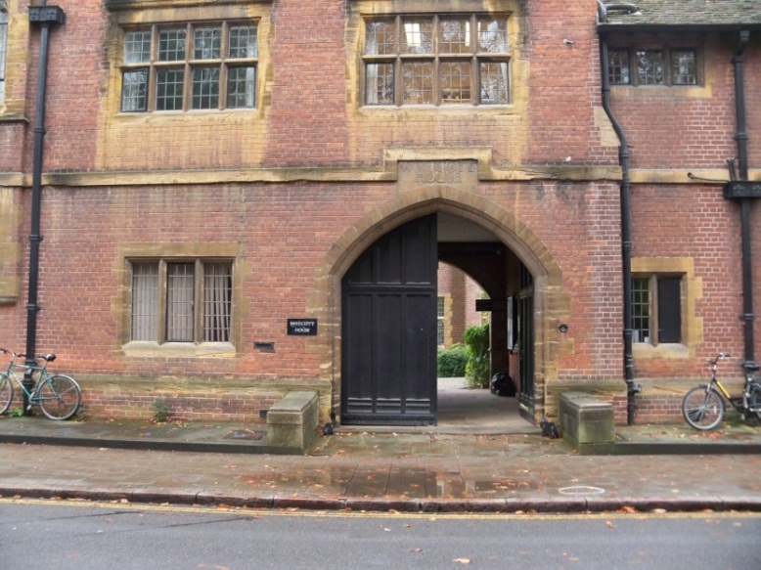
Entrance to Westcott House, Cambridge
Notes:
Along Jesus Lane.

Slide 23
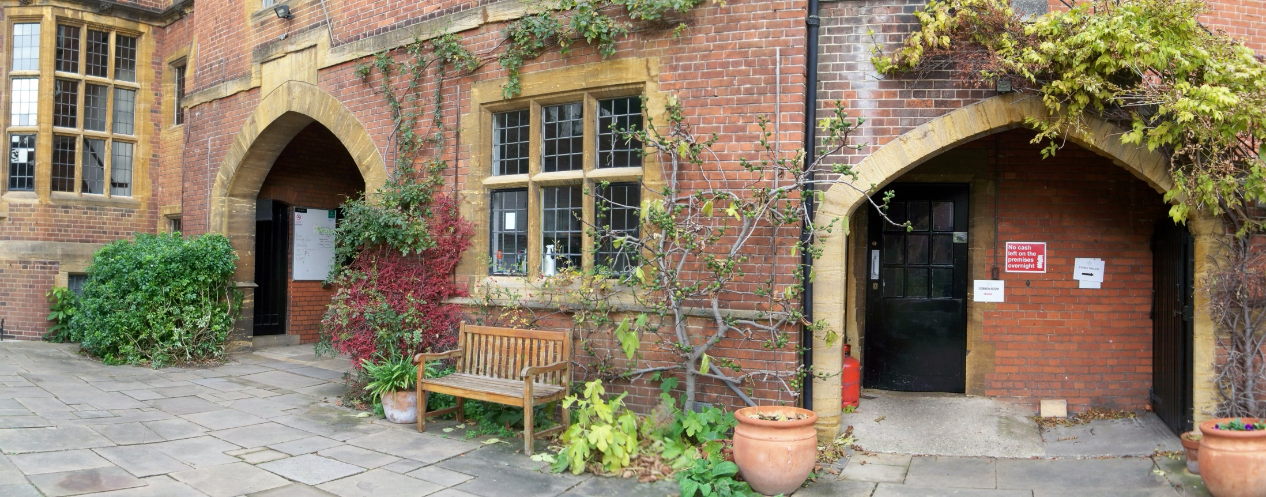
Location of the Lecture

Slide 24
The Room were the Lecture was given

Slide 25
The Address: Lewis’s Four Main Points
Some biblical critics lack literary judgment (they read between the lines of ancient texts, not understanding extra-biblical literary genres, e.g., reading John’s Gospel as a romance);
Some wrongly claim that the real teaching of Christ came rapidly to be misunderstood and has only been recovered by modern scholars (Vidler is an example);
Some wrongly claim that miracles don’t occur;
Attempts to recover the origin of a text often err (as has happened with some of Plato’s and Shakespeare’s works).

Slide 26
Four Points/Four Perspectives
A scholar of English literature
A student of history and a lay reader of the New Testament
The author of Miracles
The writer speaking from personal experience, but once again as a scholar of literature
Notes:
Lewis at age five. Pictures of Lewis that you don’t often see.

Slide 27
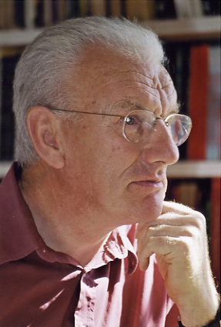
The Arguments of Don Cupitt
Translation
Rudolf Bultmann
The Jesus Seminar and Dominic Crossan
Thomas L. Thompson: the Old Testament recorded a history of Israel that should have happened rather than that which actually happened.
Notes:
At one time, Dean of Emmanuel College, Cambridge. I interviewed him.

Slide 28
John A. T. Robinson (1919–1983)
Honest to God (1963)
On March 17, 1963, just prior to the release of that book, Bishop Robinson, then Anglican Bishop of Woolwich, had an article published in The Observer entitled “Our Image of God Must Go.”
One week later, Lewis: “Must Our Image of God Go?” (The Observer)
“reportage”
Richard Bauckham, Jesus and the Eyewitnesses (2006)

Slide 29
Conclusion
A negative reaction to Lewis’s combative style?
A question of Lewis’s theological credentials?
But Lewis admitted to a lack of theological training, a note he sounded in other writings
A challenge to Lewis’s literary competence?
Or a matter of theological differences?
Lewis was not challenged on theological or literary points.
I submit that it was theological differences, represented especially by Alec Vidler and John Robinson, which could not be refuted by opponents in his audience, so they questioned his credentials.

Slide 30
Analogy and Illustration

Slide 31
Analogy and Illustration
When Lewis is writing Christian apologetics or in any other genre, his writing uses story and is full of analogies, metaphors, and picture language, creating imaginative ground for a response. A brief survey of Mere Christianity produces the following list. Coming to faith in Christ is like …
Joining a campaign of sabotage
Falling at someone’s feet
or putting yourself in someone’s hands

Slide 32
Analogy and Illustration
Taking on board fuel or food
Laying down your rebel arms and surrendering
Saying you’re sorry
Laying yourself open
Turning full speed astern
Like killing part of yourself

Slide 33
Analogy and Illustration
Learning to walk or to write
Buying God a present with His own money
A drowning man clutching at a rescuer’s hand
A tin soldier or a statue becoming alive
Waking after a long sleep
Getting close to someone or becoming infected

Slide 34
Analogy and Illustration
Like dressing up or pretending or playing
Emerging from the womb or hatching from an egg
A compass needle swinging to the north
A cottage being made into a palace
A field being plowed and resown
A horse turning into a Pegasus

Slide 35
Analogy and Illustration
A greenhouse roof becoming bright in the sunlight
Coming around from anesthetic
Coming in out of the wind
Or like going home (like Timothy Keller so powerfully demonstrates in his explanation of the parable of the Prodigal God).
Notes:
Michael Ward, “Escape to Wallaby Wood: Lewis’s Depictions of Conversion,” C. S. Lewis: Lightbearer in the Shadowlands, 151.

Slide 36
Imagination and Apologetics

Slide 37
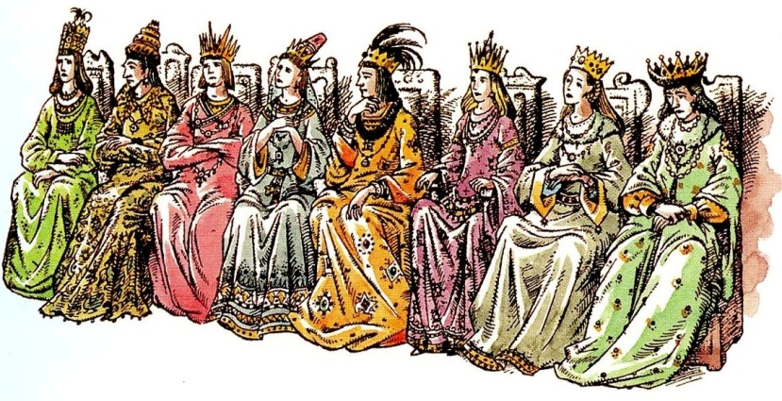
The Pilgrim’s Regress
“… if you will, it [words of wisdom] is mythology. It is but truth, not fact: an image, not the very real.” (The Pilgrim’s Regress, Chapter V, “Across the Canyon,” 169)

Slide 38
They Stand Together
Lewis on five-year-old Michael on Dec. 7, 1935:
“Minto reads him the Peter Rabbit books every evening, and it is a lovely sight. She reads very slowly and he gazes up into her eyes which look enormous through her spectacles—what a pity she has no grandchildren. Would you believe it, that child had never been read to nor told a story by his mother in his life? Not that he is neglected. He has a whole time Nurse …, a hundred patent foods, is spoiled, and far too expensively dressed: but his poor imagination has been left without any natural food at all.”

Slide 39
Lewis on Shelley’s play, Prometheus Unbound:
“Like all great myths its primary appeal is to the imagination: its indirect and further appeal to the will and the understanding can therefore be diversely interpreted according as the reader is a Christian, a politician, a psychoanalyst, or what not. Myth is thus like manna; it is to each man a different dish and to each the dish he needs.”

Slide 40
“Shelley, Dryden, and Mr. Eliot”
“It does not grow old nor stick at frontiers racial, sexual, or philosophic; and even from the same man at the same moment it can elicit different responses at different levels. But great myth is rare in a reflective age; the temptation to allegorize, to thrust into the story the conscious doctrines of the poet, there to fight it out as best they can with the inherent tendency of the fable, is usually too strong.”
Notes:
“Shelley, Dryden, and Mr. Eliot,” Rehabilitations, 29f.

Slide 41
Lewis’ Idea of the Person
Imagination
(outer circle)
Intellect
(middle circle)
Will

Slide 42
Imagination
“The battle is between faith and reason on one side and emotion and imagination on the other.” (Mere Christianity, 139)
Not in the sense of daydream or reverie or wish-fulfilling fantasy.
Not even in the mere sense of invention.
But in the sense of inspiration or poetic imagination (Surprised by Joy, Chapter I, “The First Years”).

Slide 43
“On Three Ways of Writing for Children”
“I thought I saw how stories of this kind could steal past a certain inhibition which had paralyzed much of my own religion in childhood. Why did one find it so hard to feel as one was told one ought to feel about God or about the sufferings of Christ? I thought the chief reason was that one was told one ought to. An obligation to feel can freeze feelings. And reverence itself did harm.”

Slide 44
“On Three Ways of Writing for Children”
“The whole subject was associated with lowered voices; almost as if it were something medical. But supposing that by casting all these things into an imaginary world, …

Slide 45
“On Three Ways of Writing for Children”
… stripping them of their stained-glass and Sunday school associations, one could make them for the first time appear in their real potency? Could one not thus steal past those watchful dragons? I thought one could.”

Slide 46
Miscellaneous Insights from various articles
From “God and Evil”: “If thought is the undesigned and irrelevant product of cerebral motions, what reason have we to trust it?”
The same article addresses the fatal difficulties of Dualism, although that belief we seldom encounter today.
From “God in the Dock”: “I have been asked to write about the difficulties which a man must face in trying to present the Christian Faith to modern unbelievers.” Lewis goes on to write about a skepticism about history from the average person, the importance of knowing the language and vocabulary people use, and “the almost total absence from the minds of my audience of any sense of sin.” Hence, he writes “We Have Cause to be Uneasy.” (in MC)
Notes:
“God and Evil,” God in the Dock, pp. 21-24.

Slide 47
“Religion and Rocketry”
Two opposite arguments have been used against the Christian faith, i.e., that we are “alone in an infinite desert” and, therefore, a creator couldn’t be interested in us versus the “universe was probably quite well provided with inhabitable globes and with livestock to inhabit them” and, therefore, it’s the height of parochialism to think that we could be important to God.
Notes:
“God and Evil,” God in the Dock, pp. 21-24.

Slide 48
“On Juvenile Tastes”
“I was therefore writing ‘for children’ only in the sense that I excluded what I thought they would not like or understand; not in the sense of writing what I intended to be below adult attention. I may of course have been deceived, but the principle at least saves one from being patronizing. I never wrote down to anyone; and whether the opinion condemns or acquits my own work, it certainly is my opinion that a book worth reading only in childhood is not worth reading even then. The inhibitions which I hoped my stories would overcome in a child’s mind may exist in a grown-up’s mind too, and may perhaps be overcome by the same means.”

Slide 49
“The Funeral of a Great Myth”
Though Lewis held to biological evolution, he opposed the “Myth” of “popular Evolutionism or Developmentalism.” And Lewis cites Professor D. M. S. Watson who suggests that, in Lewis’s words, “the sole ground for believing it is not empirical but metaphysical—the dogma of an amateur metaphysician who finds ‘special creation’ incredible.”
Lewis cites the atheist scientist and evolutionist J. B. S. Haldane: “We are therefore inclined to regard progress as the rule in evolution. Actually it is the exception, and for every case of it there are ten of degeneration.” (“Darwinism Today,” Possible Worlds, p. 28)
Then Lewis states, “But the Myth simply expurgates the ten cases of degeneration.”
Haldane also once wrote, “If my mental processes are determined wholly by the motions of atoms in my brain, I have no reason to suppose that my beliefs are true . . . and hence I have no reason for supposing my brain to be composed of atoms.”
Notes:
In Christian Reflections, 1945. Last quote from Haldane, Possible Worlds, p. 209, cited in Collected Letters, II, 715.

Slide 50
Notes:
Malvern College, 1914. Middle row, middle position.

